Slide 1
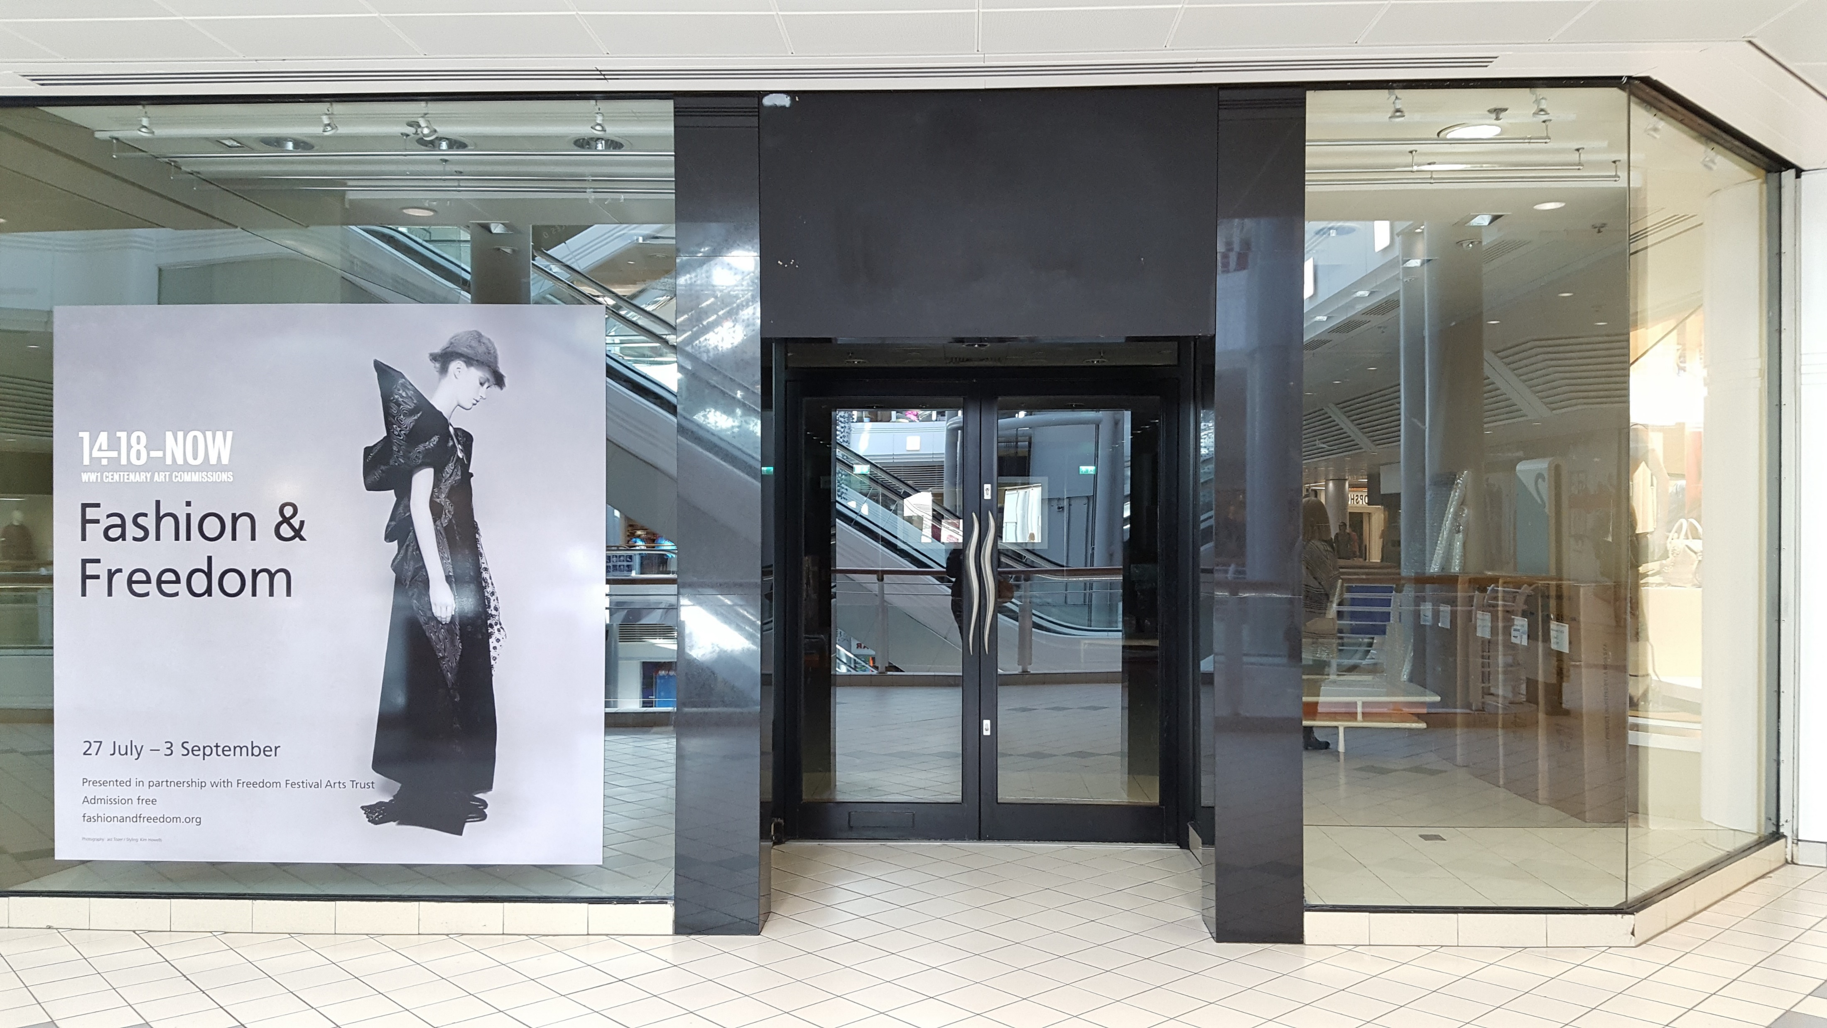
HULL GADA - SHOP OF POEMS
Princes Quay, 24 – 30 Sep
SHOP FRONT
This bit should
be transparent
This bit should
be transparent

Slide 2
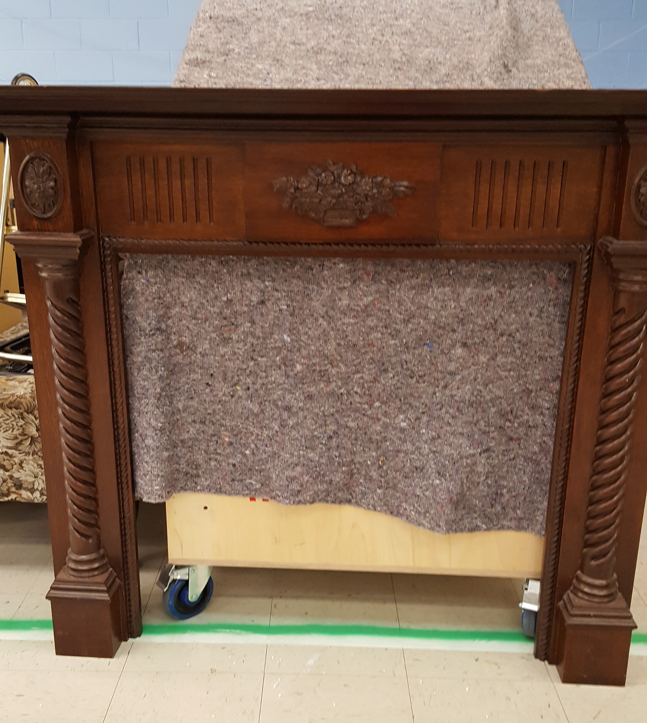
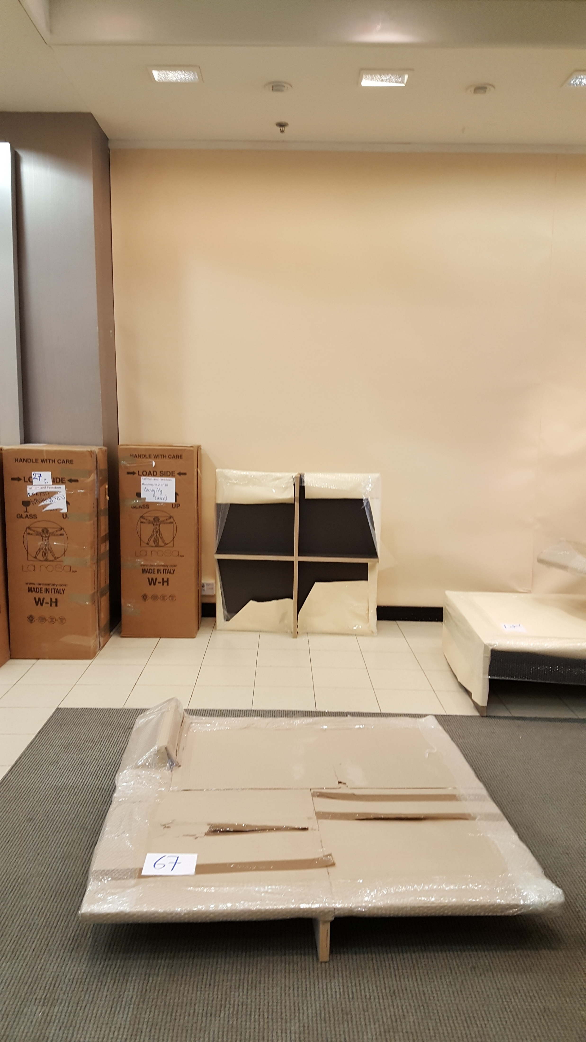
SHOP LIBRARY
Brick fire surround to sit behind the fireplace.

Slide 3
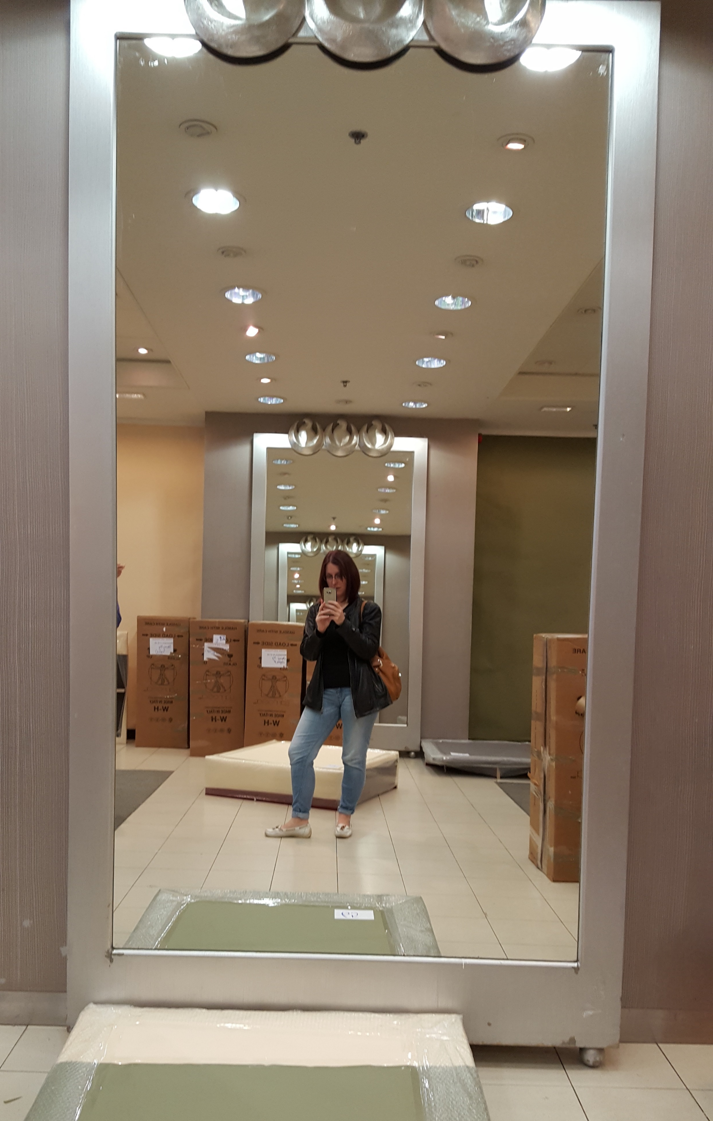
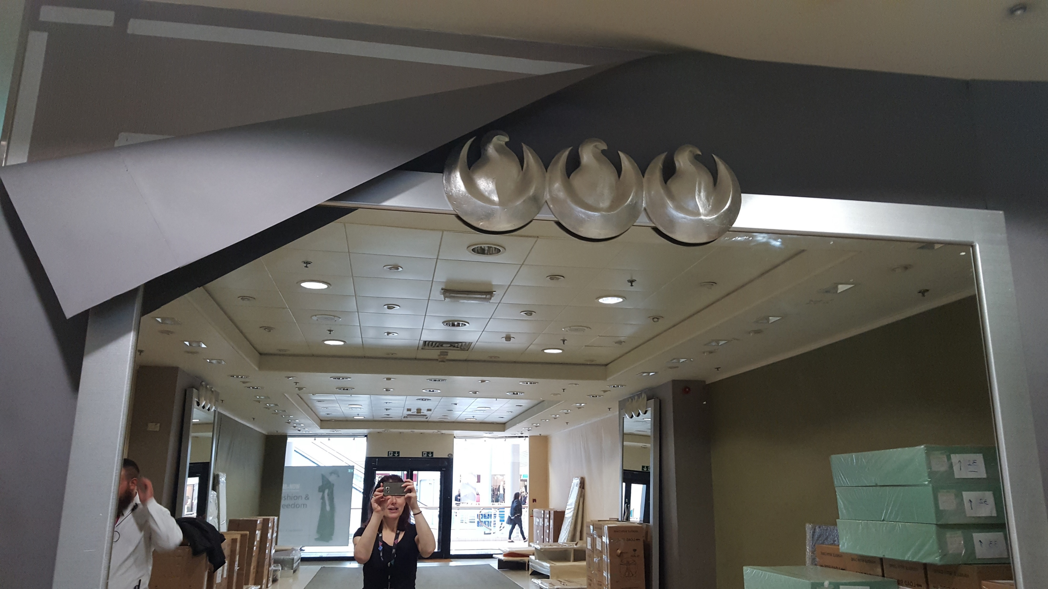
SHOP MIRRORS
One speech bubble on each vertical mirror – doesn’t matter which is first in terms on English or Polish.
Horizontal graphic for mirror.

