Slide 1

Radio 1 Big Weekend
Burton Constable Hall
Saturday 27th May and Sunday 28th May 2017
Draft Transport and Traffic Management Plan (v5)
3rd May 2017
Prepared for Hull 2017 by Local Transport Projects Ltd

Slide 2

General Arrangements
Figure 1 outlines the key travel arrangements in relation to the event site.
There is no parking at the event for ticket holders except for Blue Badge holders (with a ticket) and special guests (by invitation).
It is envisaged that the large proportion of ticket holders will be transported to/from the event by shuttle buses operating from designated pick-up points and temporary Park & Ride facilities.
Vehicular access to the event will be by authorised vehicles only including:
  Bus shuttle services operating from Hull Paragon Interchange, Walton Street/KC Stadium (P&R), Grovehill Depot, Beverley (Drop-off/Pick-up) and Normandy Barracks Leconfield (P&R).
  Taxis and Private Hire Vehicles carrying ticket holders (AM).
  Blue badge holders (with ticket)
  Special guests (by invitation)
  Operational and Production vehicles
  Artistes vehicles
  Emergency services vehicles
  Local Residents (by permit)
Bus shuttle transport from the event will be facilitated by a temporary bus station located adjacent to the main event area.
There are no suitable walking or cycling routes to the event and “drop-offs” near to the event need to be discouraged through clear messaging prior to the event and traffic regulation/visible enforcement on the event days.
A Local Area Traffic Management Plan (LATMP) will be implemented in and around Burton Constable and surrounding villages to manage both access to the event and parking/waiting/stopping activities on surrounding roads.
DRAFT

Slide 3
Figure 1: Radio 1 Big Weekend Transport Plan: General Arrangement
KEY
Proposed bus shuttle route
Normandy Barracks
P&R
Grovehill Depot
Bus Shuttle Pick-up/Drop-off
Beverley
Burton Constable Local Area Traffic Management Plan
Cottingham
Kingston upon Hull
City Centre
Walton Street/KCS
P&R
Hedon
Hull Paragon Interchange
Bus Shuttle Pick-up/Drop-off
Priory Park P&R
Bus access to Interchange
Reproduced from OS Open data

Slide 4
Proposed Shuttle Bus Operations
The Shuttle Bus services will operate from:
Hull Paragon Interchange (see Figure 2) – operating the shuttle service from this location allows and encourages arrivals by rail, local-bus and by foot. In addition the proximity to the City Centre provides an opportunity for ticket holders to park in local car parks for the day with additional parking available at the Priory Park Park & Ride which has services running directly to the interchange. Further arrivals are envisaged through drop-offs adjacent to the Interchange. It is estimated that 12,250 ticket holders will use the Hull Paragon Interchange service. The two-way travel time to the event is 75 minutes.
Rail arrangements - Agreement has been reached with Network Rail, Rail Operators, Hull CC and local bus operators regarding the use of Hull rail station and Interchange to facilitate transport to the event including keeping the station/interchange open until post-event shuttle bus operations are complete (est. 01:30). The following additional rail services will operate on 27 & 28 May – 22:48 & 23:48 Hull to Bridlington and 22:40 & 00:05 Hull to Selby.
Walton Street/KC Stadium P&R (see Figure 3) – agreement has been reached with Hull CC/NPS Humber regarding the use of Walton Street over the Big Weekend and KC Stadium have provided agreement in principal regarding using their adjacent stadium car park. With a combination of park & ride, drop off and walk up, it is anticipated that 5,500 ticket holders will use this location.
Normandy Barrack Leconfield (see Figure 4) – agreement has been reached with Defence School of Transport to use their site at Leconfield for a Park & Ride facility. The Park & Ride would be located on the hardstand areas that make up the runways. It has the potential to provide for significant numbers of ticket holders. Minor improvement works to Grange Road required as this will be the entry/exit route for cars. Temporary security fencing, signing and lighting will be required for the site. The two-way travel time to the event is 87 minutes. It is anticipated that 4,500 ticket holders will use this site.
Grovehill Depot, Beverley (see Figure 5) – agreement has been reached with ERYC to use their vacant Grovehill Depot site in Beverley as a “Pick-up/Drop-off” area. The site is located approximately 1.5 miles (30 minutes walk time) from Beverley town centre. There will be no provision for car parking at the site and ticket holder will be encouraged to either travel by foot or be dropped off/picked-up by car. The area will need to be cleared and have some minor improvement works to put it into operation. It is envisaged that some 3,250 ticket holders will use the facility. The two-way travel time to the event is 76 minutes.
All estimated travel times include an allowance of 10 minutes boarding, 5 minutes alighting and 10% contingency.

Slide 5
Proposed Shuttle Bus Route Details
The numbers of ticket holders, travel distances and estimated travel times for the proposed bus shuttle operations is provided below.
 |  | Hull Interchange | Walton Street/KC Stadium | Normandy Barracks | Grovehill | Total
Demand |  | 12,250 | 5,500 | 4,500 | 3,250 | 25,500
Assumed bus occupancy | 70 | 70 | 70 | 70 | 70
Estimated shuttle route length (miles) | Out* | 13.4 | 14.5 | 21 | 13.9
 | In* | 10.5 | 11.5 | 15.8 | 17.3
 | Total | 23.9 | 26 | 36.8 | 31.2
Estimated bus journey time (Google) (mins) |  | 54 | 70 | 64 | 54
Estimated loading time (mins) | 10 | 10 | 10 | 10 | 10
Estimated alighting time (mins) | 5 | 5 | 5 | 5 | 5
Contingency (10%) | 10% | 6.9 | 8.5 | 7.9 | 6.9
Journey time (mins)** |  | 75.9 | 93.5 | 86.9 | 75.9
* Direction based on “entry phase” operations
** All estimated travel times include an allowance of 10 minutes boarding, 5 minutes alighting and 10% contingency.

Slide 6
Proposed Shuttle Bus Operations (Entry Phase)

Slide 7
Proposed Shuttle Bus Operations (Exit Phase)

Slide 8
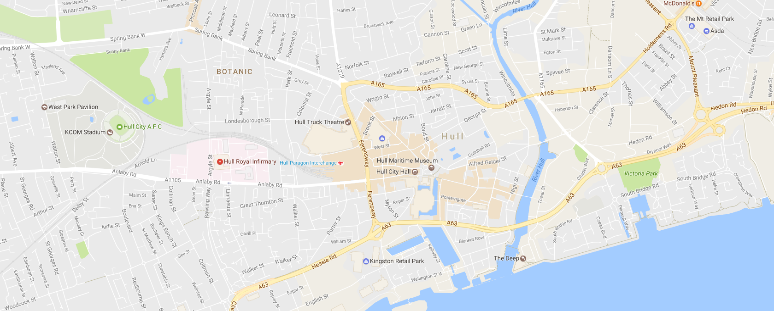
Figure 2: Hull Paragon Interchange Shuttle Bus Operation
Estimated ticket holders using facility: 12,250
Two-way journey time to event: 75 minutes
Source Imagery: Copyright Google Earth Pro (License Key-JCPMR5M58LXF2GE)
To Burton Constable
Pryme Street Car Park
(514 Spaces)
∼ 500m (7 minute walk)
N
`
George Street Car Park
(549 Spaces)
∼ 800m (10 minute walk)
Hull Paragon Interchange
Albion Street
Pick-up/ drop-off
Taxi/ PHV Area
From Burton Constable
To/ From Priory Park Park and Ride
(580 spaces)
10-15 minute frequency
13 minute travel time
KEY
Proposed bus shuttle route
Direction of shuttle bus
Priory Park Park & Ride Route (existing)

Slide 9
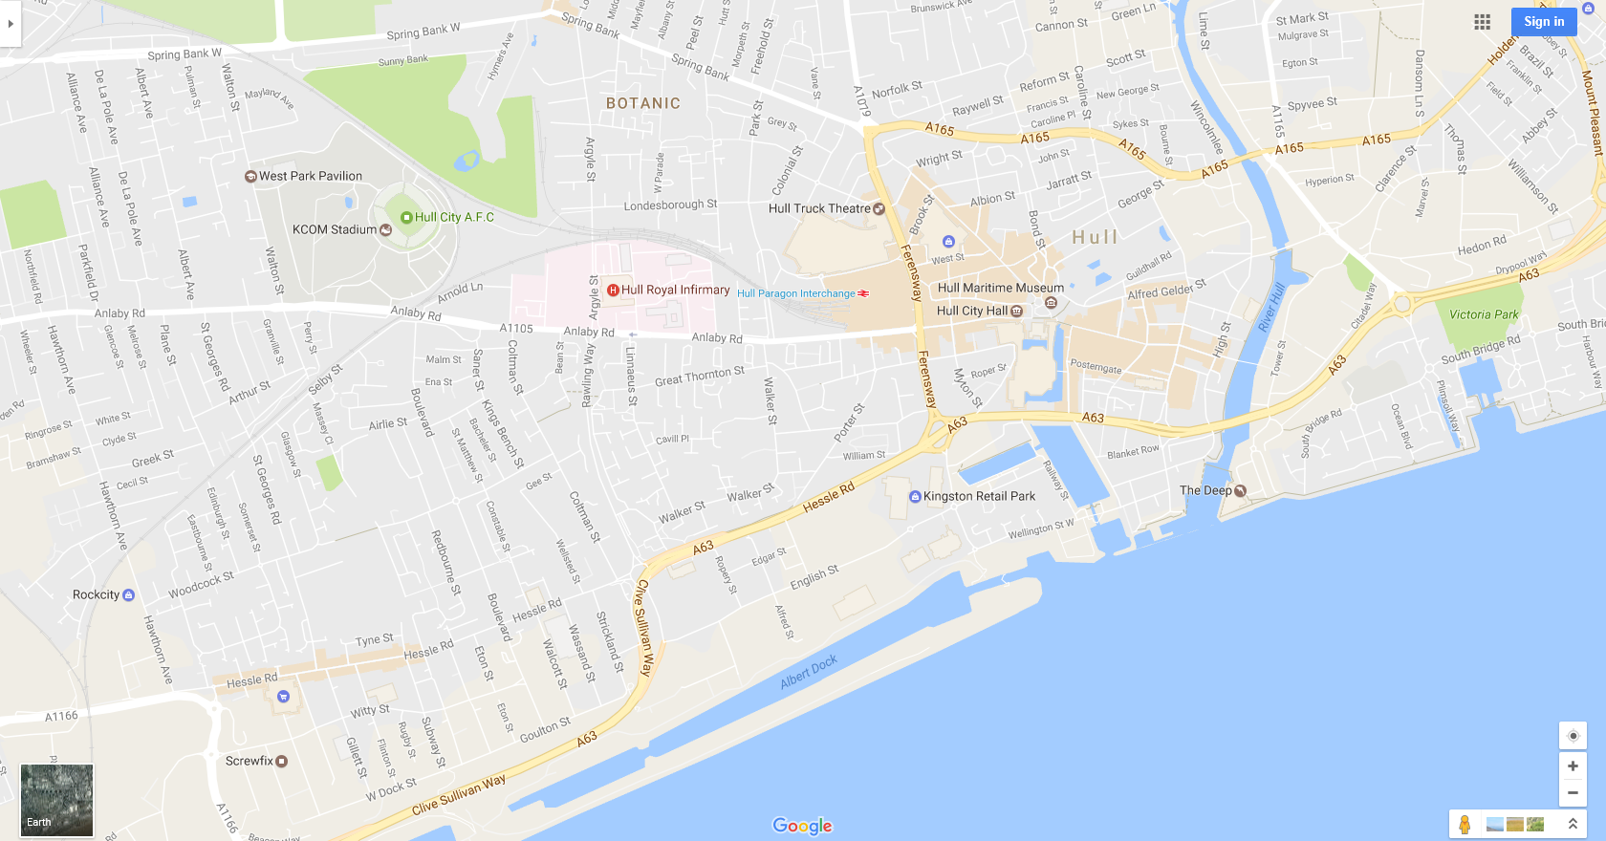
Figure 3: Proposed Park & Ride, Walton Street/KC Stadium, Hull
Estimated ticket holders using facility: 5,500
Two-way journey time to event: 90 minutes
Source Imagery: Copyright Google Earth Pro (License Key-JCPMR5M58LXF2GE)
To/from Burton Constable
N
Walton Street/KCS Site
(~1,700 parking spaces)
Walton Street
Proposed shuttle bus pick up/ drop off
KEY
Proposed bus shuttle route
Direction of shuttle bus

Slide 10
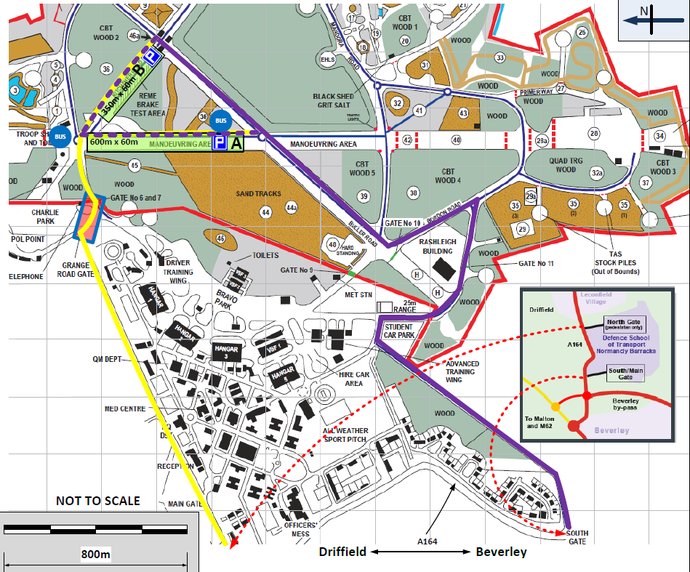
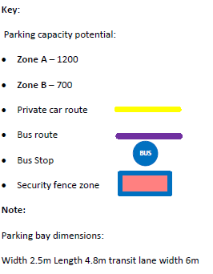
Figure 4: Proposed Park & Ride, Normandy Barracks Site
Estimated ticket holders using facility: 7,600
Two-way journey time to event: 87 minutes
DRAFT
DRAFT

Slide 11
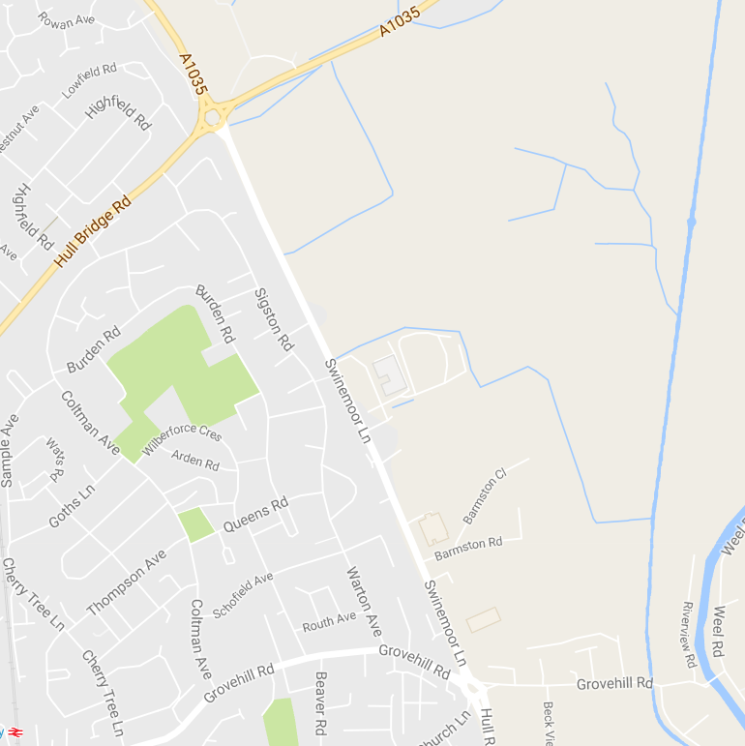
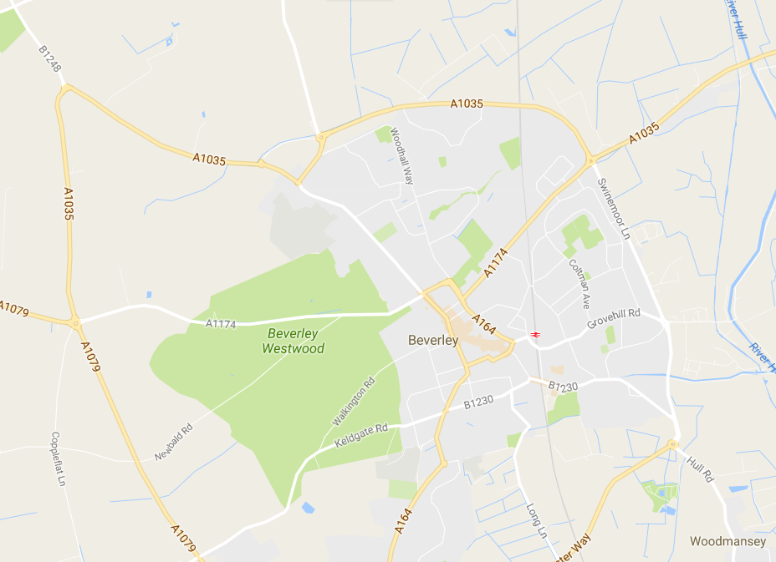
Figure 5: Proposed Drop-off/Pick-up Grovehill, Beverley
Source Imagery: Copyright Google Earth Pro (License Key-JCPMR5M58LXF2GE)
Estimated ticket holders using facility: 3,250
Two-way journey time to event: 76 minutes
To/from Burton Constable
Grovehill Depot
Proposed shuttle bus pick up/ drop off
KEY
Proposed bus shuttle route
Direction of shuttle bus

Slide 12
Proposed Local Area Traffic Management Plan (LATMP)
Figure 6 illustrates the general arrangement of the LATMP at the Burton Constable event site that includes the following elements:
Authorised vehicle route
Access to the event will be principally via the authorised vehicle route that runs north to south through the site with an entry point on the A165 south of Skirlaugh and an exit point on the B1238 east of Sproatley. This routing provides the best arrangement to accommodate vehicle checking during the “entry phase” and reduces the impact of heavy and potentially queuing traffic in Sproatley on the Saturday and Sunday morning. A disadvantage of this direction of operation is that it introduces a cross-over movement for buses using the temporary bus station at the event.
This route will operate in a north to south direction at all times during the event with the exception of the exit phase when it will operate south to north as shown in Figure 7. The switch to south-north will take place between 14:00 and 14:30 during which time the road will be closed for all event traffic except for the traffic management contractor and emergency services. South-north operation will come into operation at 14:30 and remain in operation until the completion of the “exit phase” at around mid-night. The reason for this switch in direction is to remove the bus cross-over movement at the temporary bus station that will improve the performance and efficiency of the “exit phase” bus operation.
The operation of the switch over will need to be reflected in signing proposals, communication strategy and information issued to operational/production/artiste traffic.
The section of the authorised vehicle route between the A165 and New Ellerby will have two-way operation to support access for local residents.
The remainder of the route between will operate one-way as described above. This section of the route between New Ellerby and B1238 will be closed to all traffic with the exception of authorised vehicles including local residents. This closure will be in place for the duration of the event. The road closure will require a Temporary Traffic Regulation Order (TTRO).
Vehicle check area and un-authorised vehicle exit route
This will operate immediately south of New Ellerby and function to identify and re-direct un-authorised vehicles attempting to enter the event. It is envisaged that this would largely consist of ticket holders looking to be dropped off at or close to the event.
Where un-authorised vehicles are identified they will be re-directed away from the site via the designated exit route back to the A165 via Old Ellerby and Coniston.
Control Points
Marshalled control points are proposed at each potential entry/exit point to the event and effected local roads. The control points are principally provided to prevent access by un-authorised vehicles whilst allowing access for local residents who have been provided with an access permit.

Slide 13
Proposed Local Area Traffic Management Plan (LATMP) continued…
Temporary Bus Station and Taxi/PHV area
The temporary bus station is located adjacent to the authorised vehicle route at Burton Constable Hall and will facilitate bus shuttle operations at the event. The design of the temporary bus station is under development.
A Taxi/PHV area will be located immediately in front of the temporary bus station to facilitate both Taxi/PHV drop-off and pick-ups at the event.
Production Route
During the event, production traffic will enter the event enclosure via an anti-clockwise route via Jackey Lane and a temporary roadway.
During the Build and Break phase of the event this production/operational route will operate in the opposite (clockwise) direction.
Local Resident Access
Local residents within the area of the LATMP will be invited, prior to the event, to obtain an access permit to allow them to use the identified local access routes including the authorised vehicle route.
Access to the local roads will be controlled by marshals at the defined control points.
Blue Badge Holder and Special Guest Route
The access for Blue Badge Holder and Special Guests is via Park Road, Sproatley and the existing access to the Burton Constable Camping and Caravan site.
Clearway
Figure 9 identifies the extents of the proposed No Stopping clearway order to be implemented over the duration of the event. The clearway area extends for some 4-5km from the event in order to deter ticket holders from leaving their cars by the roadside and walking to the event. In order to maintain access to local amenities within Sproatley it is proposed to provide some areas of limited parking adjacent to local shops and public houses.
Temporary Traffic Regulation Orders (TTRO)
A TTRO will be required to facilitate the road closures for the authorised vehicle route between New Ellerby and the B1238 east of Sproatley plus road closure on a number of other local roads. It is likely that this TTRO will be required to facilitate part of the build and break phases prior to and following the event.
The proposed duration of the order is Saturday 27th May at 07:00 to Monday 29th May at 12:00 (noon). The extended duration of the road closure is to help facilitate the exit of operational/production vehicles.
A TTRO will be required to facilitate the No Stopping Clearway order etc.. as indicated in Figures 8 and 9.
All TTROs are in the East Riding of Yorkshire Council area.

Slide 14
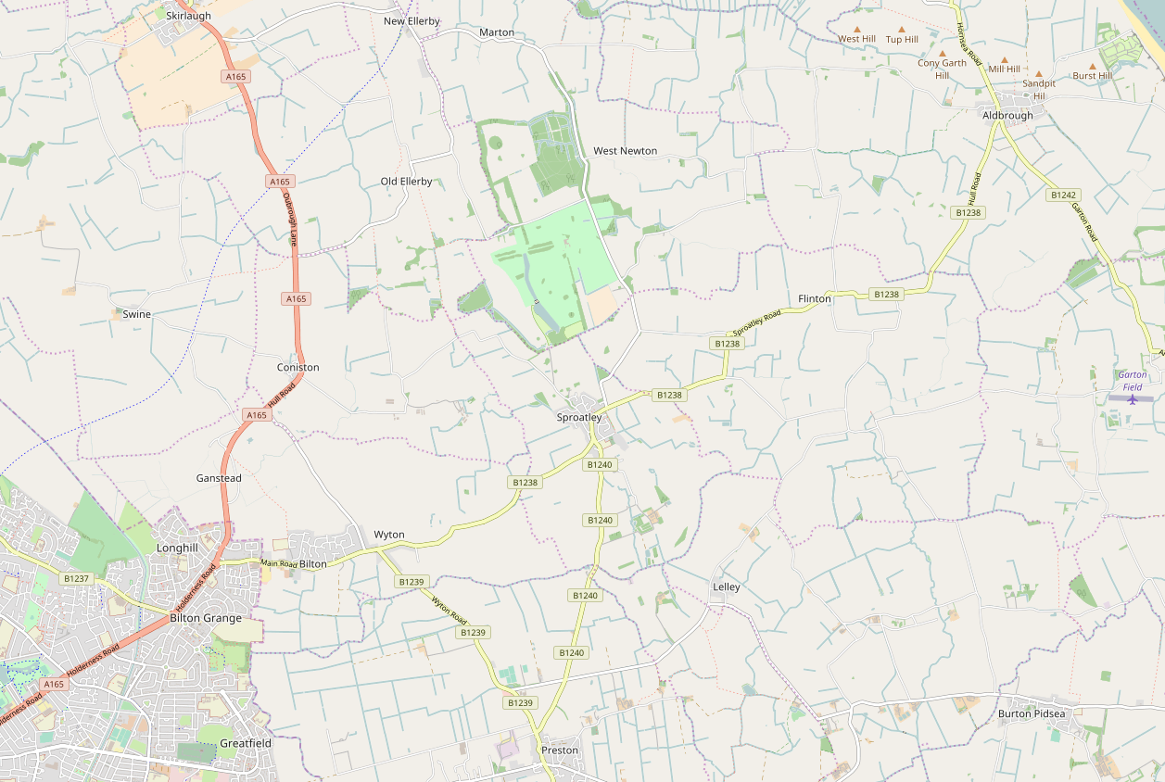
Figure 6: Burton Constable Local Area Traffic Management Plan : General Arrangement
Vehicle check area
SITE ENTRY
(A165 Skirlaugh)
Source Imagery: Copyright Google Earth Pro (License Key-JCPMR5M58LXF2GE)
N
DRAFT
Temporary Bus Station and Taxi/PHV area
Coniston
Event
Blue Badge/Special Guest Parking
SITE EXIT
(B1238 east of Sproatley)
Authorised vehicles route (Bus, Taxi, PHV, Operations, Production, Artistes, Local Residents)
Unauthorised vehicles exit route
Production Route (Event)
Blue Badge/Special Guest route
Local resident route
One-Way Traffic
Two Way Traffic
Control point

Slide 15
Figure 7: Burton Constable Local Area Traffic Management Plan : Exit Phase
Authorised Vehicle Route operates South to North during Exit Phase on both days of event (14:30 to 00:00)
SITE EXIT
(A165 Skirlaugh)
Source Imagery: Copyright Google Earth Pro (License Key-JCPMR5M58LXF2GE)
N
DRAFT
Temporary Bus Station and Taxi/PHV area
Coniston
Event
Blue Badge/Special Guest Parking
SITE ENTRY
(B1238 east of Sproatley)
Authorised vehicles route (Bus, Taxi, PHV, Operations, Production, Artistes, Local Residents)
Production Route (Event)
Blue Badge/Special Guest route
Local resident route
One-Way Traffic
Two Way Traffic
Control point

Slide 16
Figure 8: LATMP : Extents of proposed temporary Clearway order
Source Imagery: Copyright Google Earth Pro (License Key-JCPMR5M58LXF2GE)
N
DRAFT
Parking limited to 1 hour no return within hour adjacent to Post Office, local shops and Public Houses
KEY
No Stopping At Any Time

Slide 17
Source Imagery: Copyright Google Earth Pro (License Key-JCPMR5M58LXF2GE)
Figure 9: LATMP : Proposed temporary road closures except for authorised vehicles
N
DRAFT
KEY
Proposed temporary road closures

Slide 18
Other traffic and transport matters
Proposals to address the following matters are still under development:
Drop-offs – at the event are currently not provided for and any driver attempting to drop-off/pick-up a ticket holder via the authorised vehicle route will be directed away from the site and towards the Normandy Barracks P&R from where they can purchase a two-way shuttle bus ticket. This will require a ticket office being provided at the Normandy Barracks site.
Walking – to the event is not being promoted due to the large number of authorised vehicles using the main access to the event. Prior public information and the proposed clearway order will go someway to deterring ticket holders from either walking or being dropped off and walking to the event. However, despite these mitigations it is still likely that walking will be attempted by some ticket holders in which case it is proposed that a “sweeper” bus service is operated along the authorised vehicle route to pick up walkers and transport them safely to the event. Once at the event a facility will be available for them to either purchase a shuttle bus ticket.
Cycling – to the event is not being promoted due to the large number of authorised vehicles using the main access to the event. It is not envisaged that there will be a large number of ticket holders attempting to travel by cycle. Where this does occur they will be permitted to use the authorised vehicle route in the correct direction of travel. Cycle parking at the event will not be provided and cyclists will be advised that any cycles brought onto the site will be wholly at the cycle owners risk.
Taxis/PHVs – a taxi/PHV area will be provided at the site to facilitate drop-offs and potential pick-ups. The facility will not operate as a hackney carriage rank and will be available for both taxi and PHV usage. A taxi/PHV drop-off location is proposed in the Albion Street car park in Hull to facilitate taxi/PHV movements during the event exit phase on both days.
Local Ticket holders – there is potential that residents of local villages (e.g Sproatley, Marton, New Ellerby) will obtain tickets to the event and it is considered impractical for these residents to travel to the event by shuttle bus. To help facilitate these local movements it is proposed to provide a local pick-up service at the start and finish of the event.
Dilapidation Survey – ERYC will require a dilapidation survey of the authorised vehicle route to be undertaken prior to the event.
DRAFT

