Slide 1
PLACE DES ANGES
Hull 2017 and Yorkshire Festival

Slide 2
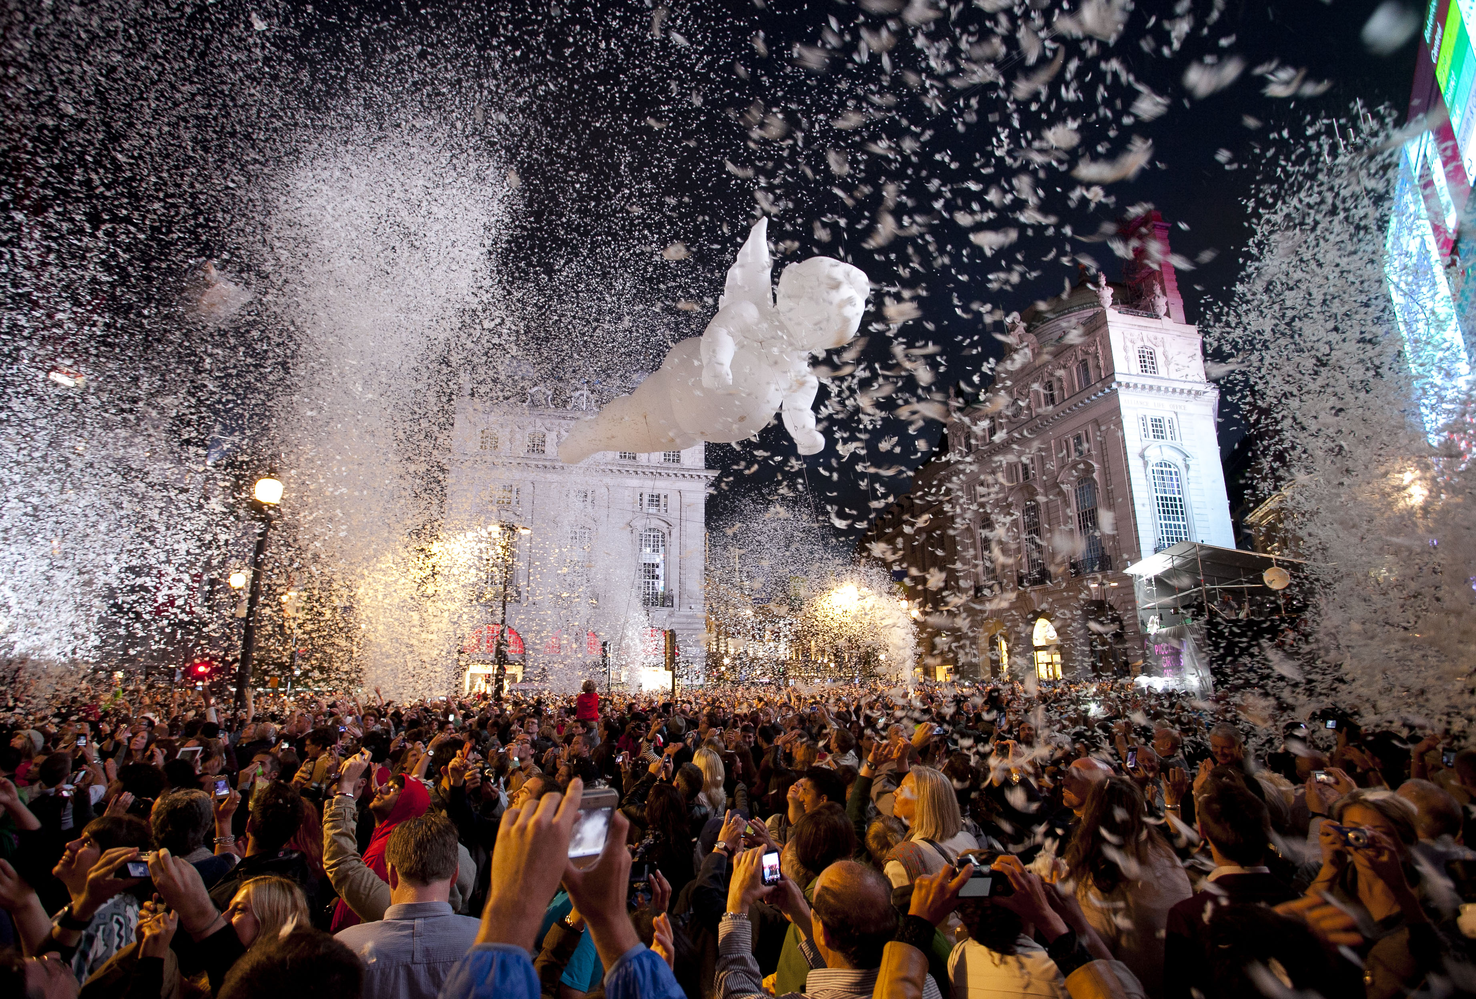

Slide 3
Gratte Ciel
Place des Anges
As night falls across the city of Hull, a number of angels begin to appear, high up on the rooftops. The angels start to glide down into the audience, releasing white feathers which float across the sky.
Once the last angel has taken flight, the crowd will be showered with a spectacular explosive display of feather fireworks.
A playful, visual spectacle that will enchant audiences of all ages.

Slide 4
The Partnership
Presented by Yorkshire Festival and Hull 2017
Finale of the Yorkshire Festival 2016
Opening the Amy Johnson Festival
First public announcement - 14th April

Slide 5
Details
Location: Queen’s Gardens, Hull
Date: Sat 2nd of July 2016
Time: 9.45pm
Tickets: Free – Ticketed [Limited Availability]
Capacity: 7000 tickets plus additional viewing for 5000

Slide 6
Gratte Ciel
Place des Anges
https://www.youtube.com/watch?v=XWz8lNMbLv4
Notes:
https://www.youtube.com/watch?v=XWz8lNMbLv4

Slide 7
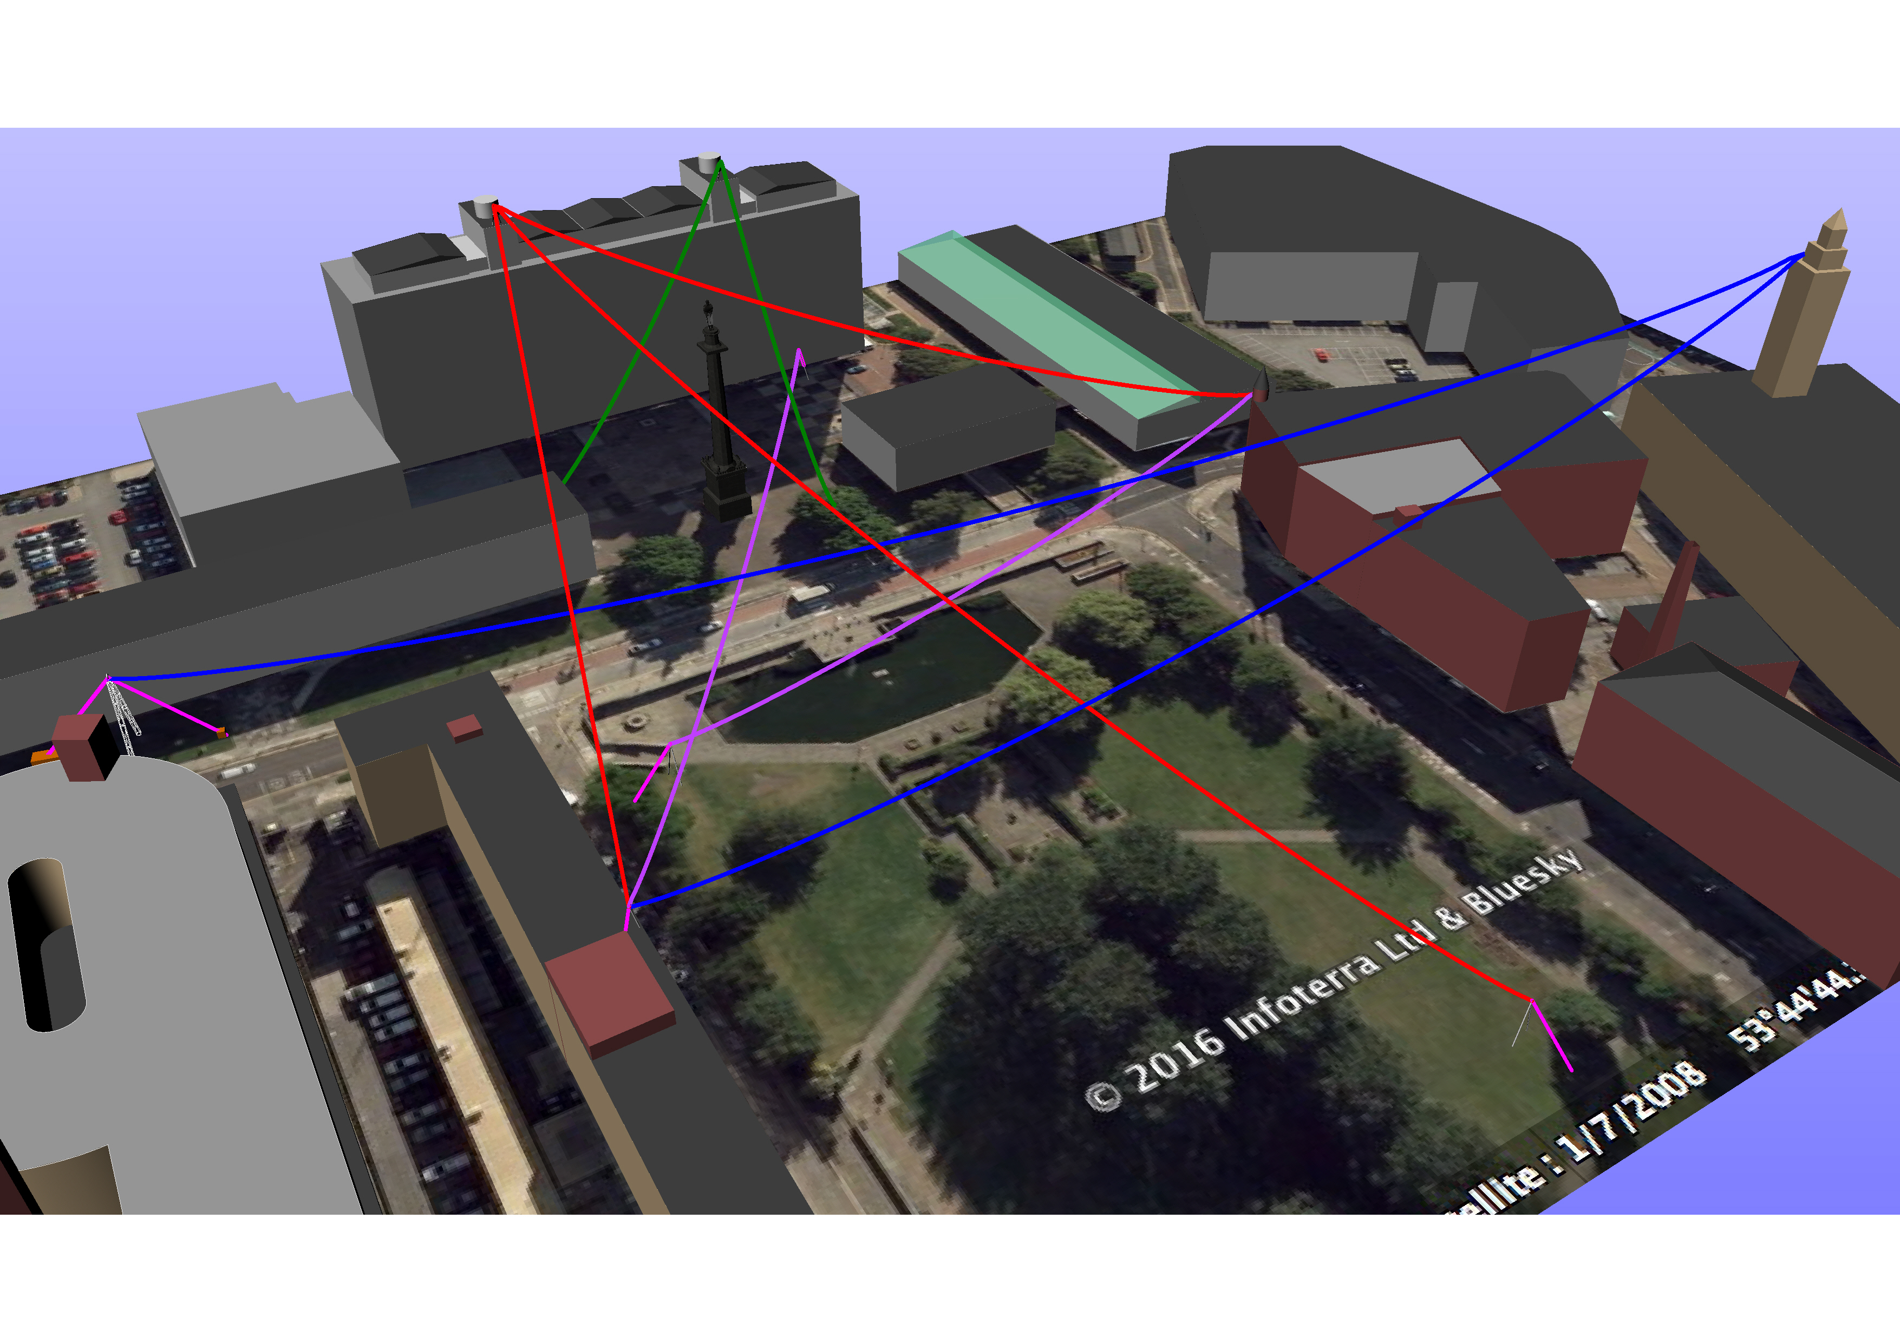

Slide 8
Hull City Council
Permissions to access and rig lines from:
Guildhall Bell Tower
Tower at 79 Lowgate
Permissions to access and put lights on roof of:
79 Lowgate
Warehouse number 9
Hooper Building

Slide 9
Hull College
Permission to use main plaza as event site
Permission to access and rig lines from:
Main Building – towers and ground level
Permissions to access and put lights on roof of:
School of Art and Design
Wilberforce Centre
Access to additional inside spaces, if possible, to use for green room etc.

Slide 10
Next steps
Agreement in principle
Assignment of key contacts for Hull 2017 to liaise with
Independent Structural Engineer to check rigging documents and RAMS
Hull 2017 to provide schedule of access needs for discussion

Slide 11
