Slide 1


Slide 2

We will cover:
Intro to 2017
Intro to Project
Outline Programme
Future Progamming
Title
Item 6
Item 7
TODAY’S MEETING

Slide 3
THE VISION OF 2017
  365 days of transformative, artistic adventures.
  Raising aspirations, changing perceptions, celebrating talent.
  Hull will be the epicentre of cultural activity and debate in the UK in the run up to and during 2017.

Slide 4

THE PROGRAMME FOR 2017
The arts and cultural programme for the year will celebrate the unique character of the city, its people, history and geography.
In 2017, the programme will run from 1 Jan to 31 Dec.

Slide 5
THE FOUR SEASONS
The year will be split into four seasons, each with something distinctive, intriguing and created to challenge and thrill
MADE IN HULL
ROOTS & ROUTES
FREEDOM
TELL THE WORLD

Slide 6


NEIGHBOURHOOD NETWORK TOURING

Slide 7
WHEN WILL THESE FESTIVALS HAPPEN?
IN THE HALF TERMS OF:
FEBRUARY
MAY
OCTOBER
JANUARY

Slide 8
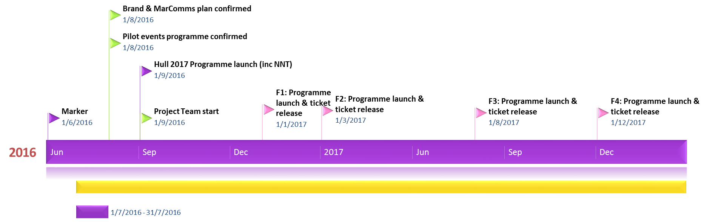
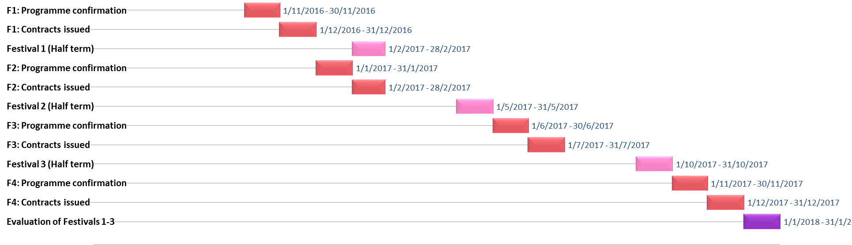

Slide 9
What is this project going to look like?
INDICATIVE PROGRAMME

Slide 10
THU 23 FEB
TEXT
HERE
William Gemmell
WINIFRED HOLTBY
NORTH POINT
SENTAMU
POTATO NEEDS A BATH
COMEDY CLUB
RED LADDER THEATRE
SESH BANDS
WOMEN OF TROY
HULL UK CITY OF CULTURE 2017
HULL2017.CO.UK

Slide 11
FRI 24 FEB
TEXT
HERE
WALTON STREET
HYMERS
KINGSWOOD
SENTAMU
FREEDOM
GEMMELL
POTATO NEEDS A BATH
POLISH FILM CLUB
RED LADDER THEATRE
FAMILY FILM CLUB
LOCAL BANDS
COMEDY
WOMEN OF TROY
HULL UK CITY OF CULTURE 2017
HULL2017.CO.UK

Slide 12
SAT 25 FEB
TEXT
HERE
LOCAL PUBS
KINGSWOOD
FREEDOM
SENTAMU
GEMMELL
POTATO NEEDS A BATH
FAMILY FILM CLUB
RED LADDER THEATRE
WOMEN OF TROY
LOCAL BANDS
COMEDY CLUB
HULL UK CITY OF CULTURE 2017
HULL2017.CO.UK

Slide 13
WHAT SHALL WE CALL IT?
A FEW OPTIONS
BACK TO OURS
HUMBER LIVE
LIVE & LOCAL
LATE NIGHT PERFORMANCES: UP YOURS

Slide 14
STRUCTURE
VENUE
VENUE
VENUE
VENUE
VENUE
VENUE
VENUE
NORTH
VENUE
VENUE
WEST
EAST
PROGRAMMING
PARTNERS
PROJECT TEAM
TOURING
PRODUCTIONS
PROGRAMME
CONSULTANT
HULL 2017
CORE TEAM

Slide 15
KINGS-WOOD
HYMERS
WINIFRED HOLTBY
North Point Shopping Centre
ARCH-BISHOP SENTAMU
PER VENUE:
◆ Venue Manager & Programming Lead
◆ Venue Technical Liaison
◆ Performing Arts Lead Teacher (schools)
SIRIUS WEST ACADEMY
WILLIAM GEMMELL
FREEDOM CENTRE
PUBS
(X3)
MALET LAMBERT
PER AREA:
◆ Local Technical Manager
◆ Local Technicians (x2)
◆ Technical Apprentice
◆ Local Marketing & Engagement Manager
◆ Box Office Team (x2)
◆ Marketing & Engagement Apprentice
◆ FOH Manager & Volunteer Co-ordinator
◆ Hull 2017 Volunteers (x10)
WALTON
ST
NORTH
WESTERN LIBRARY
East Park
WEST
EAST
◆ Hull Dance
◆ Hull Independent Cinema
◆ Humber Mouth
◆ Hull Truck
◆ Programme Director
◆ Project Administrator (p/t)
◆ Programme Consultants/
Local partners & promoters
◆ Technical Co-ordinator (p/t)
◆ Artists
◆ Booking Agent
◆ Technical Manager
◆ Technicians
◆ Marketing Agency
◆ PR Agency
PROGRAMMING
PARTNERS
PROJECT TEAM
TOURING PRODUCTIONS
◆ Programme Consultant
◆ Exec Producer
◆ Technical & Ops Team
◆ Artist Liaison
◆ MarComms Team
◆ Head of Education
◆ Volunteering Team
◆ Finance Team
◆ Monitoring & Evaluation
(University of Hull)
PROGRAMME
CONSULTANT
HULL 2017
CORE TEAM

Slide 16
MARKETING
WHAT TECHNIQUES WORK WHERE YOU ARE:

Slide 17
CONTRACT
WHAT IT COVERS:

Slide 18
CATERING & BAR
TECHNICAL
AOB

Slide 19
SPARE
AND:

Slide 20
SPARE
AND:

Slide 21
SPARE
AND:

Slide 22
SPARE
AND:

Slide 23
SPARE
AND:

Slide 24
SPARE
AND:

Slide 25
SPARE
AND:

Slide 26
SPARE
AND:

