Slide 1


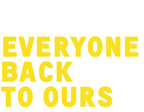
CREATIVE COMMUNITIES PROGRAMME

Slide 2
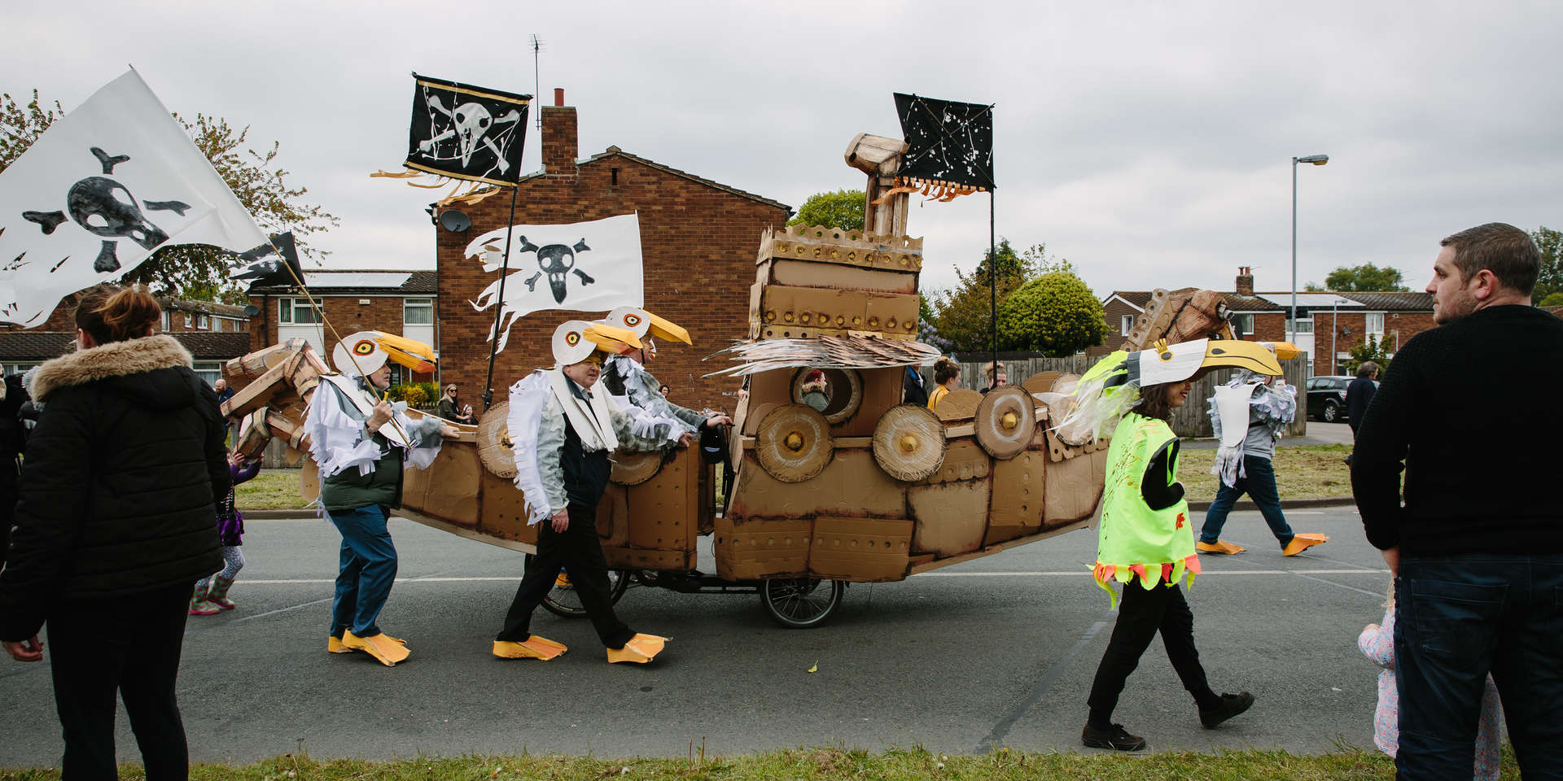

Slide 3
63 PROJECTS

Slide 4
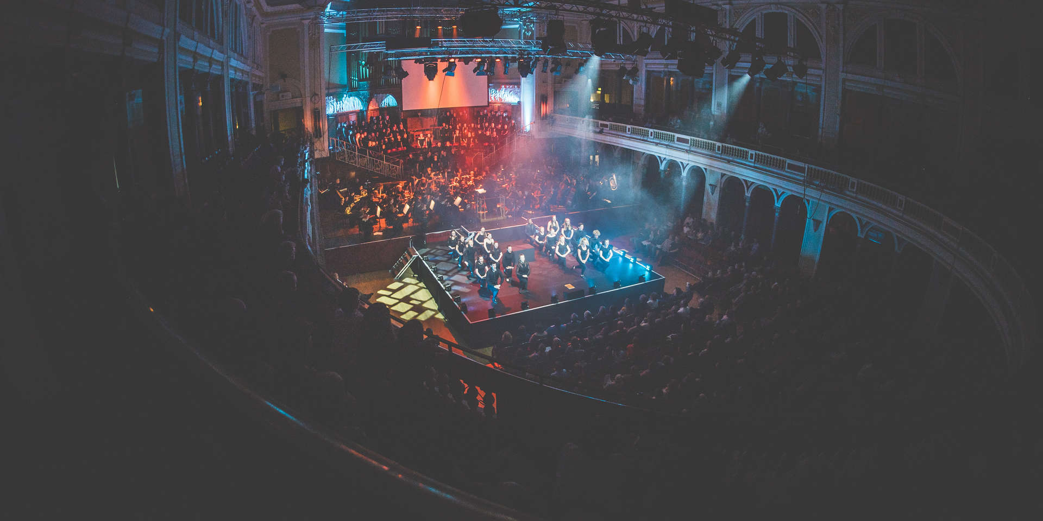

Slide 5
OVER 25,000 PARTICIPANTS

Slide 6
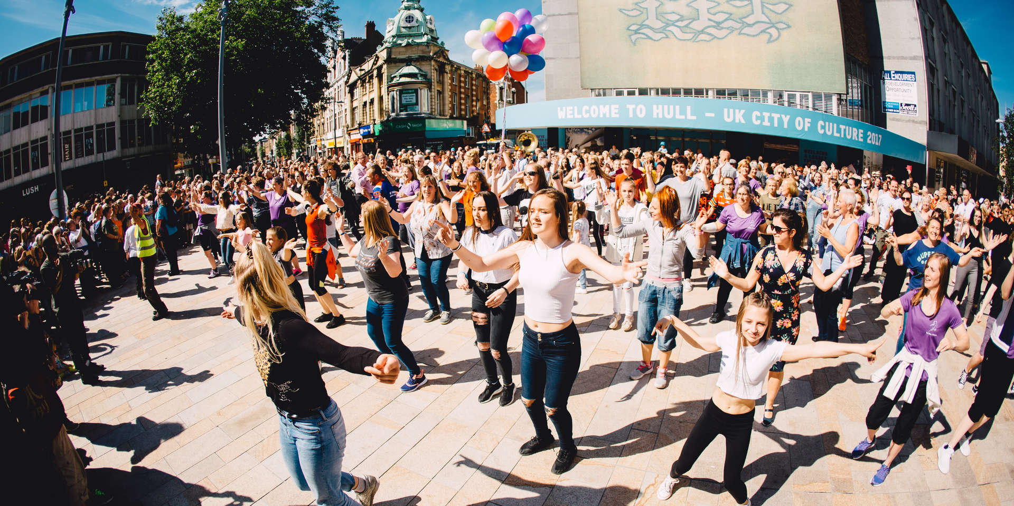

Slide 7
OVER 600,000 TOTAL AUDIENCES

Slide 8
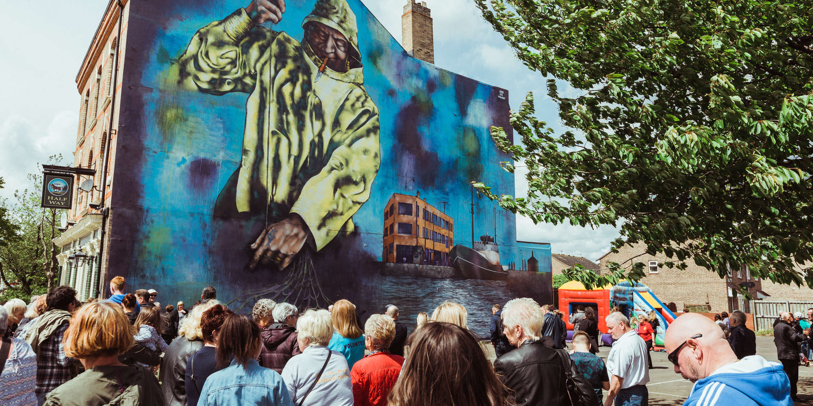

Slide 9
OVER 10,000 VIEWS OF ONLINE CONTENT

Slide 10
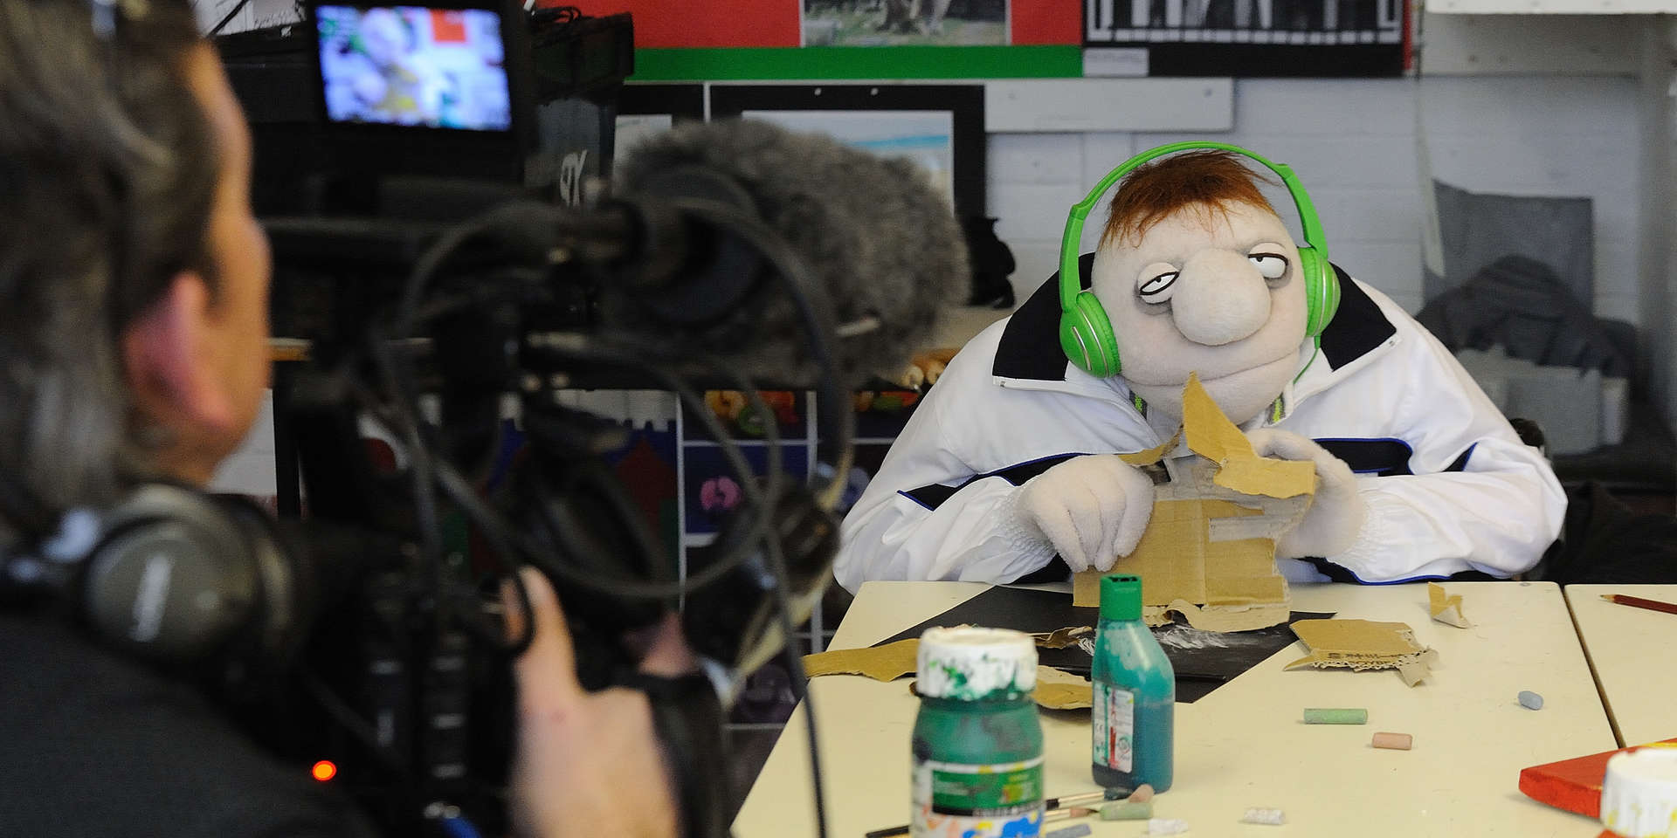

Slide 11
WE ASKED YOU FOR THE BEST BITS OF YOUR CREACTIVE COMMUNITIES PROGRAMME EXPERIENCE AND YOU SAID…

Slide 12
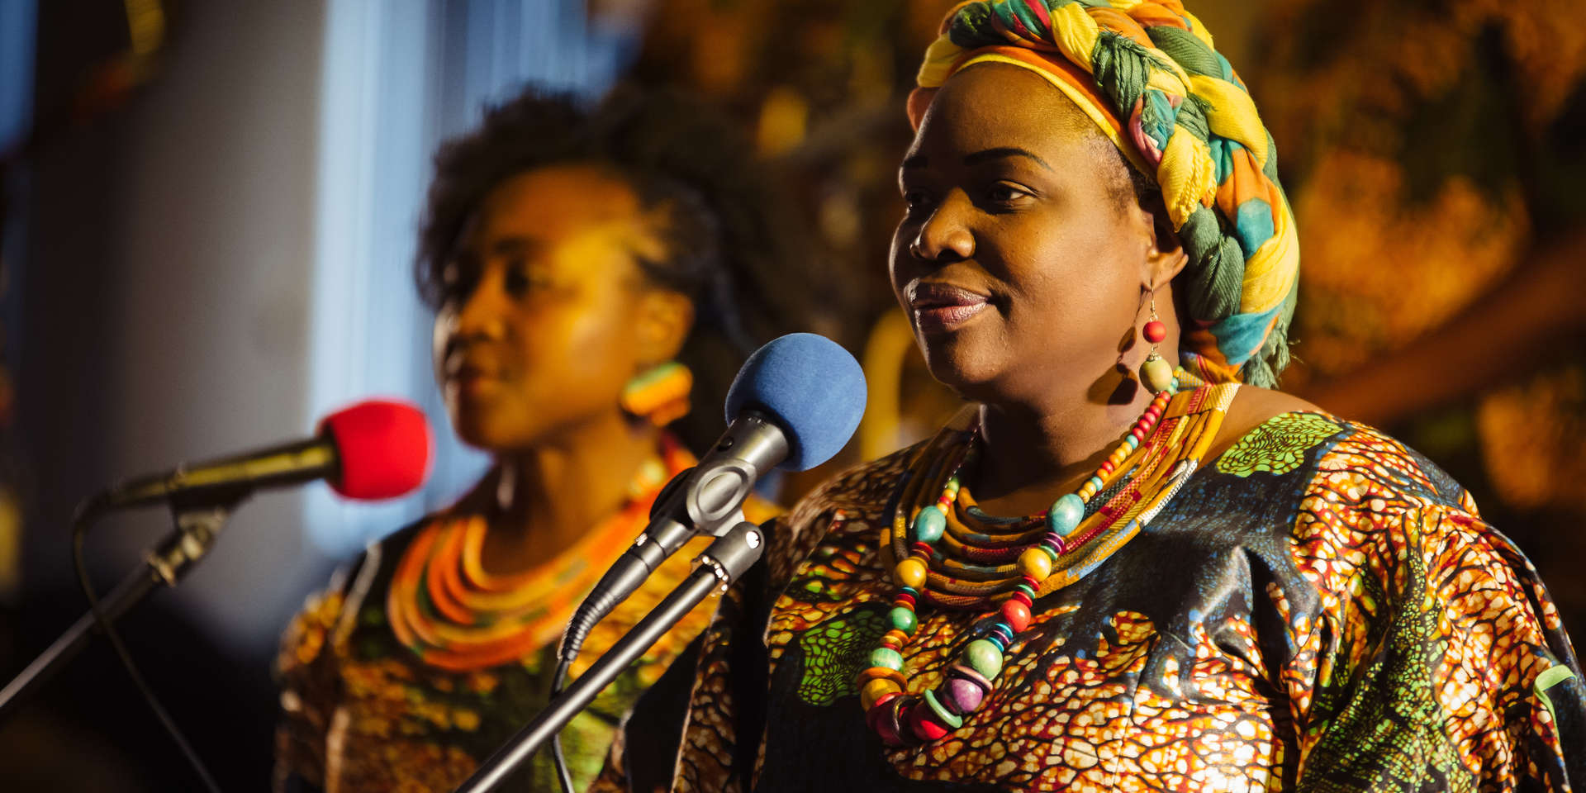

Slide 13
“Achieving a sell-out run of performances and the positive reaction of audiences working with a team of committed artists and volunteers.”

Slide 14
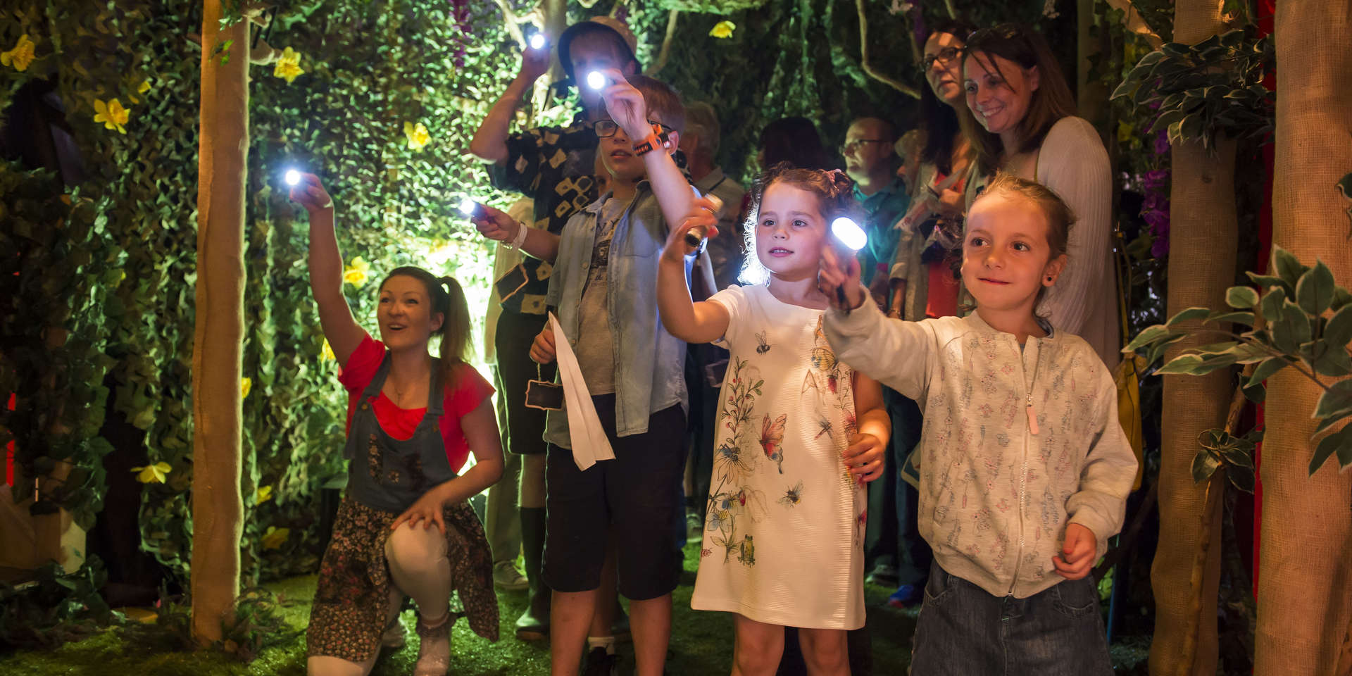

Slide 15
“Meeting many lovely people who were willing to share their memories and stories and watching these audio recordings inform a script that resulted in a fantastic show.”

Slide 16
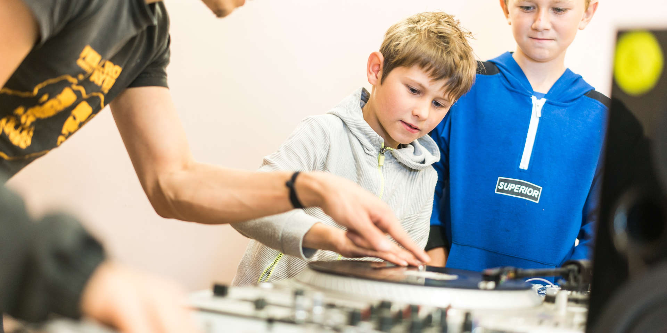

Slide 17
“Working with others in the community. Seeing enjoyment on the faces of participants, audiences and volunteers.”

Slide 18
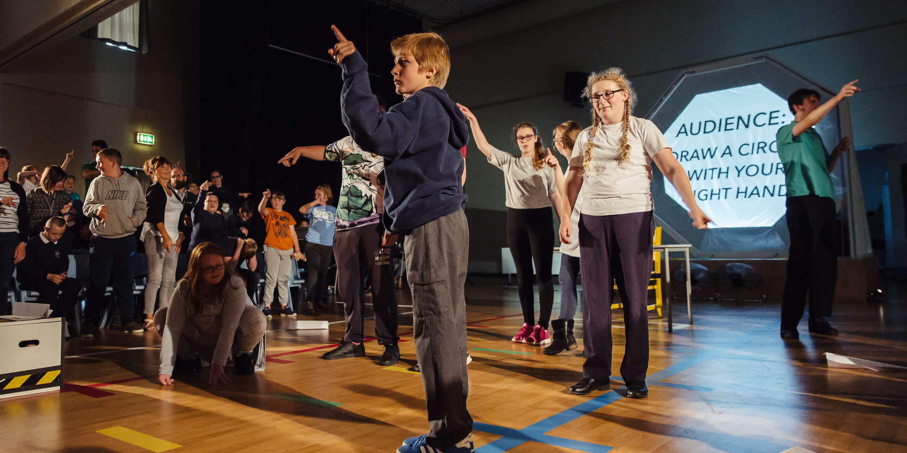

Slide 19
“Getting to spend time in Hull for first time ever - want to come back! Working with the fab creative community and the people of Hull.”

Slide 20
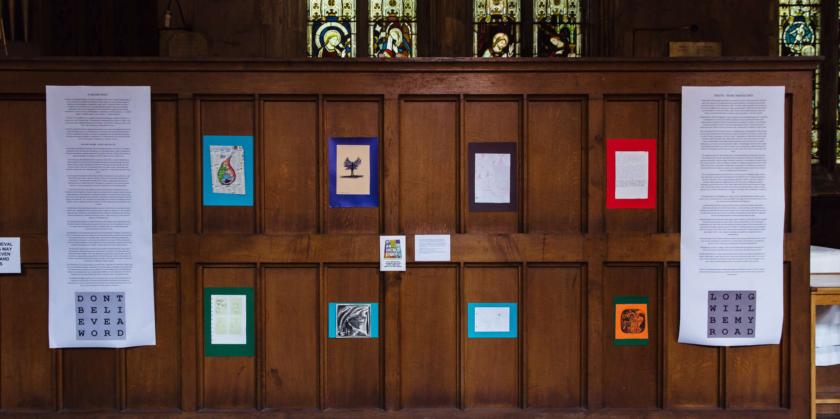

Slide 21
“If you'd have told me that nearly 30,000 people would experience the artwork, which would have coverage around the globe, become a prayer station, a TV package on hate crime, etc. etc. etc... I never would've believed you!!!”

Slide 22
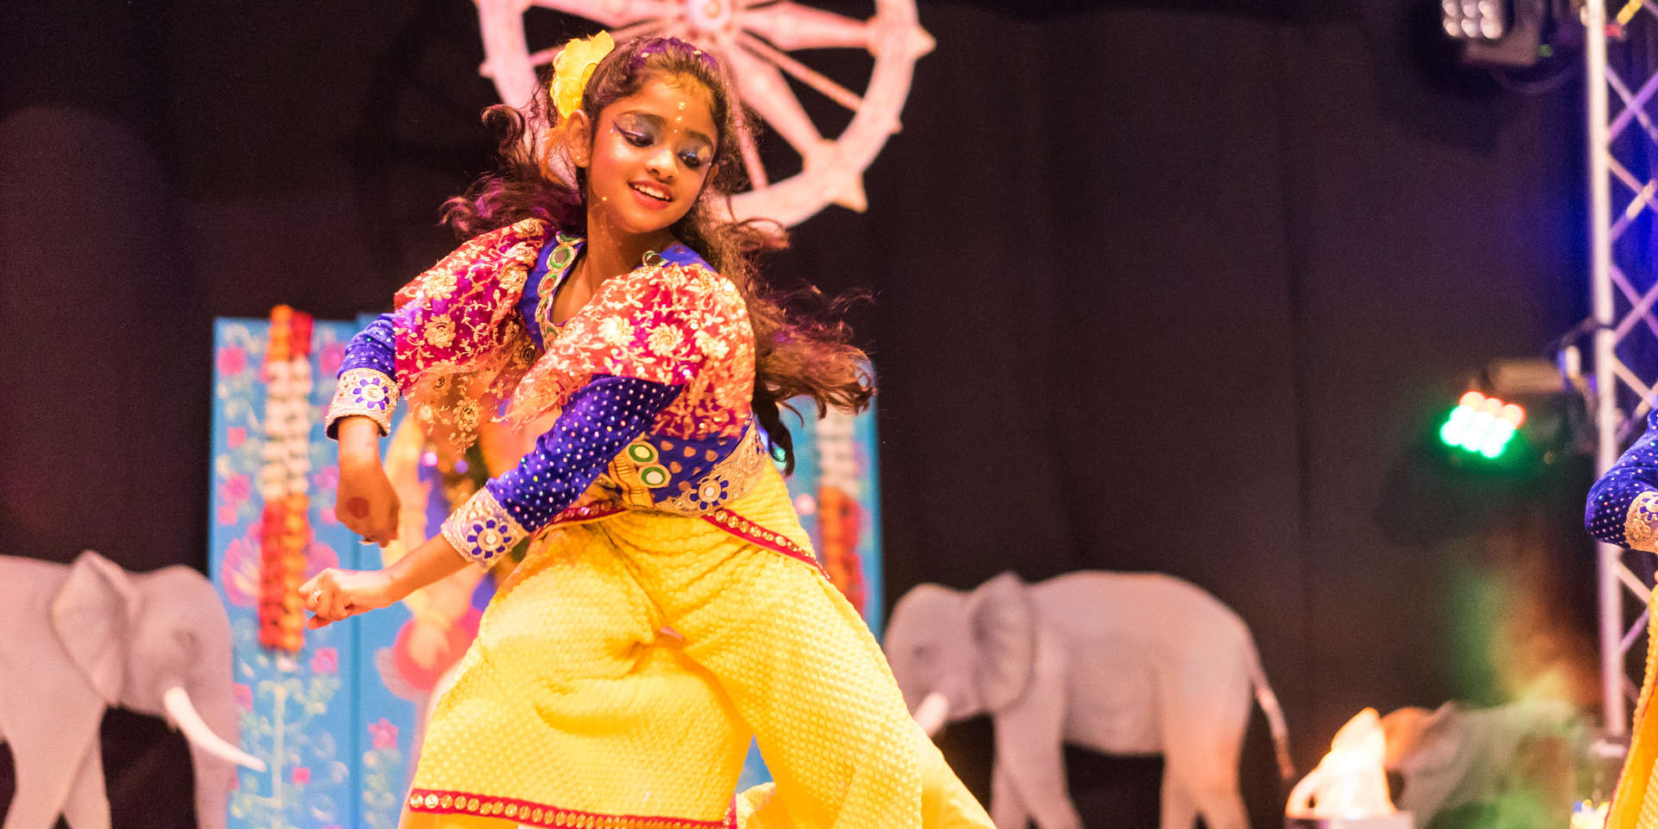

Slide 23
“Bringing such a large group of people of varied ages and backgrounds together to perform.”

Slide 24
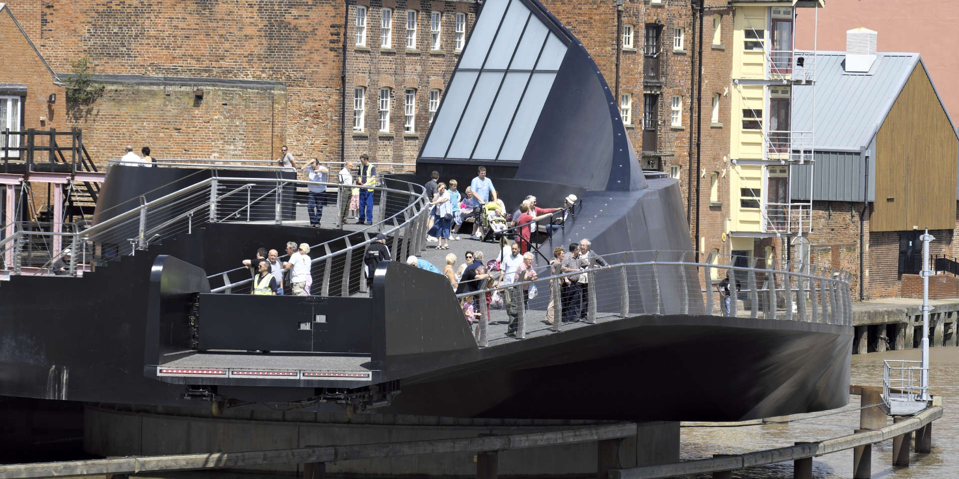

Slide 25
“Seeing the impact on young people and how their creative input, leadership and words had a powerful impact on others.”

Slide 26
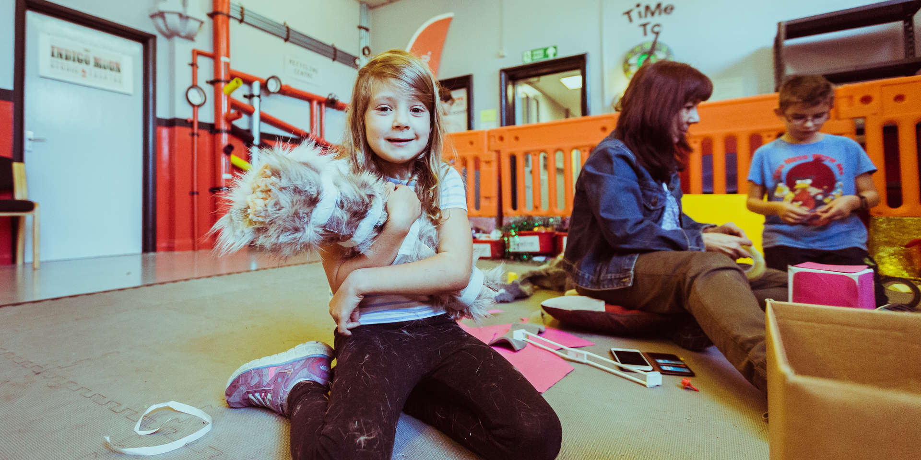

Slide 27
“The collaboration with other people, firms and organisations who share a passion for improving the opportunities within the local community were profound.”

Slide 28
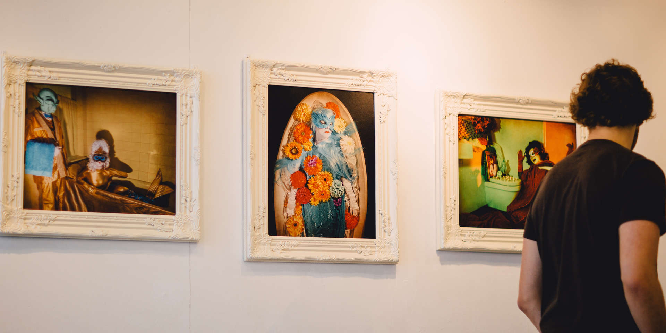

Slide 29
“For one of my staff, who is an art graduate from years ago, it helped him to fulfil a dream of having a significant art installation that he had designed, in his home city. Bravo!”

Slide 30
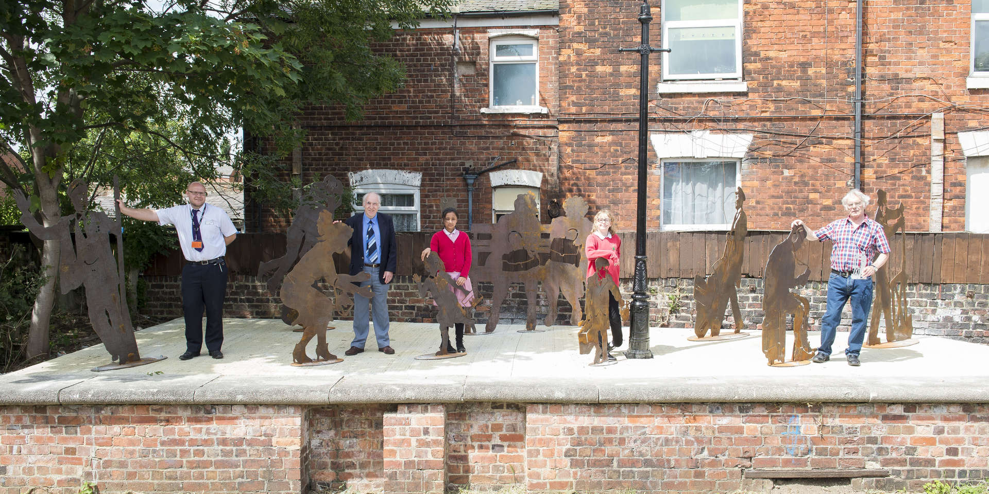

Slide 31
“Being part of it.”

Slide 32
