Slide 1

WELCOME
TO WOW HULL
THE MERCURE HOTEL
MONDAY 21ST NOVEMBER 2016
WOW Thinkin

Slide 2
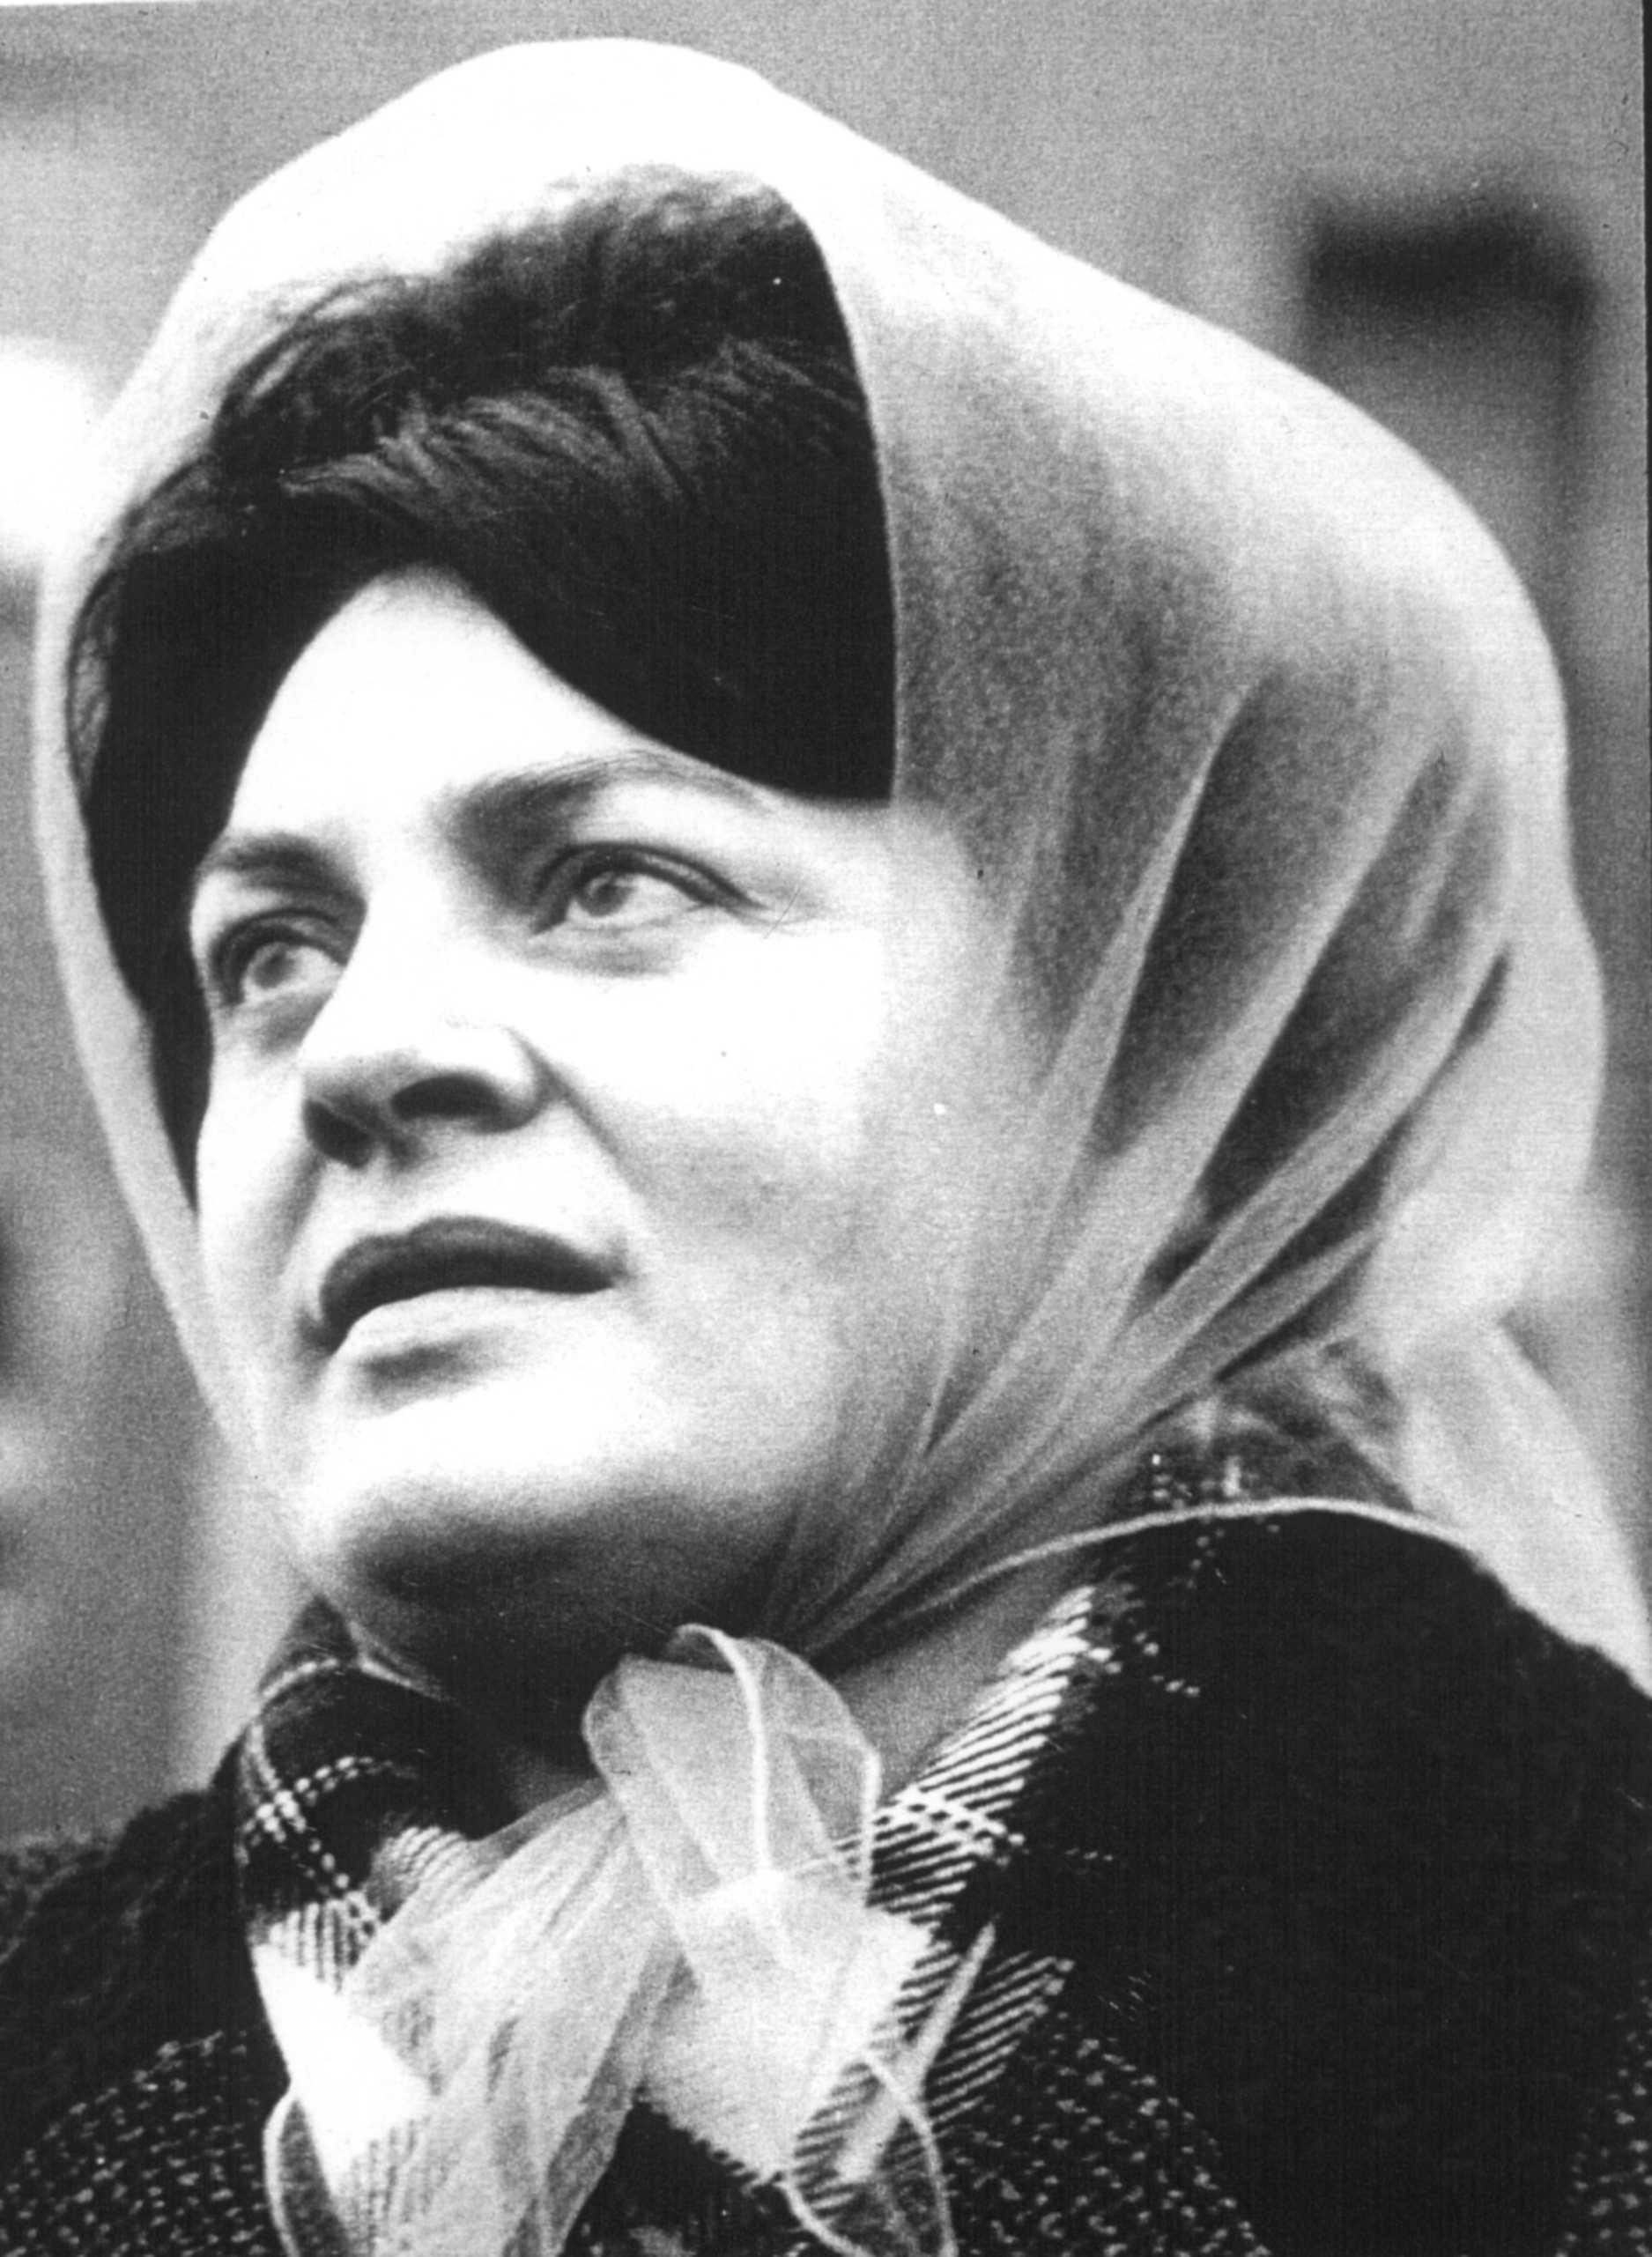

WOW HULL
#WOWHULL
DISCOVER MORE: HULL2017.CO.UK/WOWHULL
WOW Thinkin
Lillian Bilocca
Trawler Safety Campaigner
Photo: © Hull Daily Mail

Slide 3
HENRIETTA DUCKWORTH
Executive Producer
Hull UK City of Culture 2017
WOW Thinkin

Slide 4
KATE FOX
Poet
WOW Thinkin

Slide 5
ROSIE MILLARD
Chair of Hull UK City of Culture 2017
WOW Thinkin

Slide 6
JUDE KELLY CBE
WOW Founder
WOW Thinkin

Slide 7
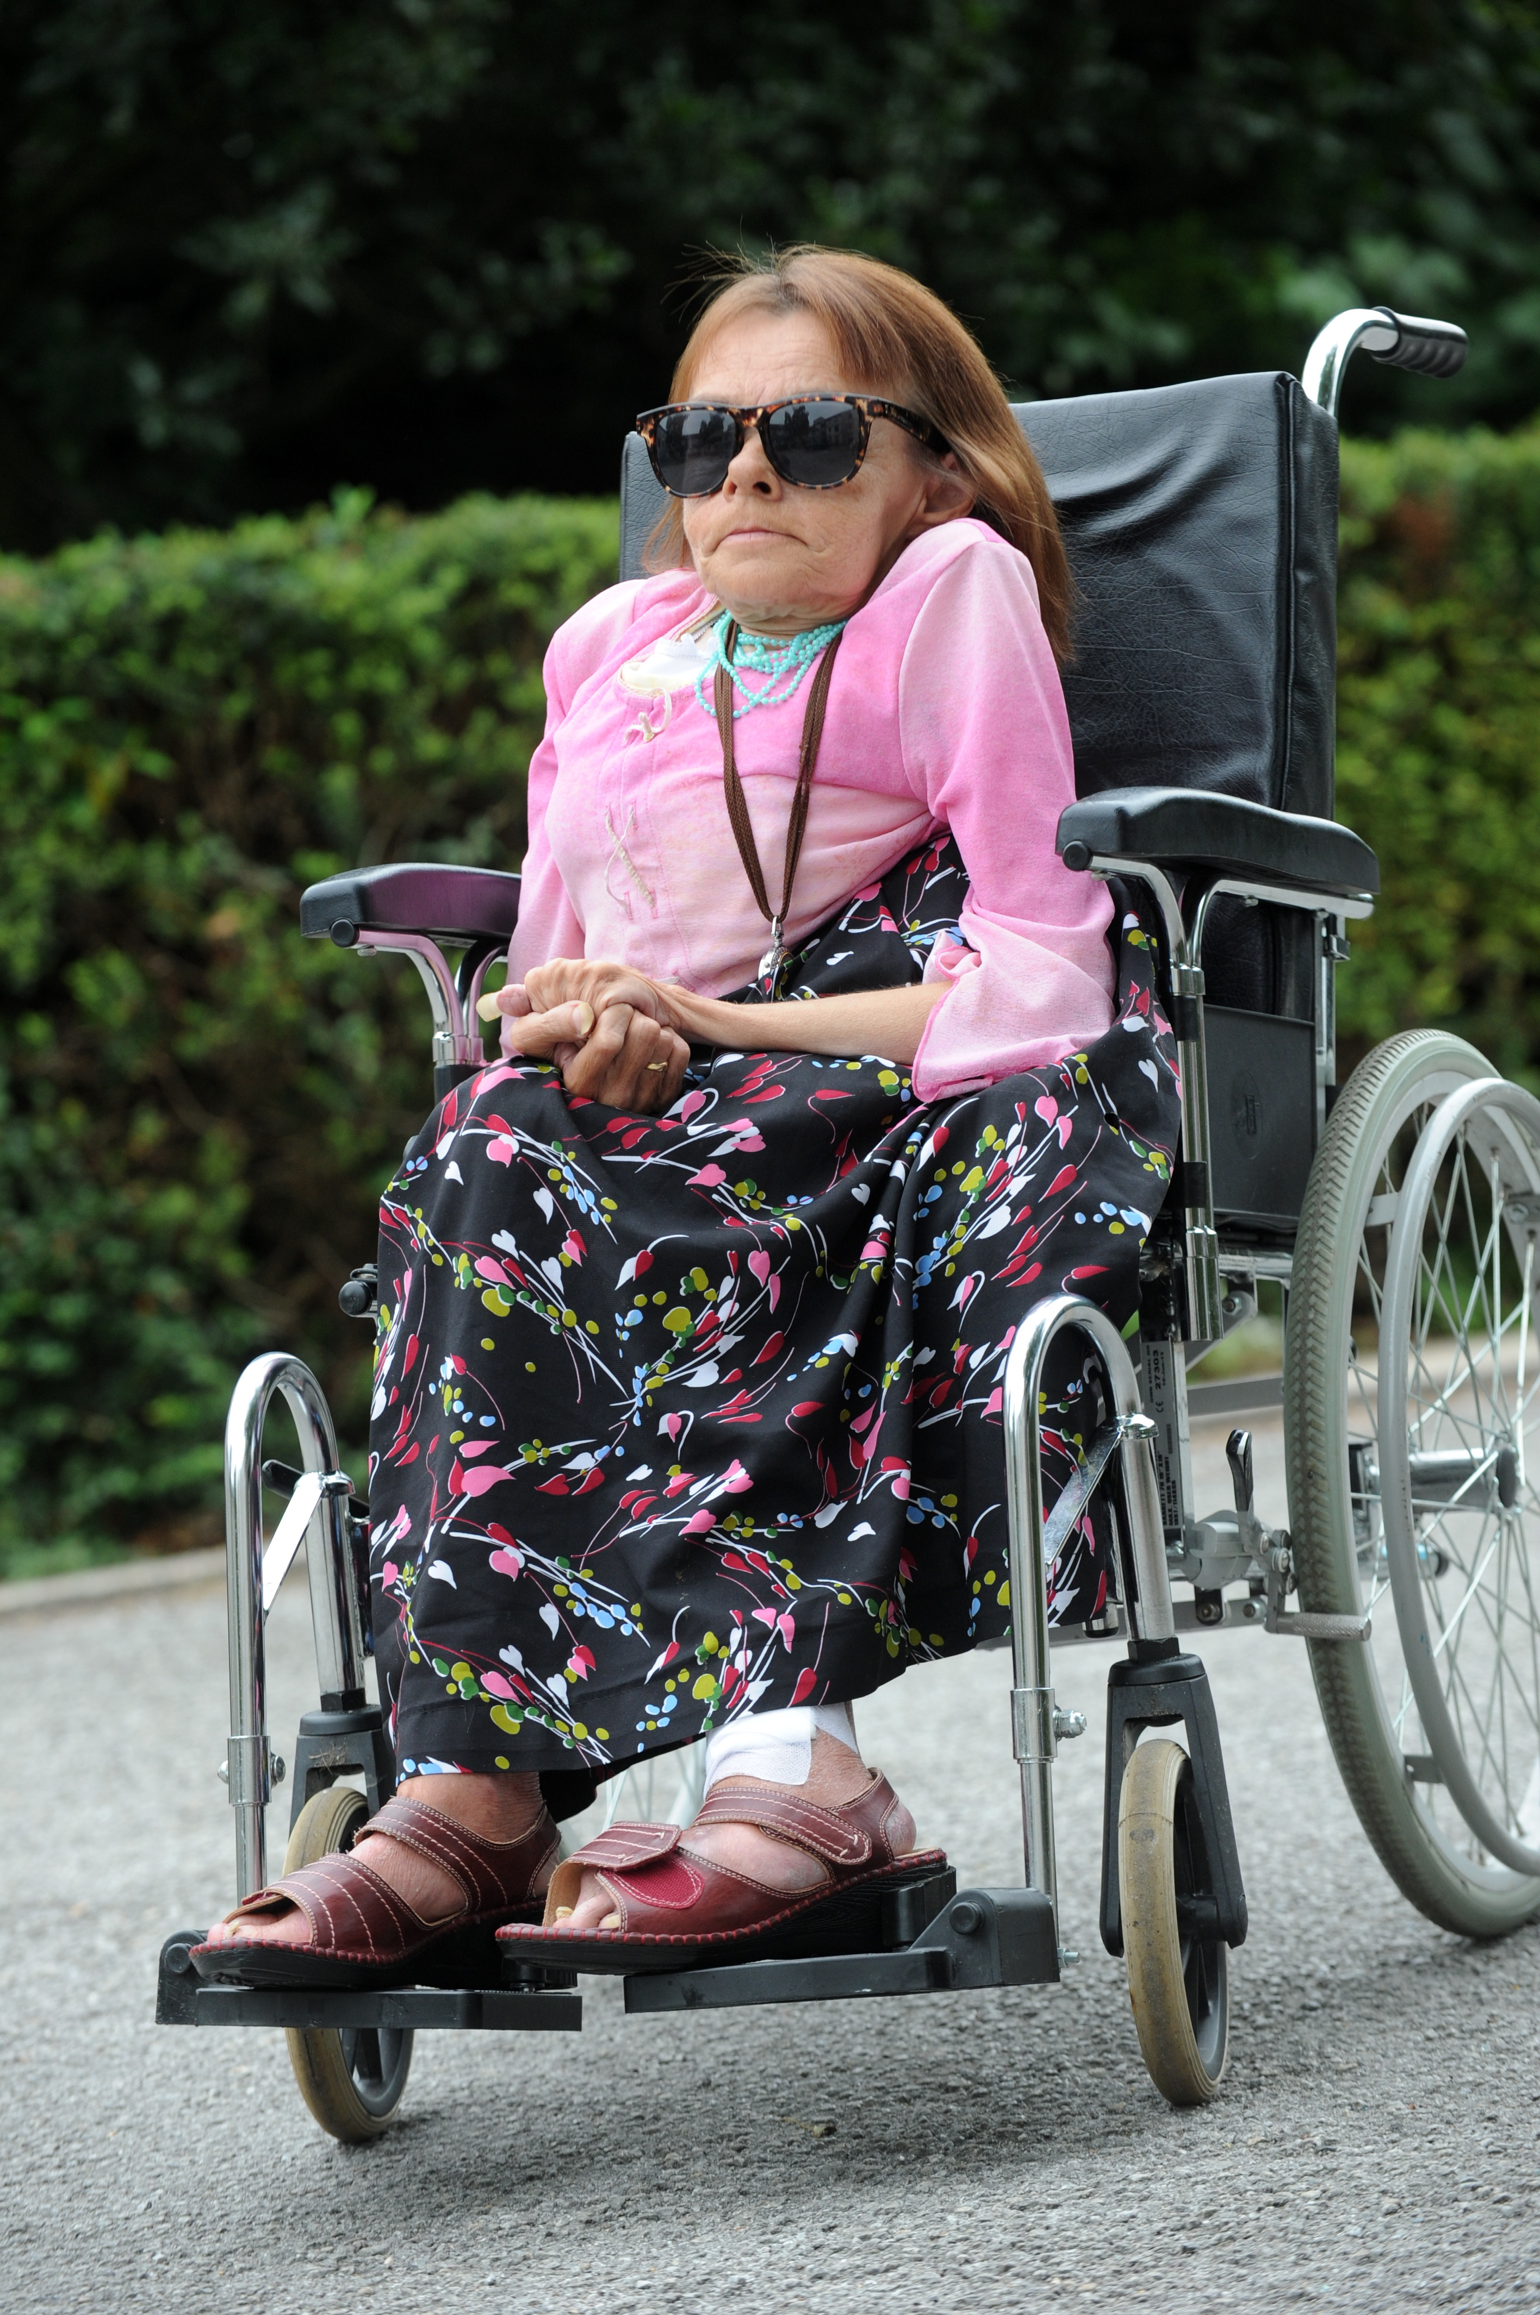
KEY NOTE
WOW Thinkin
Susie Meakin Clarke
Activist
Photo: © Hull Daily Mail

Slide 8
CIRCLE OF FRIENDS
Jude Kelly
Suzanne Clisby
Tish Lamb
David ‘Burnsy’ Burns
Bea Campbell
Melanie Eusebe
WOW Thinkin

Slide 9
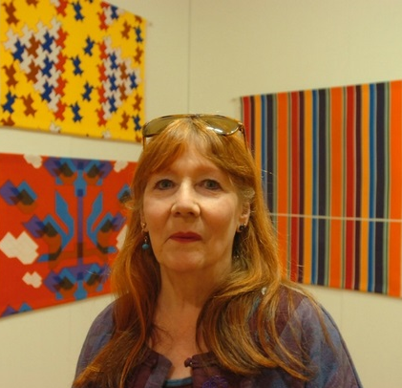
REVOLUTIONARY
MAKERS
Ian Read
Head of Learning & Participation
Hull UK City of Culture 2017
WOW Thinkin
Shirley Craven
Textile Designer
Photo: © Hull Daily Mail

Slide 10
Introductions
WOW Thinkin

Slide 11
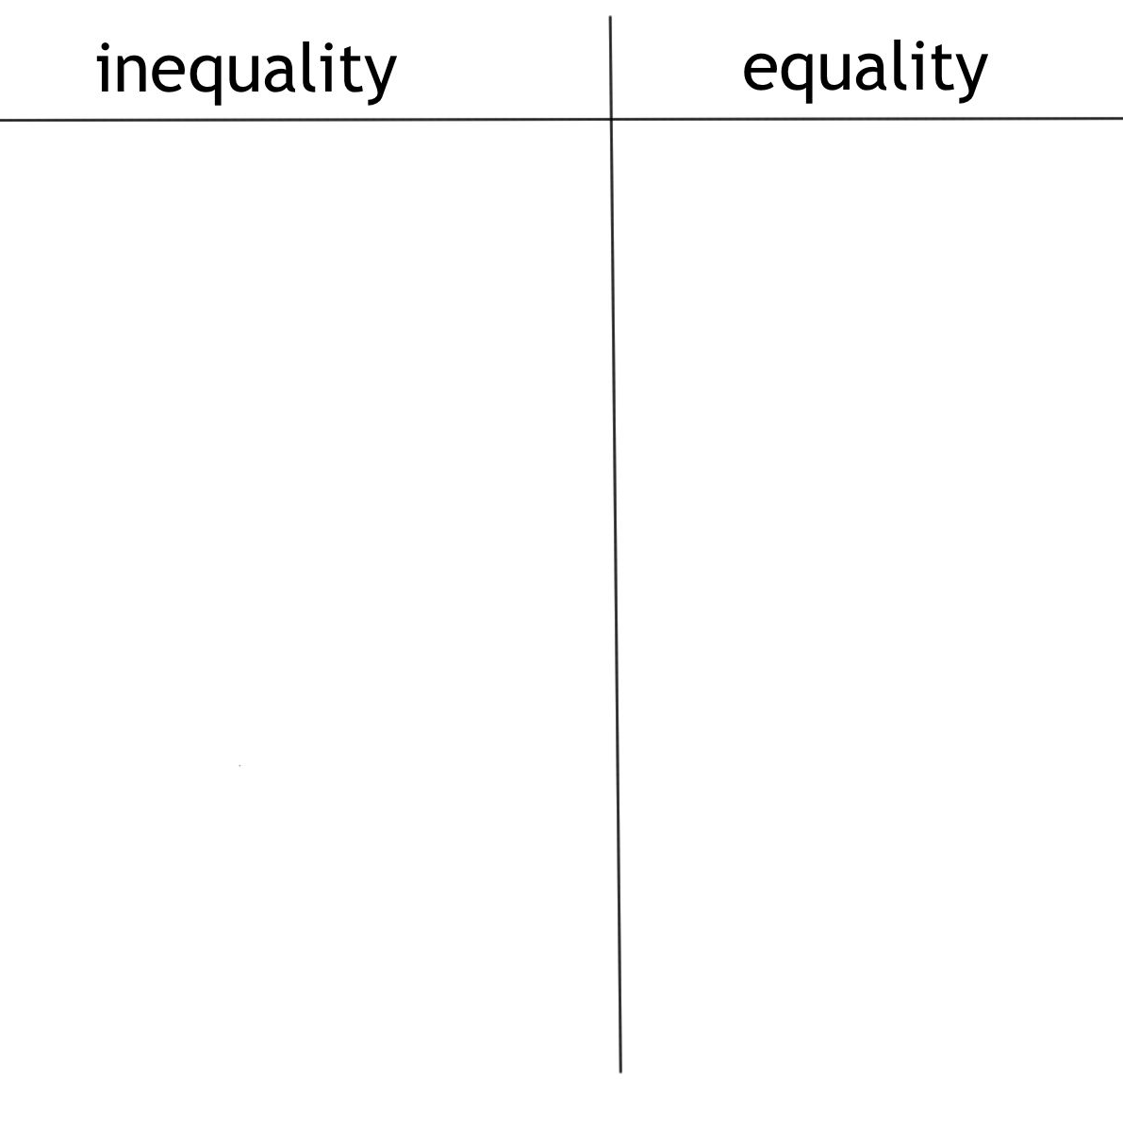
When have you experienced or witnessed gender inequality?
When have you experienced or witnessed gender equality?
WOW Thinkin

Slide 12
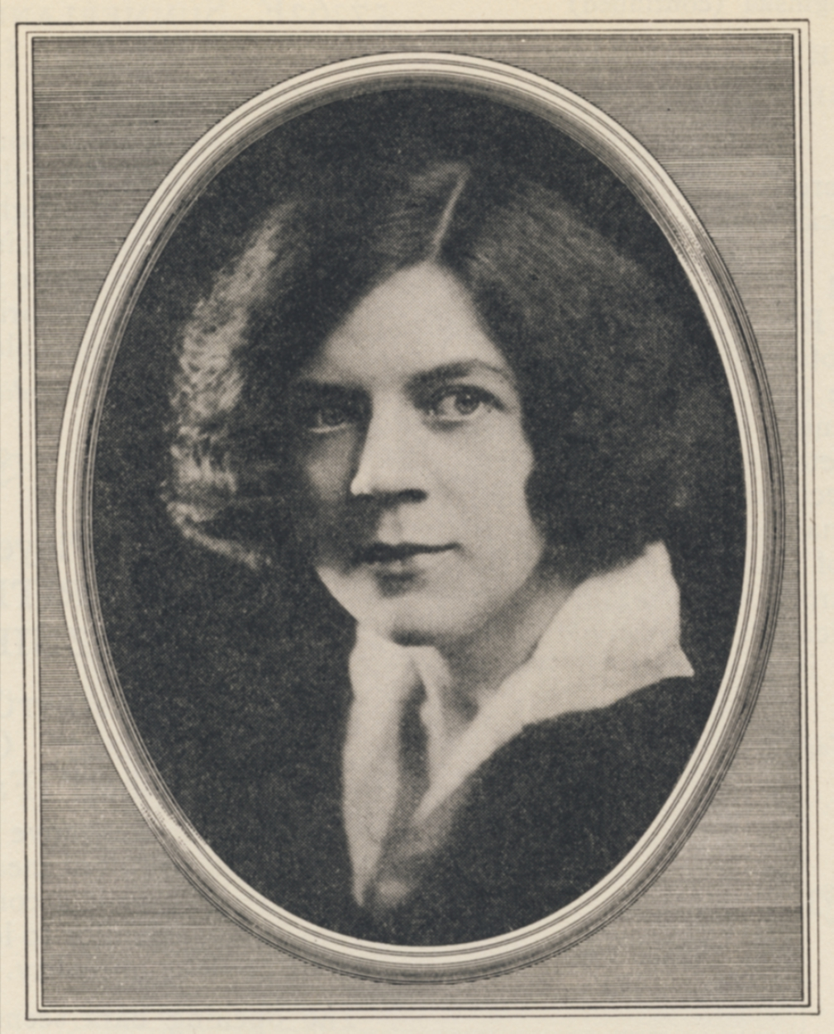
What would we like to change?
What pledges could we make at WOW Hull to make these things happen?
WOW Thinkin
Ethel Leginska
Composer & Conductor

Slide 13
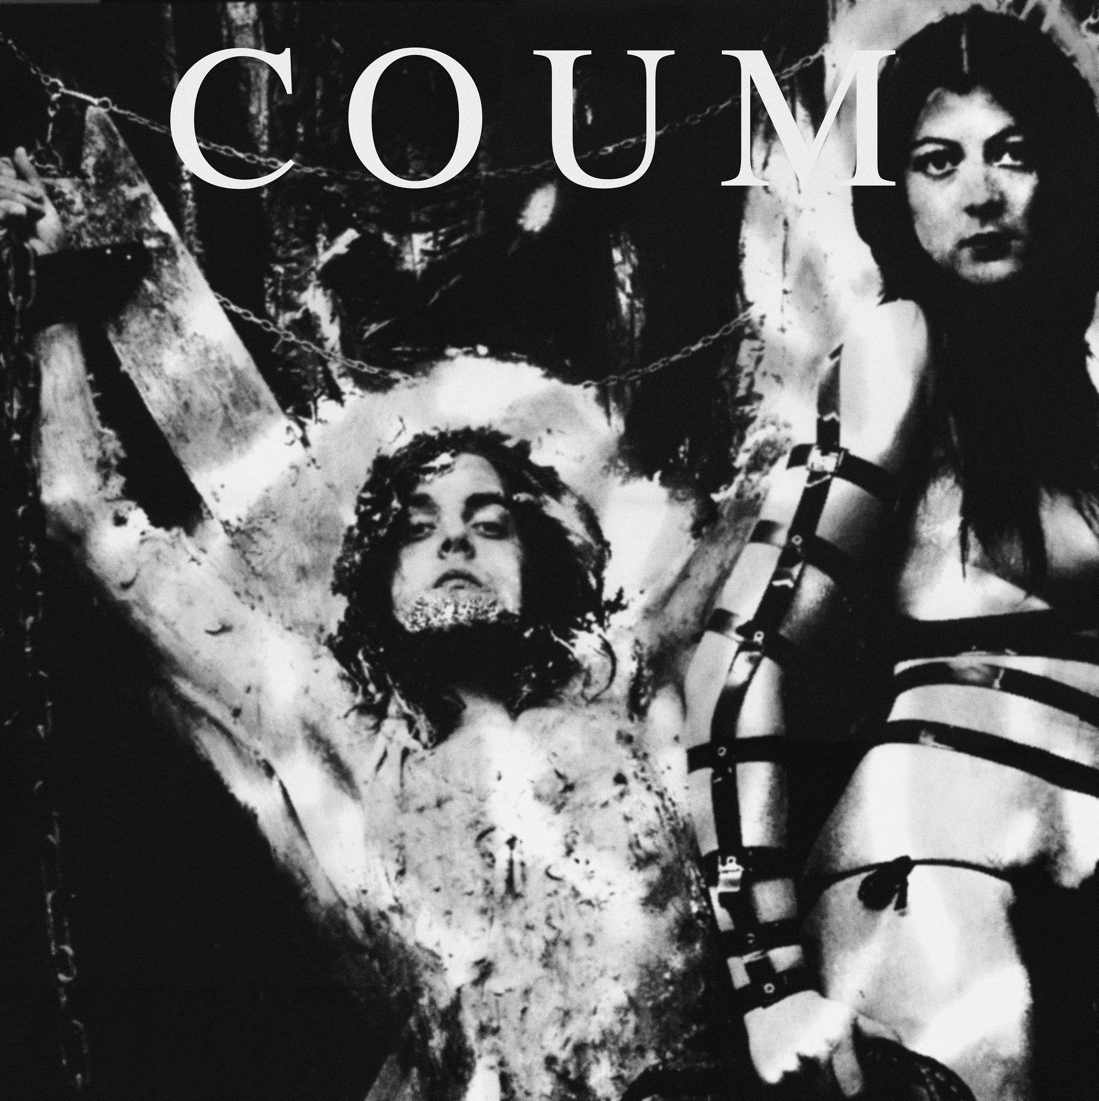
Examples of Pledges
More equal representation in local politics
Equal broadcasting of men and women’s football in Hull.
Empower everyone to challenge everyday sexism.
WOW Thinkin
Cosey Fanni Tutti and Coum Transmissions
Artist
Photo: © Coum Transmissions

Slide 14
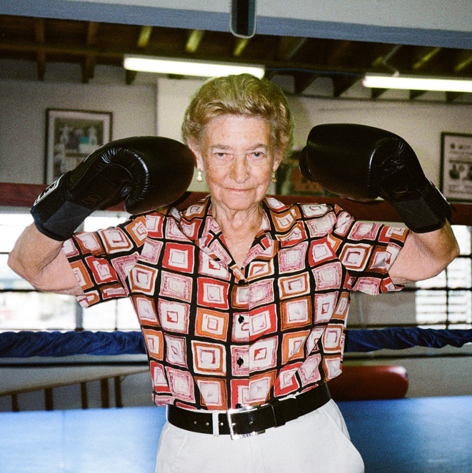
PLEDGES
WOW Thinkin
Barbara Buttrick
Boxer
Photo: © Dana Goldstein

Slide 15
PLEDGES
WOW Thinkin
Barbara Buttrick
Boxer
Photo: © Dana Goldstein

Slide 16
KATE FOX
Poet
WOW Thinkin

Slide 17
Thank you
WOW Thinkin

Slide 18
WOW Hull
10th – 12th March 2017
WOW HULL
DISCOVER MORE: HULL2017.CO.UK/WOWHULL
WOW Thinkin

Slide 19


Slide 20
WOW Hull
10th – 12th March 2017
WOW HULL
DISCOVER MORE: HULL2017.CO.UK/WOWHULL
WOW Thinkin

