Slide 1
Place des Anges
Katy Fuller
Senior Producer

Slide 2
Gratte Ciel
Place des Anges
As night falls across the city of Hull, a number of angels begin to appear, high up on the rooftops. The angels start to glide down into the audience, releasing white feathers which float across the sky.
Once the last angel has taken flight, the crowd will be showered with a spectacular explosive display of feather fireworks.
A playful, visual spectacle that will enchant audiences of all ages.

Slide 3
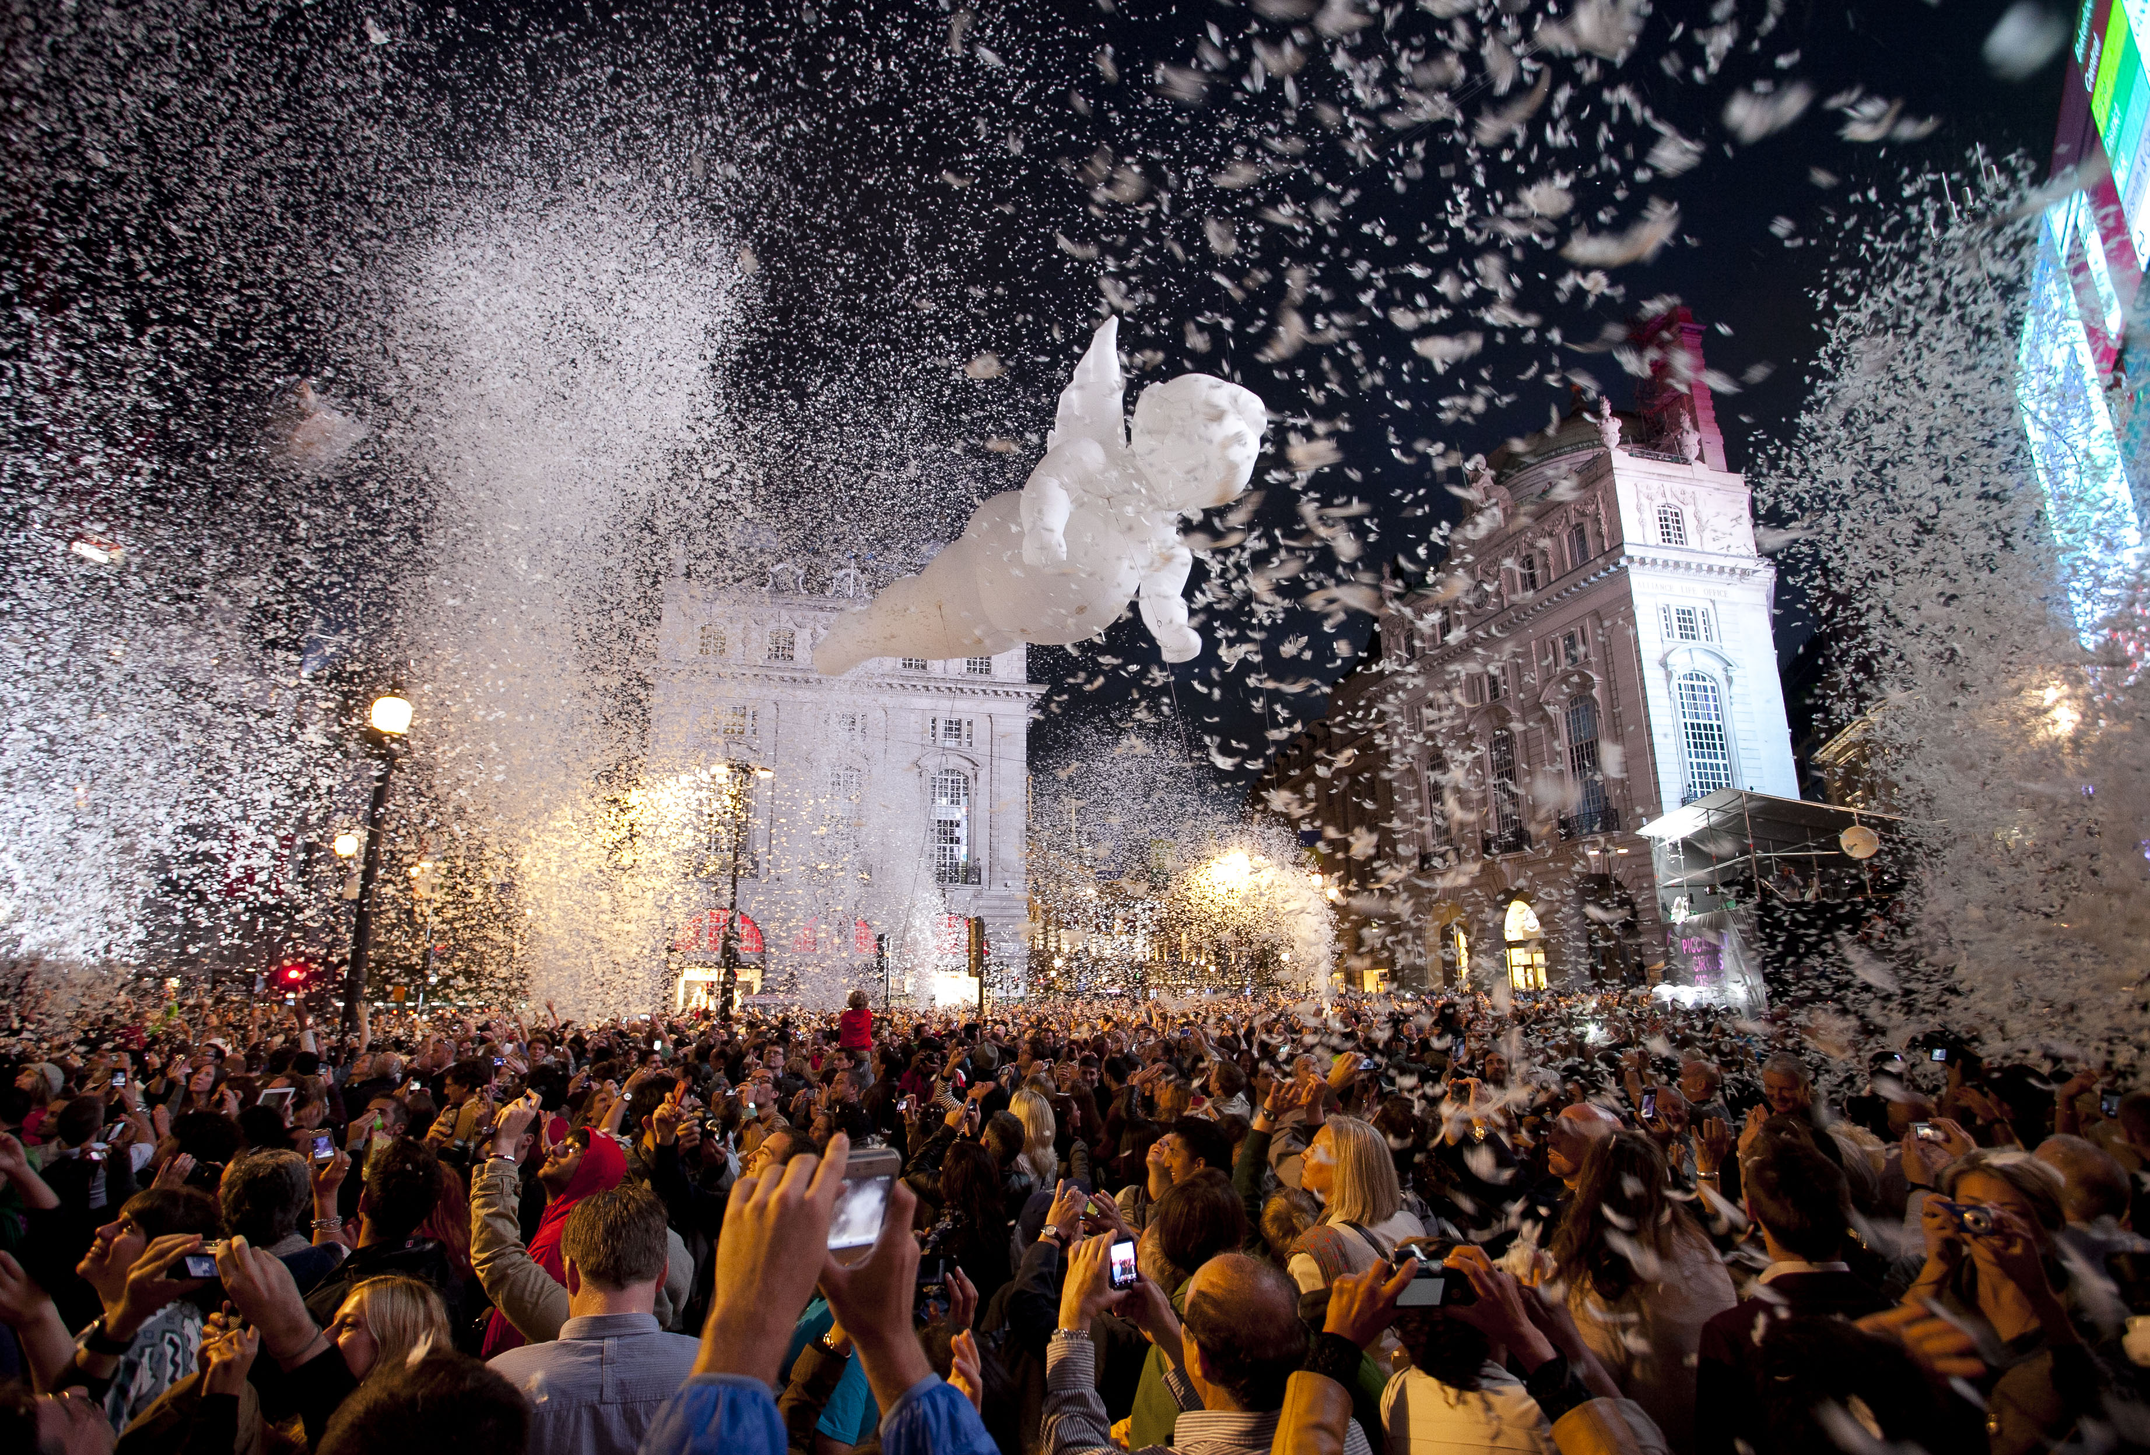

Slide 4
Gratte Ciel
Place des Anges
https://www.youtube.com/watch?v=XWz8lNMbLv4
Notes:
https://www.youtube.com/watch?v=XWz8lNMbLv4

Slide 5
The Partnership
Presented by Yorkshire Festival and Hull 2017
Finale of the Yorkshire Festival 2016
Opening the Amy Johnson Festival
First public announcement - 14th April

Slide 6
Details
Location: Queen’s Gardens, Hull
Date: Sat 2nd of July 2016
Time: 9.45pm
Tickets: Free – Ticketed [Limited Availability]
Capacity: 7000 tickets plus additional viewing for 5000

Slide 7
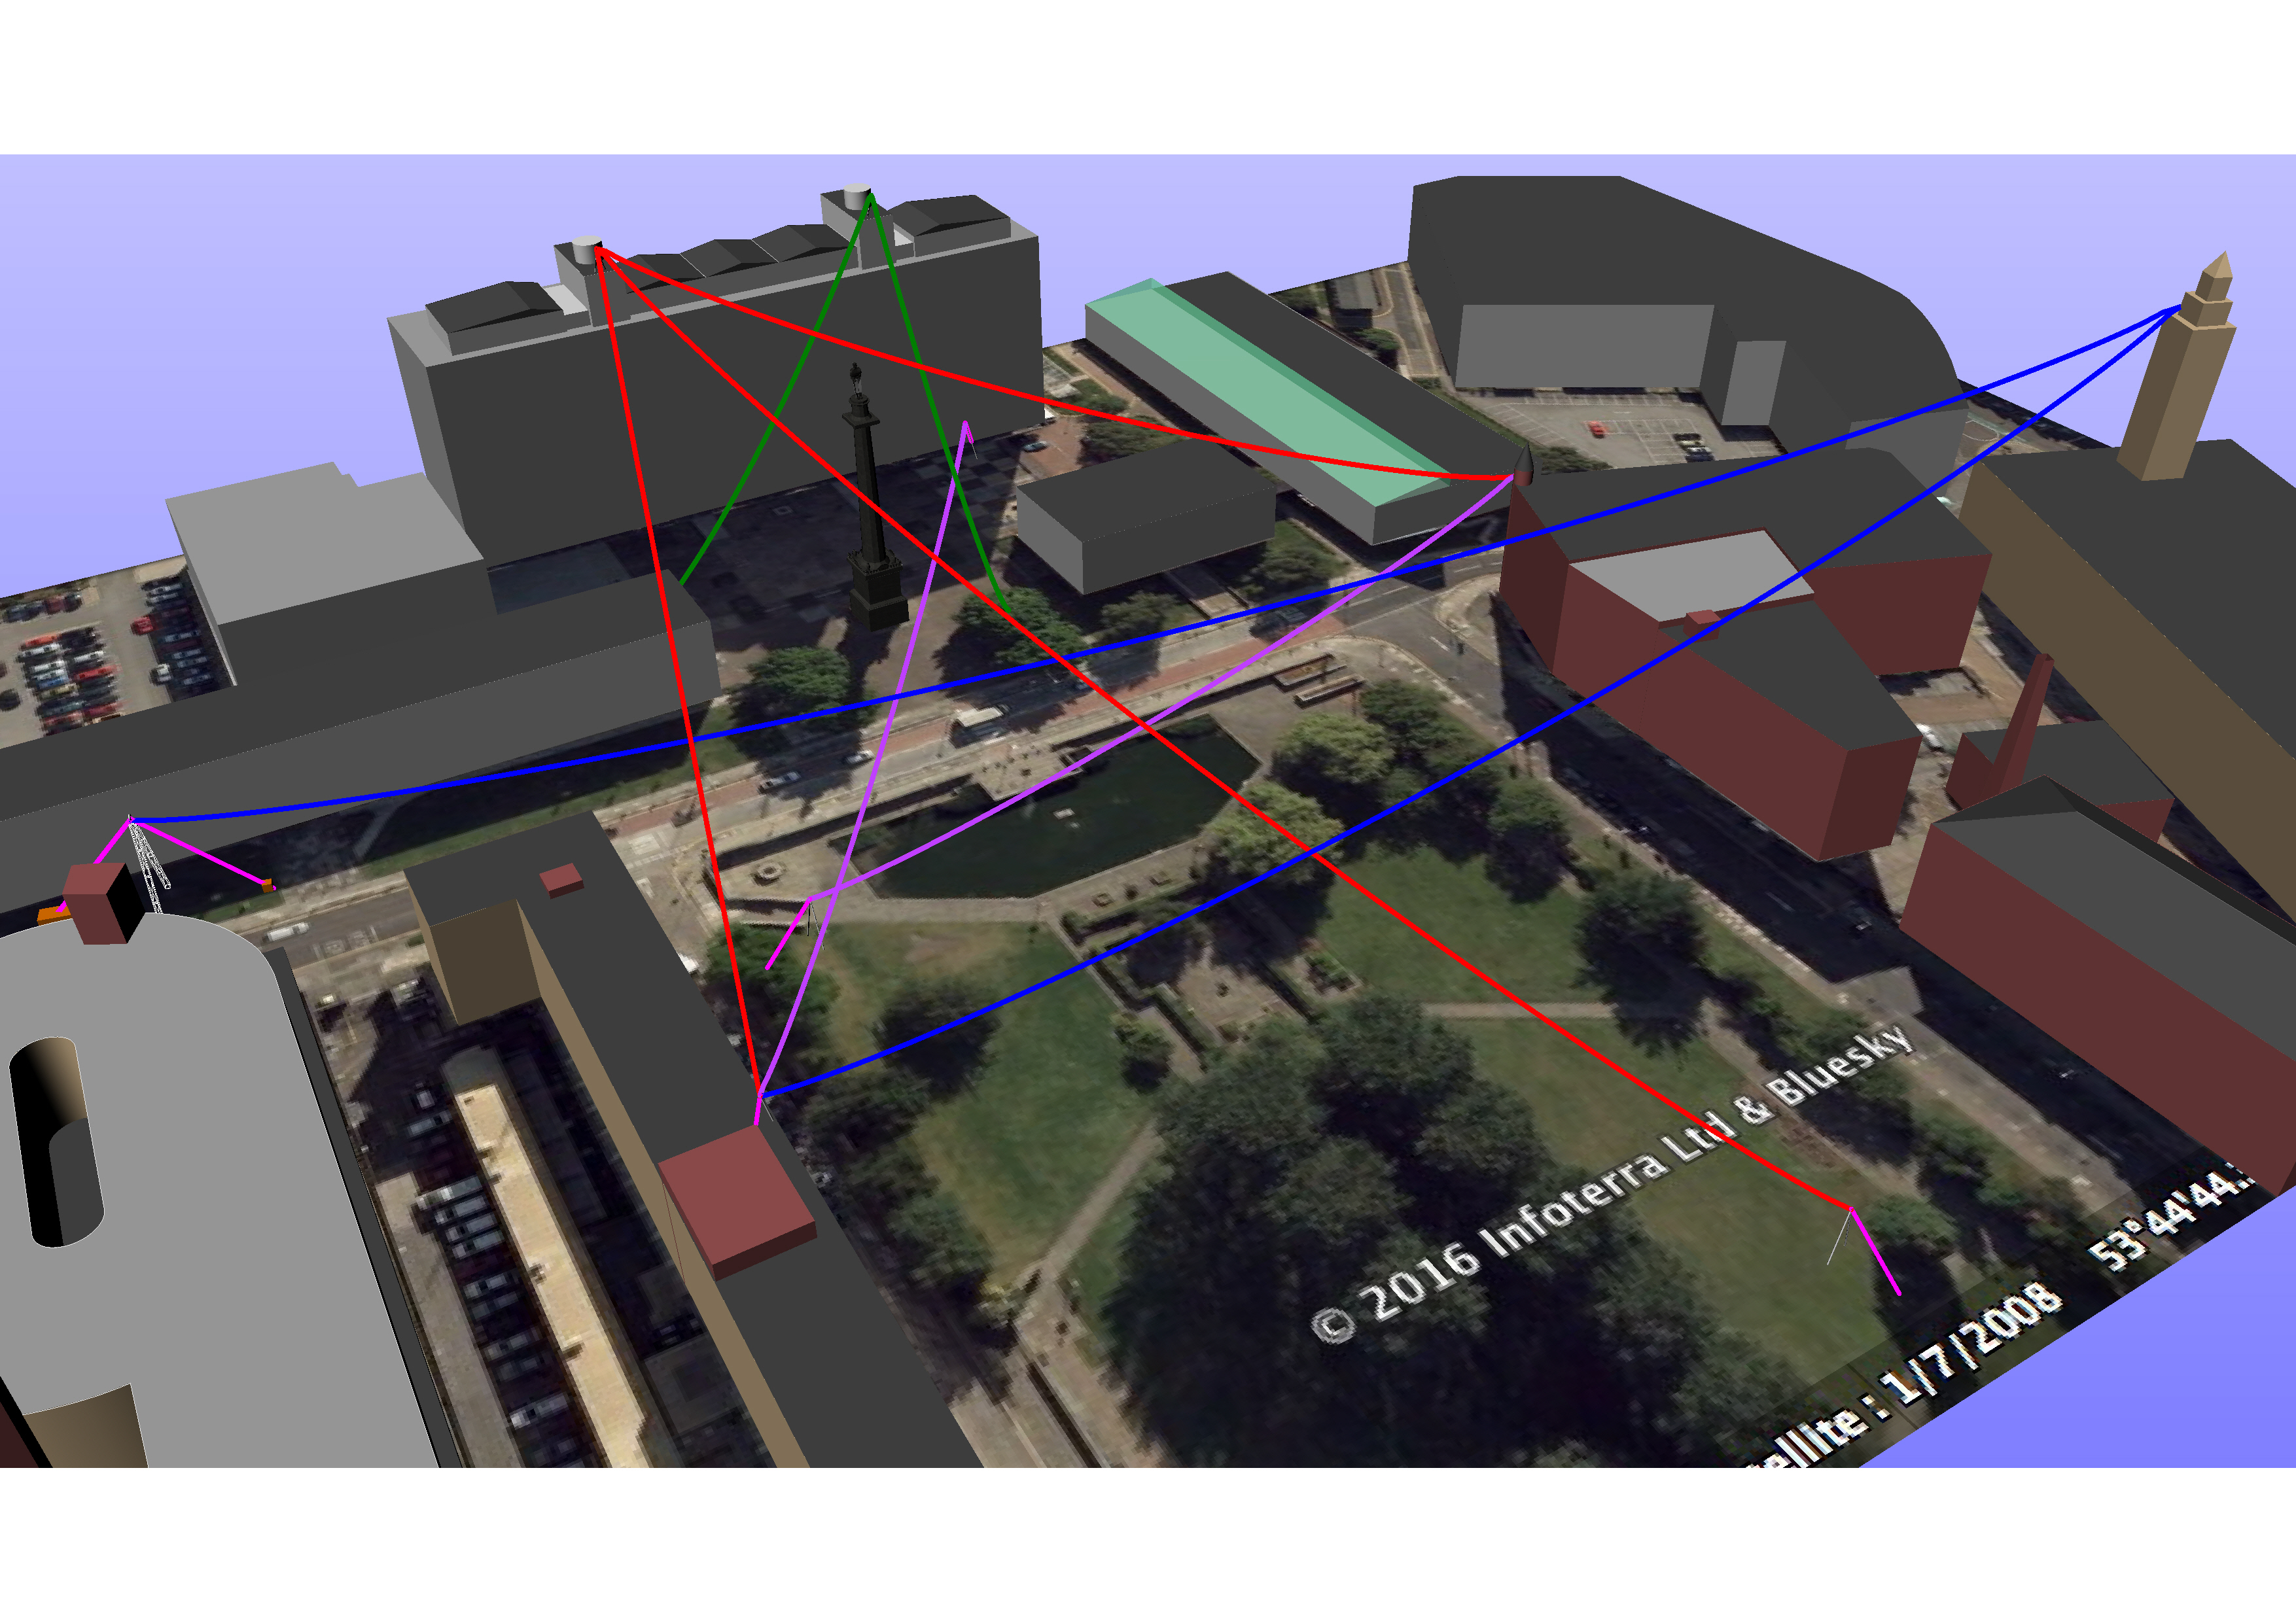

Slide 8
