Slide 1
Welcome
Hull 2017 Volunteer Training
Ferens Art Gallery

Slide 2
Welcome!
Maxine Mckee – Volunteer Coordinator for Hull Museums and Ferens Art Gallery
Your point of contact if you have any questions or concerns whilst you volunteer for us
Liaise with you regarding shifts and role
Working at the Ferens Art Gallery…
Key information…
What to do on arrival for a shift
Signing / signing out procedure
Breaks / refreshments
Coats and bags storage during shifts

Slide 3
Heritage Learning
Jane Avison – Heritage Learning Business Manager
Sarah Taylor – Heritage Learning Programme Developer
Access, Learning and Engagement & Training
Hull Museums and Ferens Art Gallery events programme
Team of cultural learning experts

Slide 4
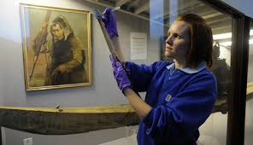
Who you will be working with…
Haley Killingbeck - Front of House & Operations Manager
Front of House Teams – Ferens Art Gallery

Slide 5
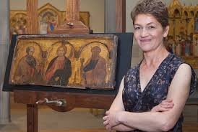
The Curator
Kirsten Simister Curator of Art
Ferens Art Gallery

Slide 6
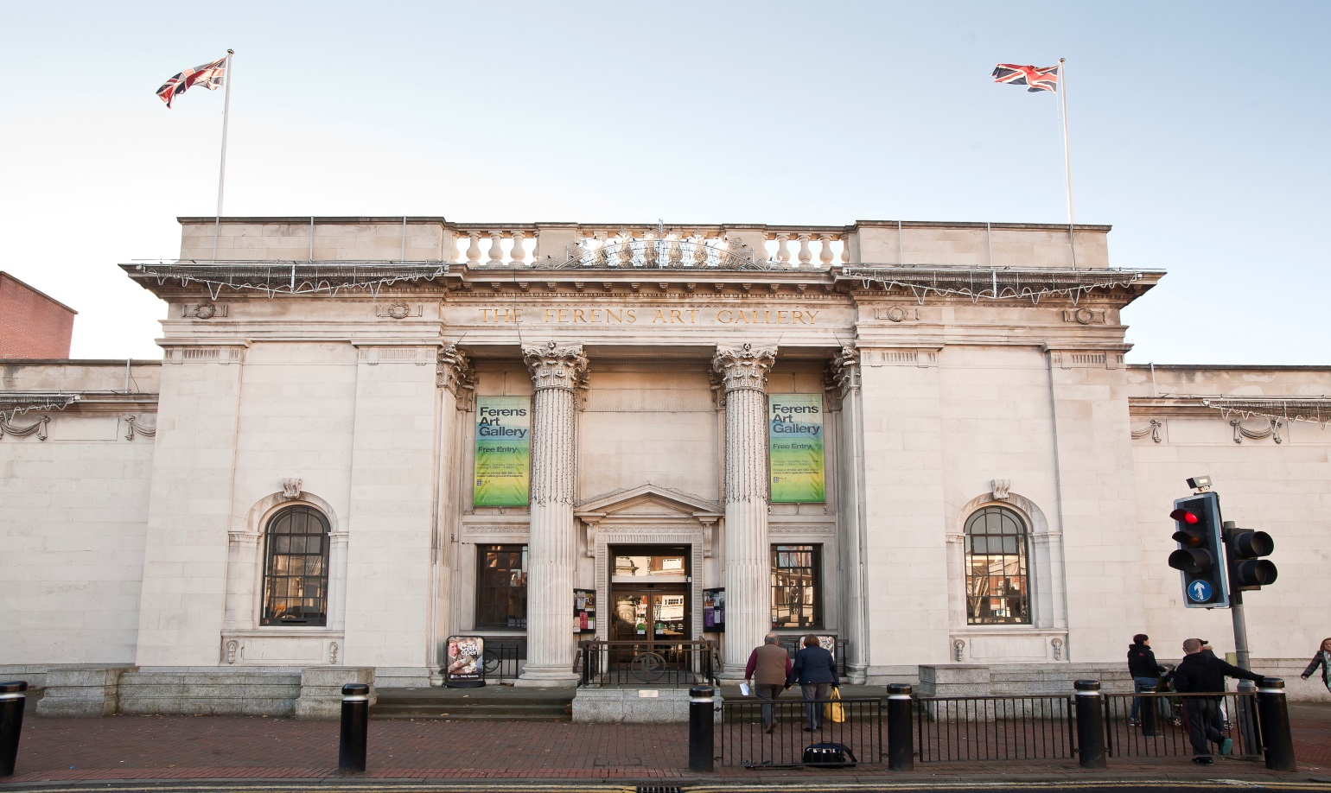
Ferens Art Gallery…

Slide 7
Introduction to Ferens Art Gallery…
The Ferens Art Gallery was built for the city by Thomas Robinson Ferens and opened in 1927
The gallery has recently undergone a multi-million pound redevelopment to ensure it can exhibit internally significant artworks during 2017 and beyond.
Ferens has a magnificent collection of paintings and sculptures, including works by European Old Masters, portraiture, marine painting, and modern and contemporary British art.
Highlights include masterpieces by Lorenzetti, Frans Hals, Antonio Canaletto, Frederick Leighton, Stanley Spencer, David Hockney, Helen Chadwick and Gillian Wearing.
The Ferens has a regular programme of events and changing exhibitions, there’s always something new to explore!
We have a café called Venue Hull and a gift shop.

Slide 8
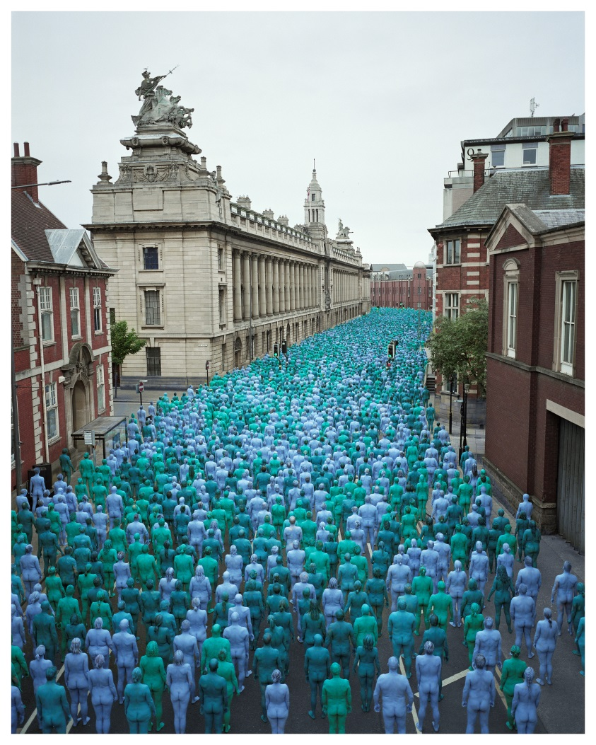
Highlights Of 2017…
Lorenzetti
SKIN & Sea of Hull
Rembrandt – the Ship Builder and his Wife
Turner Prize 2017

Slide 9
Lets talk about you & your role…

Slide 10
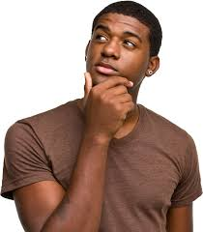
Why Volunteer?
What do you hope to gain from this experience?

Slide 11
Share Your Thoughts…

Slide 12
Our Interpretative Goals…
Goal 1
To embed and integrate learning across our museums and galleries
Goal 2
Support visitors to develop an understanding and appreciation of art & historical collections
Goal 3
To create an environment where visitors want to interact, socialise and spend time.

Slide 13
Accessibility
Intellectual barriers make the content of interpretation difficult to understand…
We propose to; provide information in a range of formats and layers of detail appropriate to a range of learning styles. Visitors can access content in a variety of ways, enabling them to develop and build knowledge on their own terms.
Sensory barriers make interpretation difficult to see, hear, experience…
We propose to; provide opportunities for visitors to use all of their senses to engage with the collections.
Physical barriers make interpretation difficult to access…
We propose; the gallery displays work at a range of heights with clear viewpoints for wheelchair users and young children.

Slide 14
Accessibility
Cultural barriers fail to reflect or relate to the cultural perspectives of audiences; this can lead to negative ‘not for me’ perceptions…
We propose to; provide interpretation in a range of formats that break down perception and language barriers challenging visitors in a positive way.
Financial barriers exclude people on low incomes…
We propose to; provide interpretation and experiences that are free and accessible to all income levels. Transport charges will remain a challenge for these visitors however the current free entrance to the gallery and targeted messaging will help to mitigate these barriers.
Organisational barriers exclude visitors because of the way the interpretation is provided…
We propose to; research and understand our visitors, ensuring we offer programming at times and in spaces that reflect the visitors needs and preference.

Slide 15
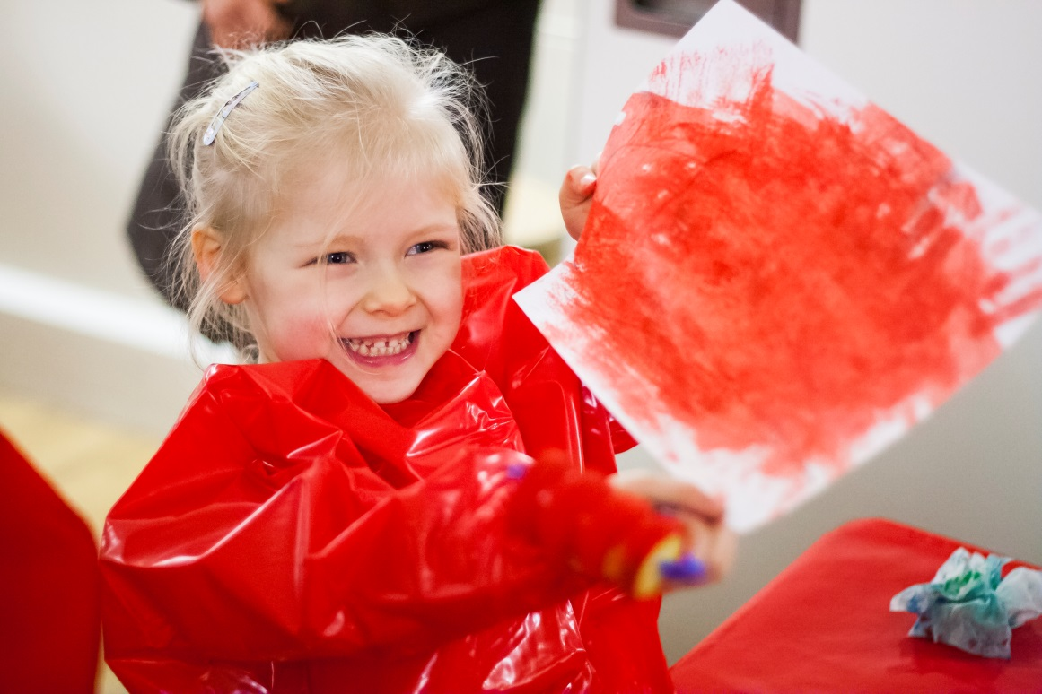
Learning & Engagement – Under 5s

Slide 16
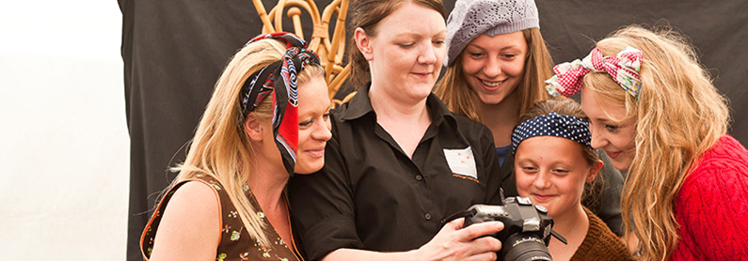
Learning & Engagement - Events

Slide 17
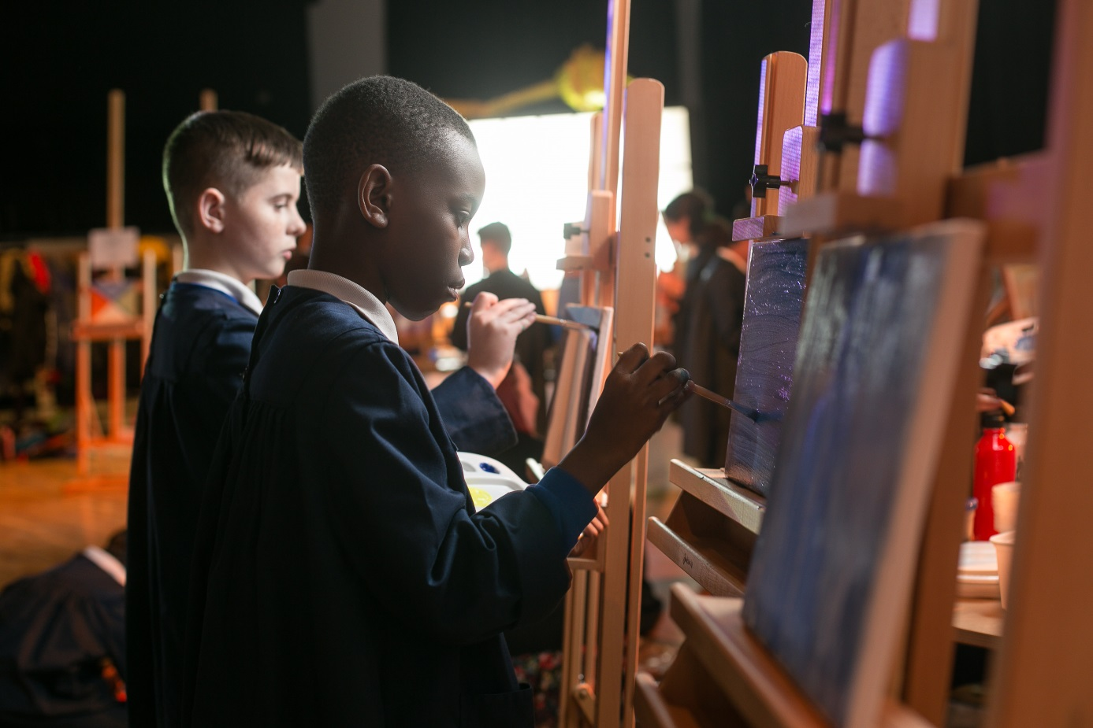
Learning & Engagement – Schools

Slide 18
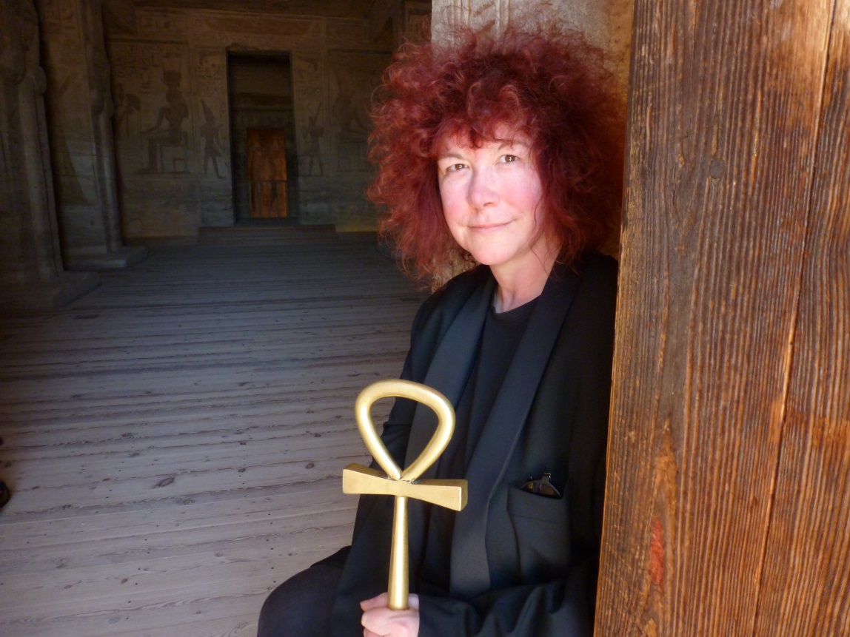
Learning & Engagement – Adult Learning

Slide 19
Your Role…
To engage visitors with our collections
To create a connection between the visitor and the collection, empowering them to engage on their own terms.
To help make collections relevant to our visitors and their lives
To challenge visitors in a positive way
Work alongside our Front of House team to
Support with the invigilation of temporary exhibitions and displays
Help manage visitor experience and flow
Notify them of any potential issues or concerns

Slide 20
Let’s have a go…

Slide 21
Engaging our visitors
Engage the visitor making them feel welcome / introduce yourself
Adjust your pitch and delivery and any questions appropriately to meet the needs of your audience.
Think of 1 to 3 memorable pieces of information that the audience could walk away with.

Slide 22
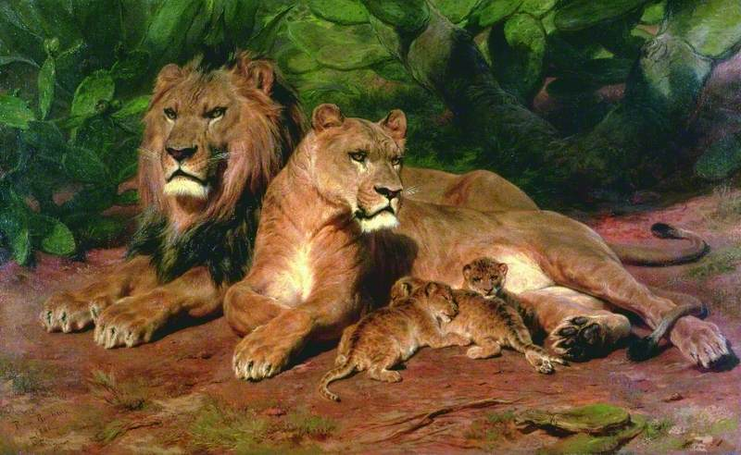
Engaging our Visitors
Rosa Bonheur
The Lion at Home
Bonheur liked to work from life, and whilst painting the Lion at Home actually kept the lions in her studio. The lions in this painting are life size.
Born in 1822 France, Bonheur only under took training in the arts after being expelled from several schools and failing her apprenticeship as a seamstress aged 12.
She was taught initially by her painter father and went on to be one of the best well known women artists of her time
She was known for her scandalous behaviour such as wearing trousers and smoking a pipe.
Quotes
“As far as males go I only like the bull’s I paint.” – Bonheur
“It has been suggested that Bonheur included several discrete portraits of herself in her paintings to celebrate her non conformity” – Walker Gallery

Slide 23
Engaging our visitors
Grandparent with grandchild aged 7
Group of young men aged 16-25
Group of adults with visual impairment
Family of two adults with two children aged 2 years and 10 years of age.

