Slide 1
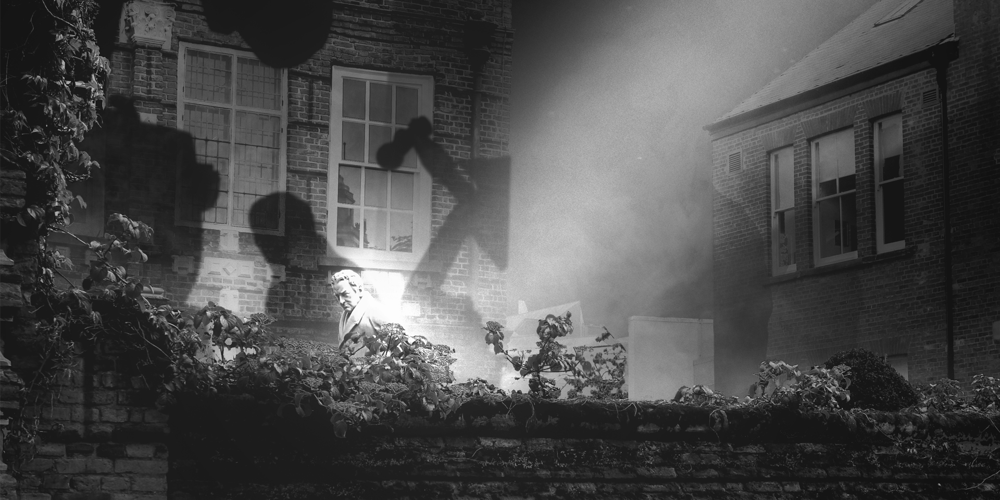
PROMPT CARD: FEEDBACK ON CONVERSATIONS
Reflecting on the conversations with members of the public linked to the 'Where Do We Go From Here?' event, please can you tell us what the main topics were brought up by attenders, in relation to the question 'Where Do We Go From Here?' (e.g. Hull, UK, The World, Science, Technology, Environment, Politics, etc…)
What were the most positive answers you received in relation to the question 'Where Do We Go From Here?‘
What were the most negative answers you received in relation to the question 'Where Do We Go From Here?‘
What were the most surprising answers you received in relation to the question 'Where Do We Go From Here?‘
Reflecting on the conversations with members of the public linked to the 'Where Do We Go From Here?' event, who did they feel had a role or responsibilities in making their vision for the future happen and why? (e.g. Government, the local authority, society at large, themselves)
Anything else about conversations you've had linked to the question 'Where Do We Go From Here?’

