Slide 1
What is the Waterstones Children’s Laureate?

Slide 2
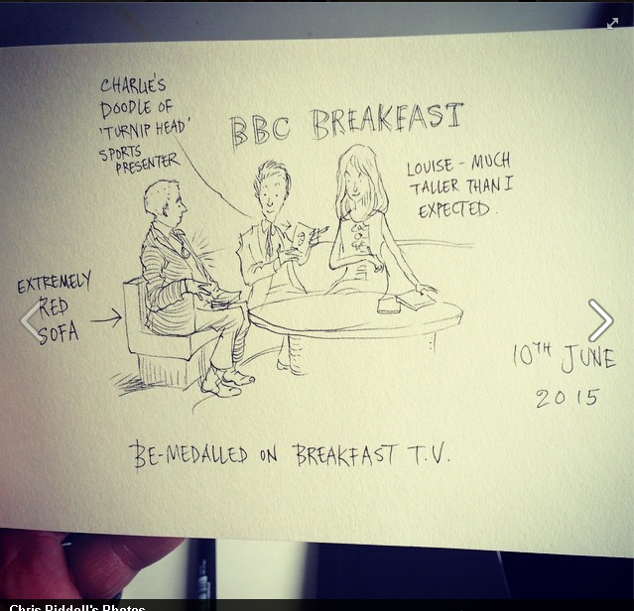
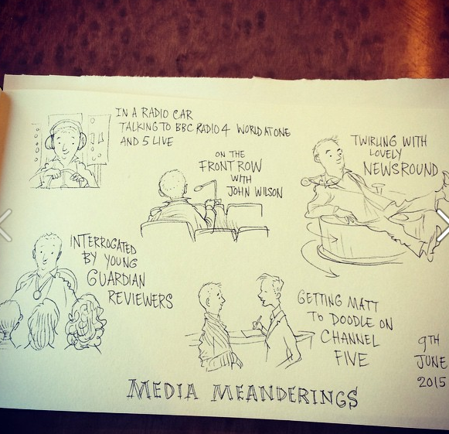
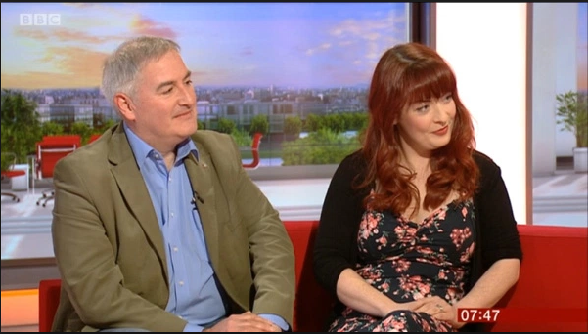
‘The Children’s
Laureate has become an
indispensable part of British
publishing. Want a spokesperson on the Today programme… ? Call the Children’s Laureate. Need a voice to question the government’s literacy drive when this seems to be at the expense of reading for pleasure? Look no further. The Children’s Laureate is alive, kicking and here to stay’
The Independent

Slide 3
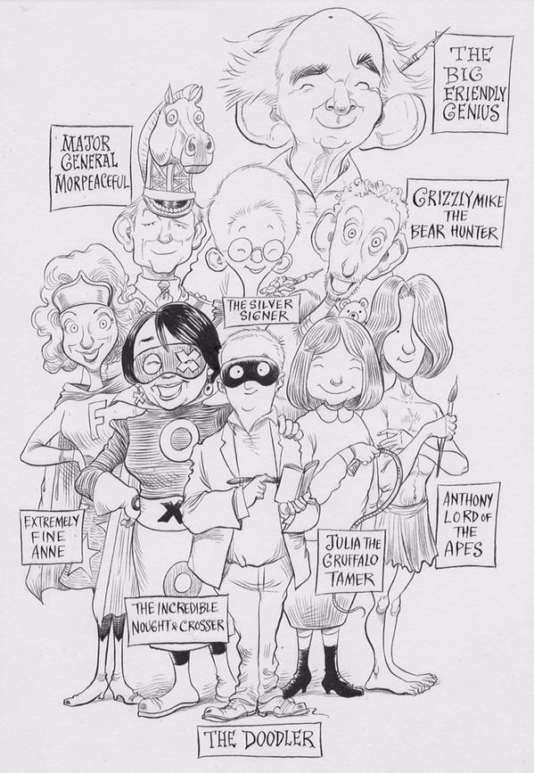

Slide 4
The Children’s Laureate transforms into a national treasure. That status sticks, former Laureates are some of the biggest stars in children’s literature.

Slide 5
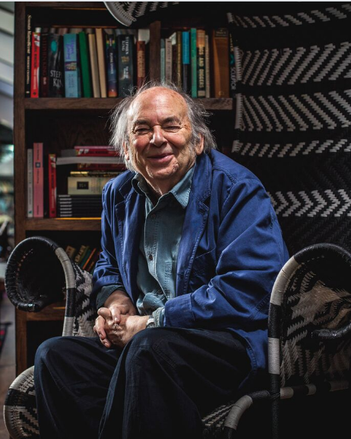
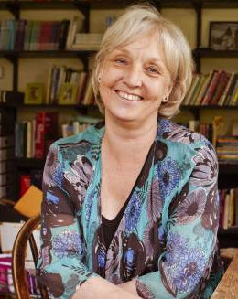
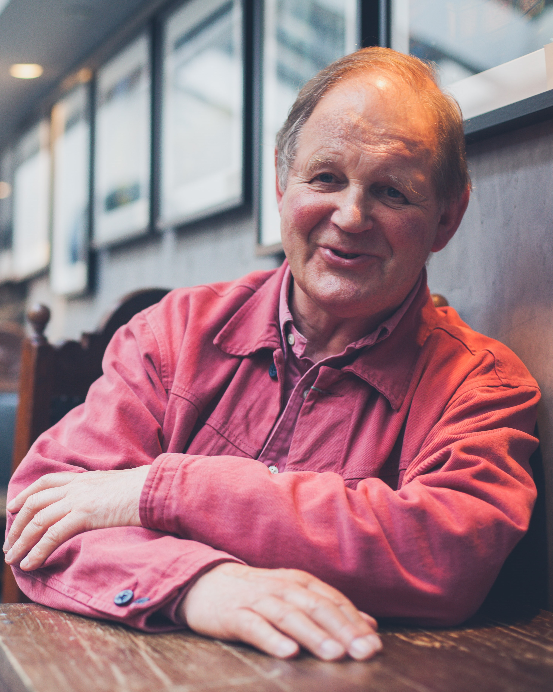
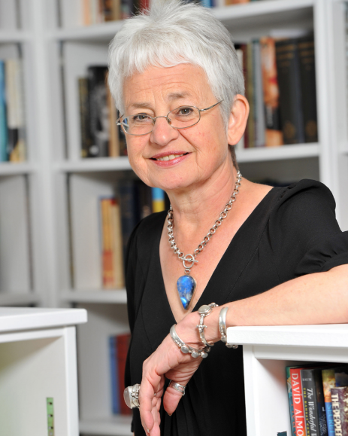
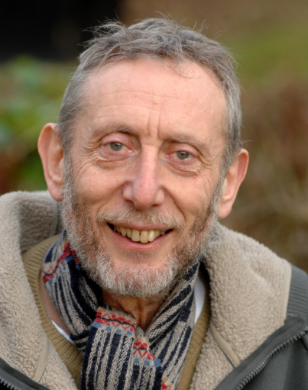
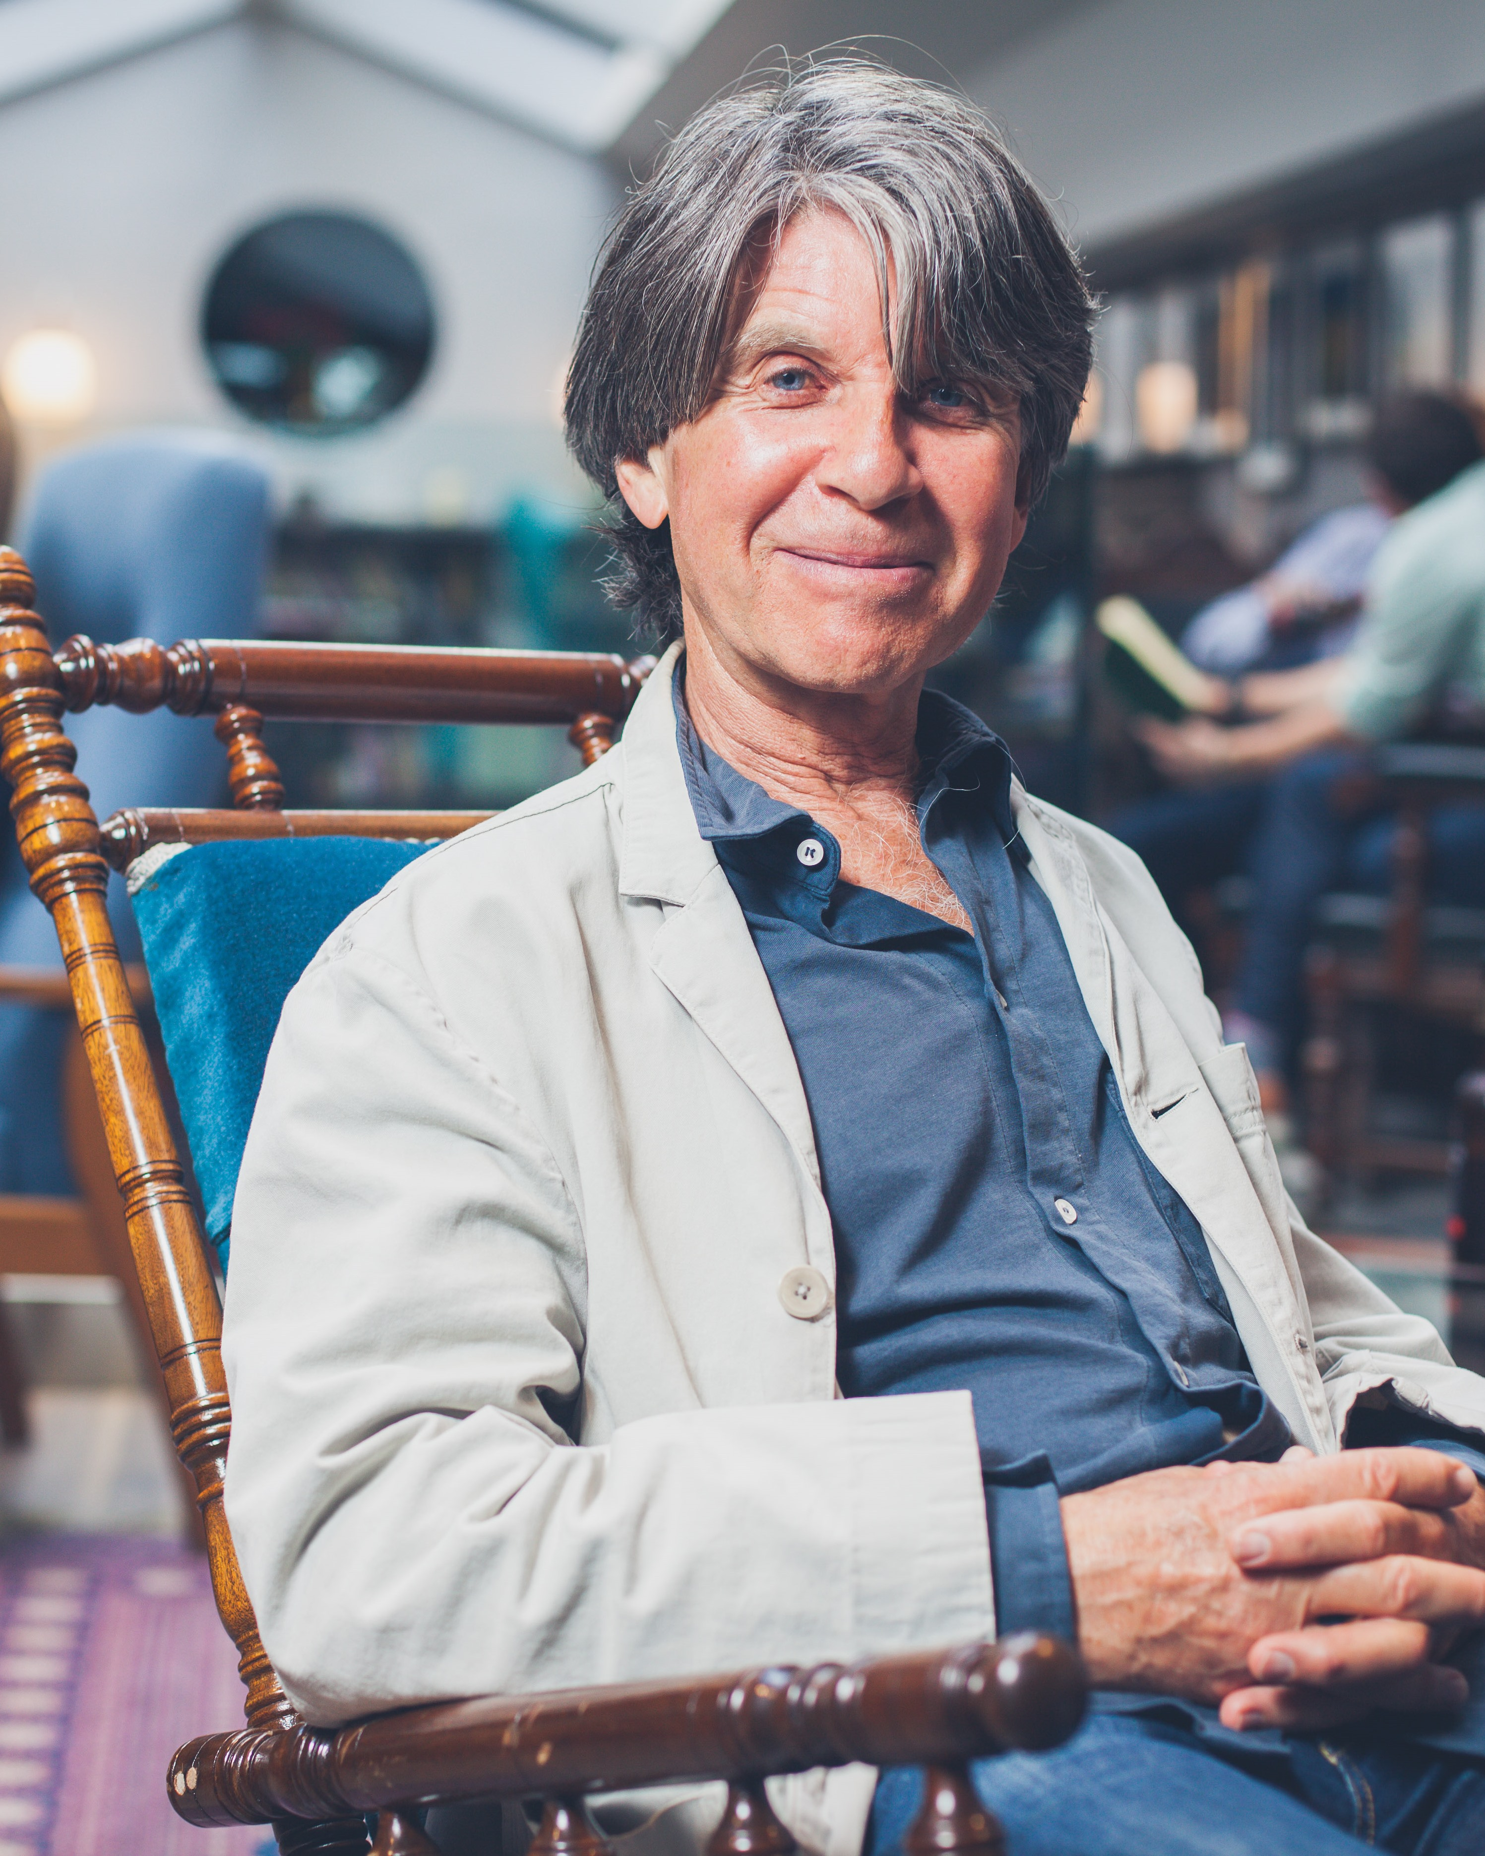
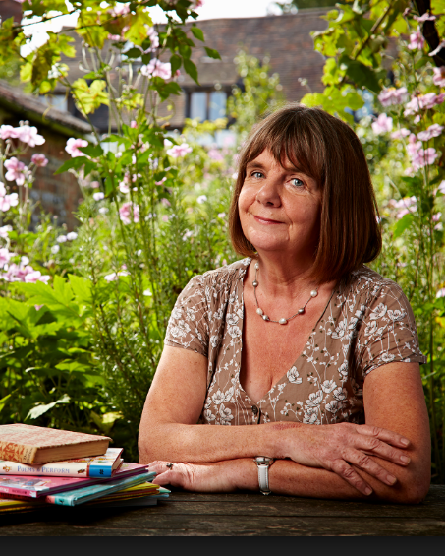
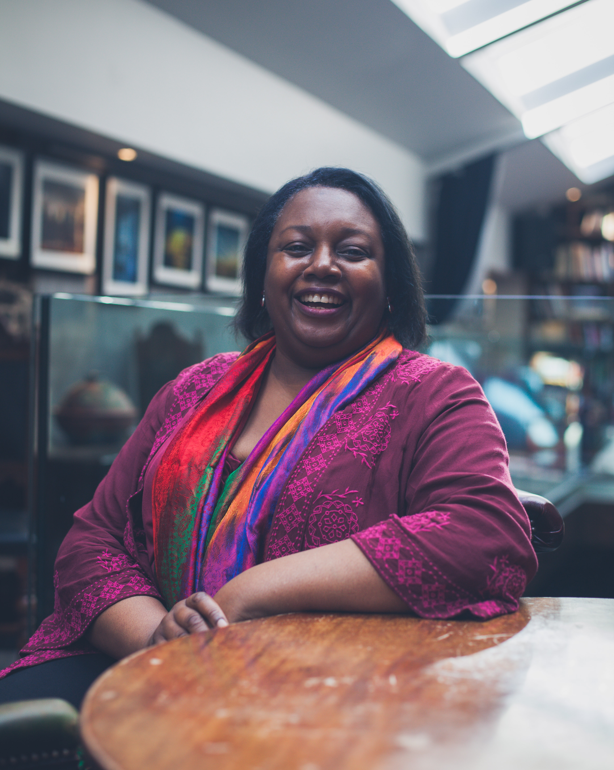
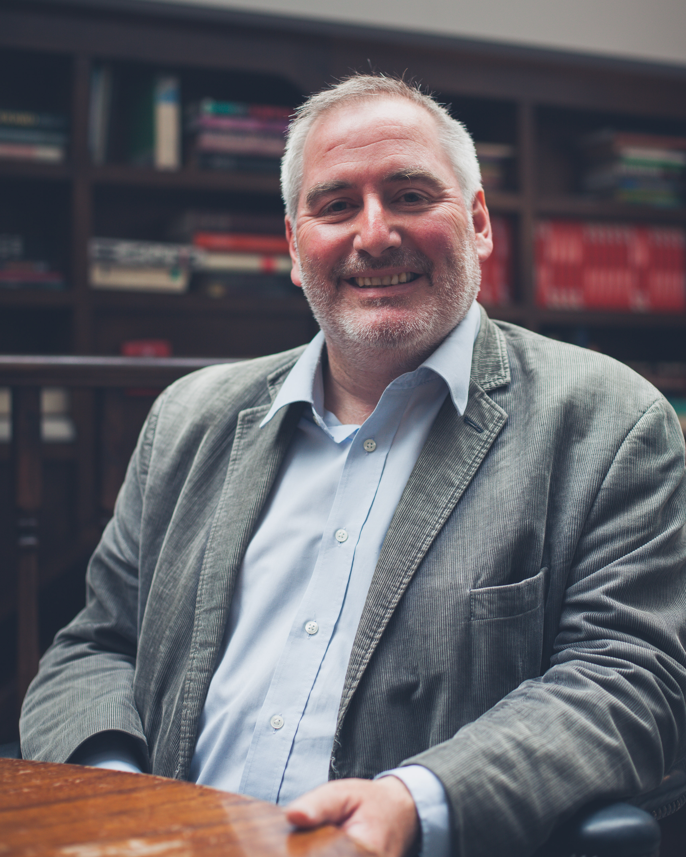

Slide 6
Chris Riddell’s Laureateship announcement n 2015 covered by:
BBC One Breakfast Show, Newsround, BBC Radio 2: The Chris Evans Show, Channel 5 News, Front Row, World Service, BBC One News at Six The Independent, The Guardian, The Times, The Sun, I, Daily Mail

Slide 7
On the day of the announcement… #ChildrensLaureate reach on Twitter = 16.1 million
#1 trend in the UK

Slide 8
The Children’s Laureate: getting books and reading into the headlines and on the national agenda from the announcement onwards!

Slide 9
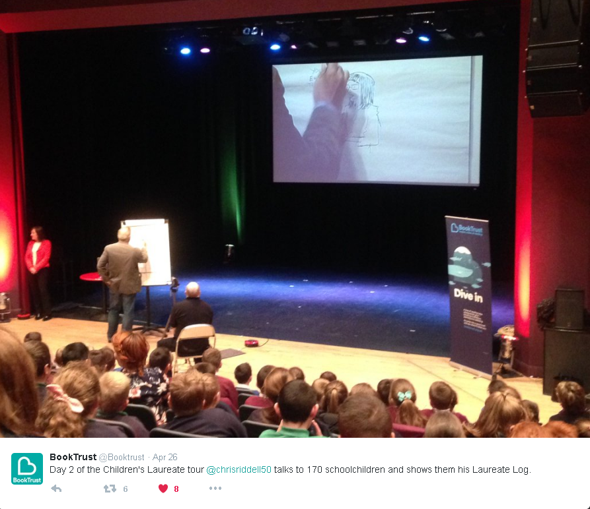

Slide 10
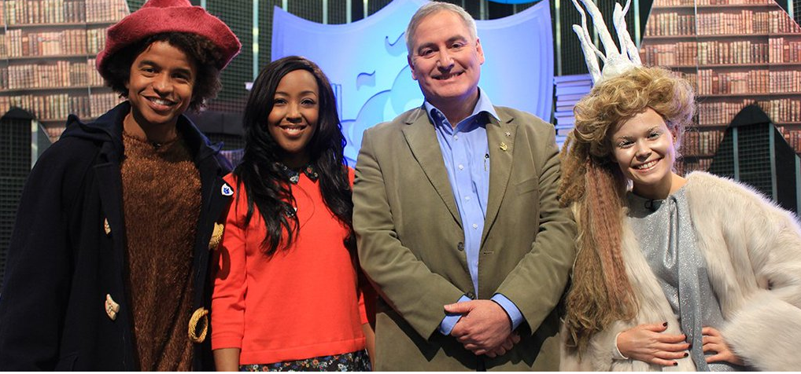
Chris’s appearance on World Book Day gave Blue Peter their third highest viewing figures of the year!

Slide 11
The Laureateship inspires children to read more books. At every one of the Laureate events, a proportion of the audience will be inspired to go home and pick up a book.

Slide 12
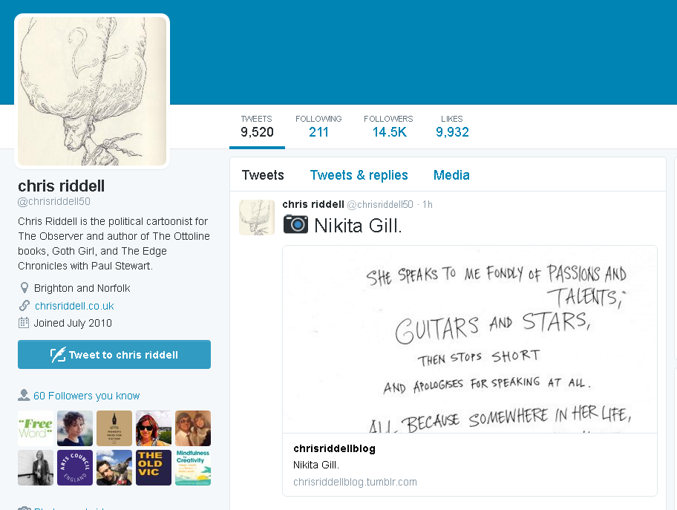
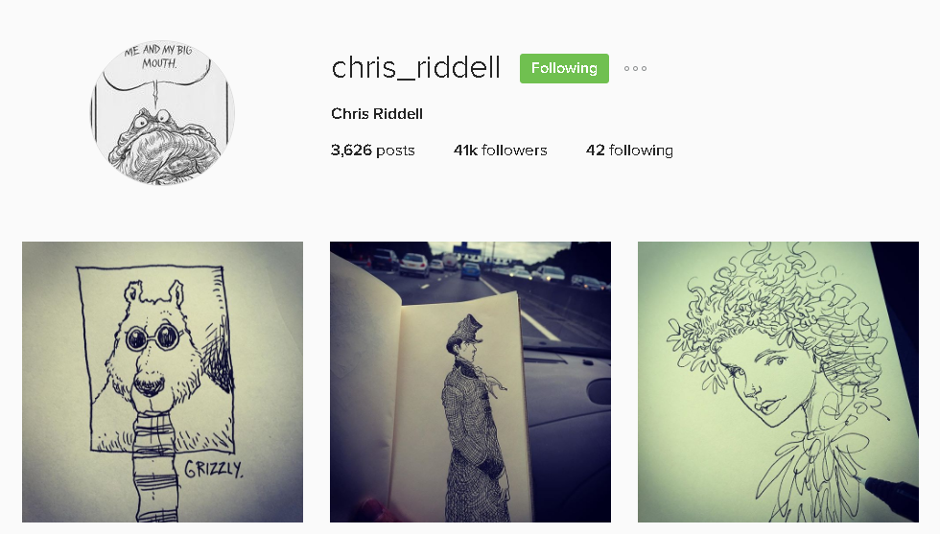
Chris will engage with over 15,000 children at his events plus reaching over 80,000 people through his social media channels and website and that’s just direct contact…

Slide 13
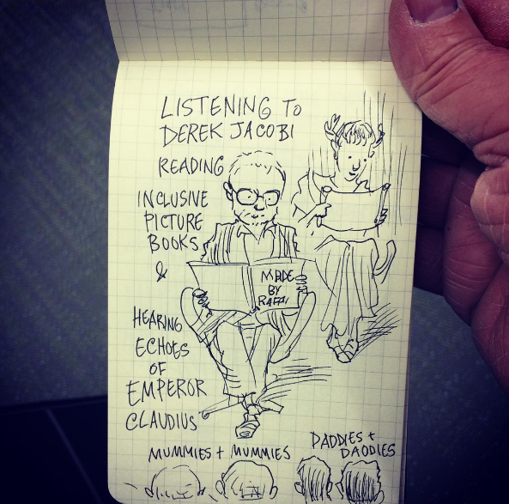
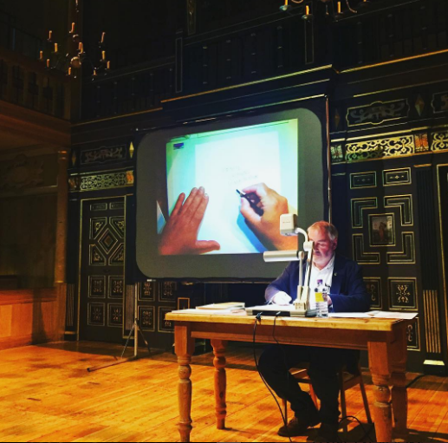
The Laureate engages with a diverse audience . This year Chris has:
Been involved with two publications by Amnesty
Attended many festivals including the Museum of London’s LGBT families day
Performed in theatres, galleries and museums as well as community venues across the UK

Slide 14
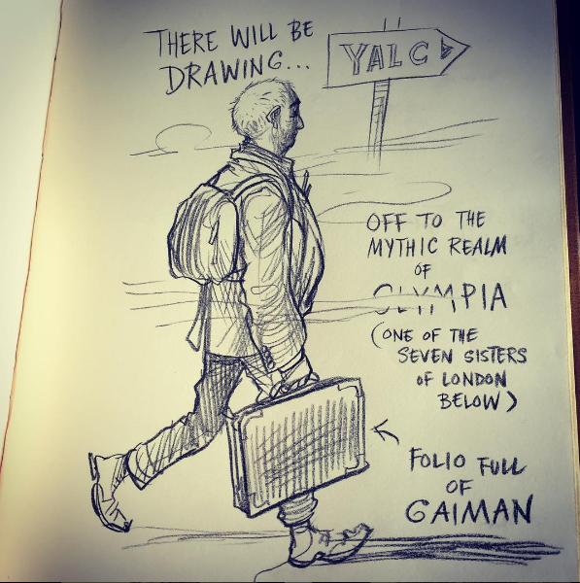
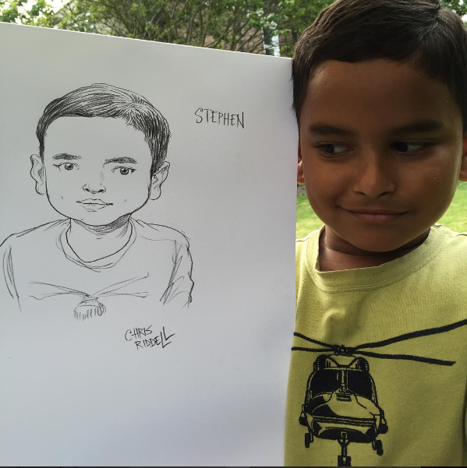
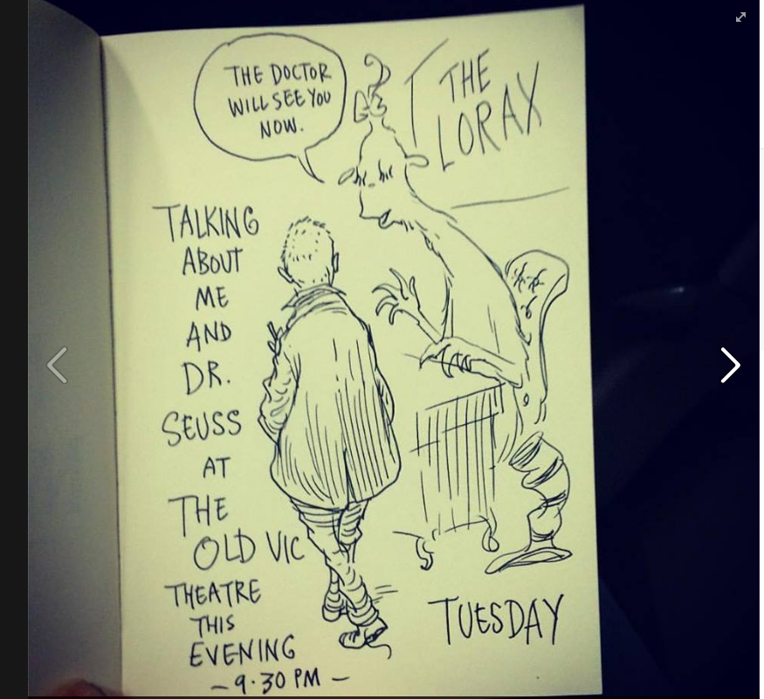
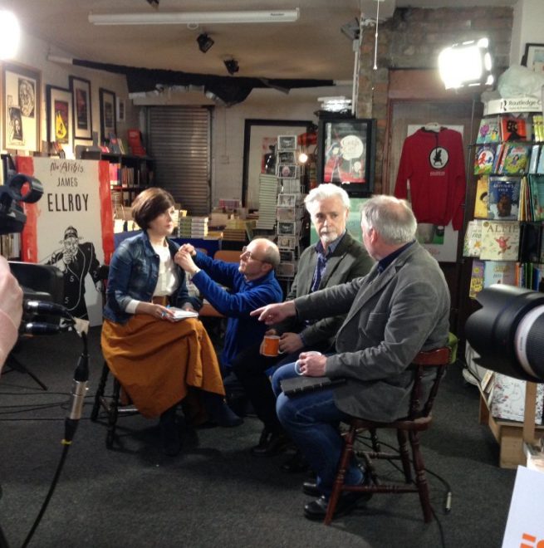
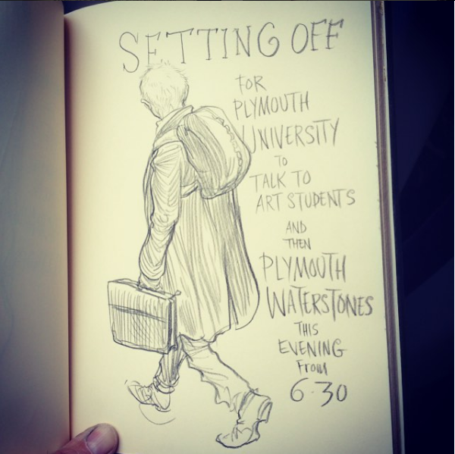
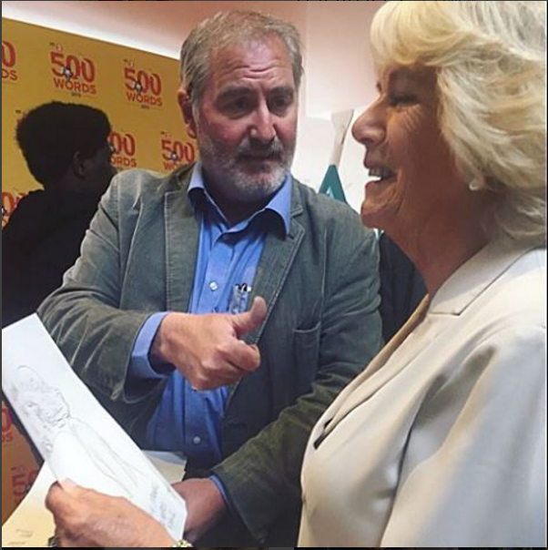

Slide 15
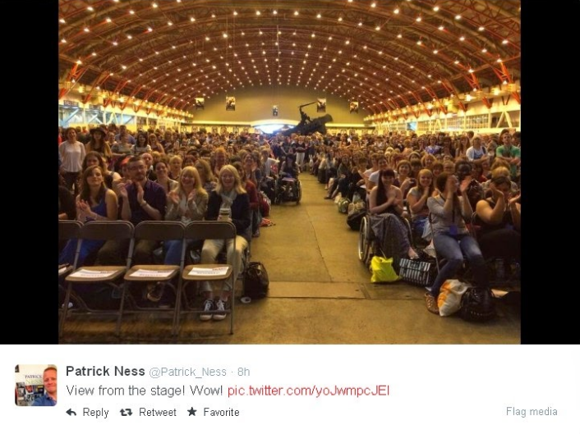
The Laureates’ special projects go on to become a part of the literature calendar - including Malorie Blackman’s Young Adult Literature Convention (YALC)

Slide 16
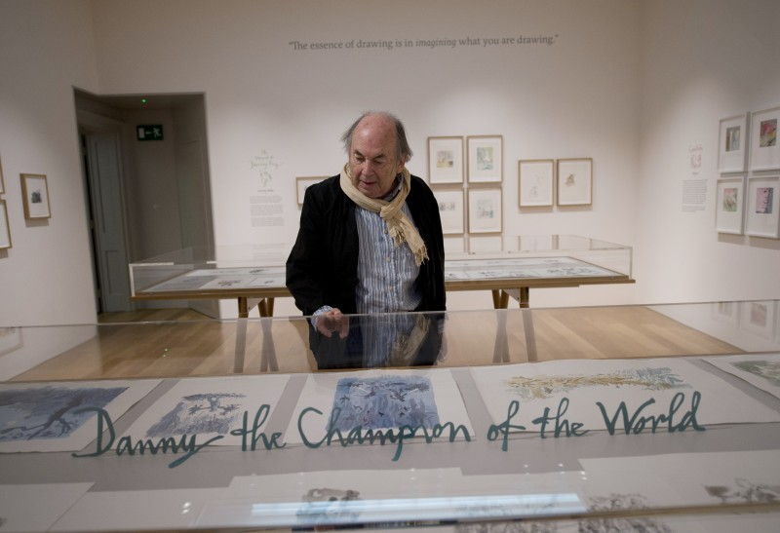
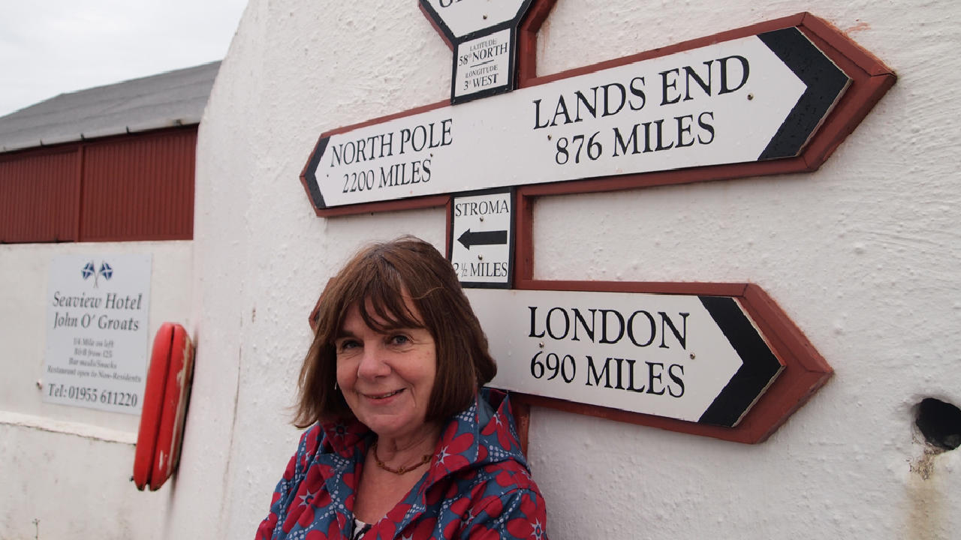
Permanent mark: Quentin Blake’s House of Illustration
Reaching into all regions: Julia Donaldson’s Land’s End to John O’Groats Tour – 90% of libraries said the tour raised their profile.

Slide 17
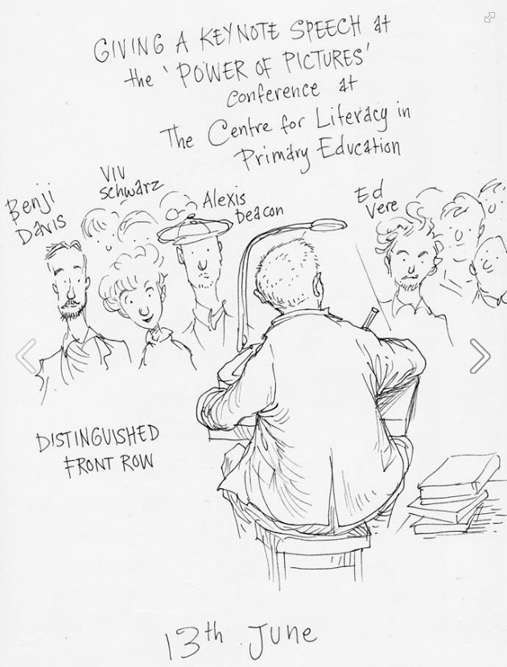
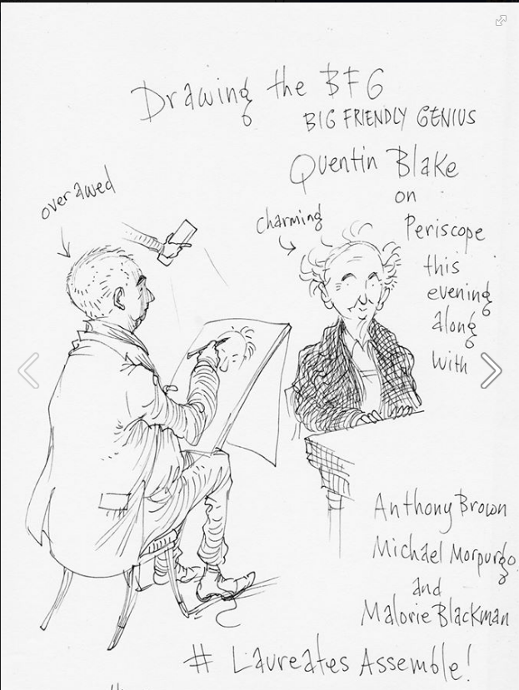
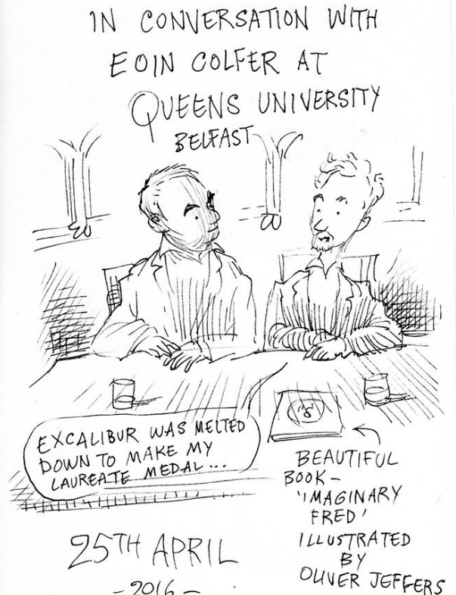
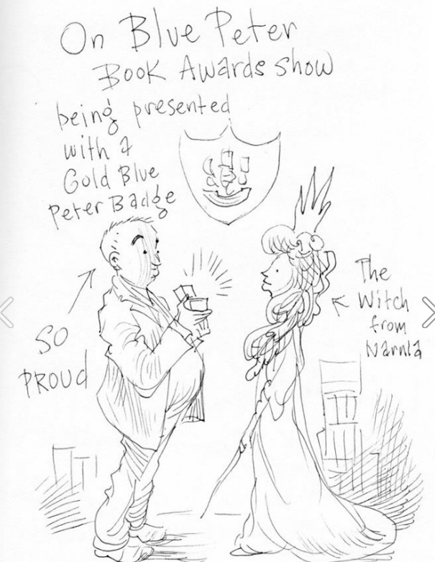
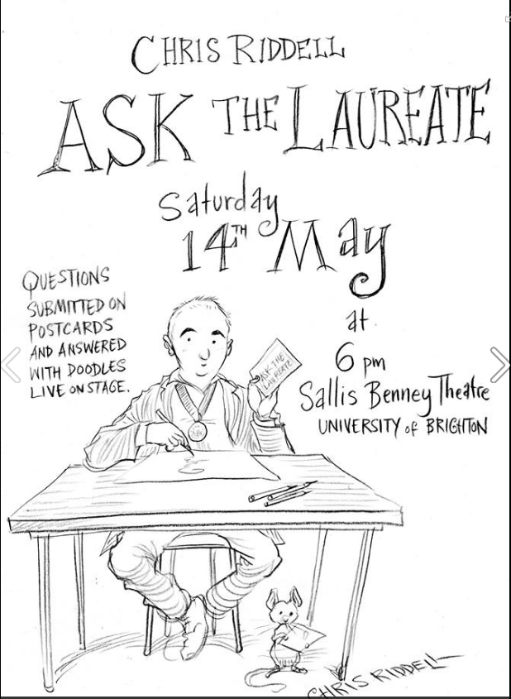
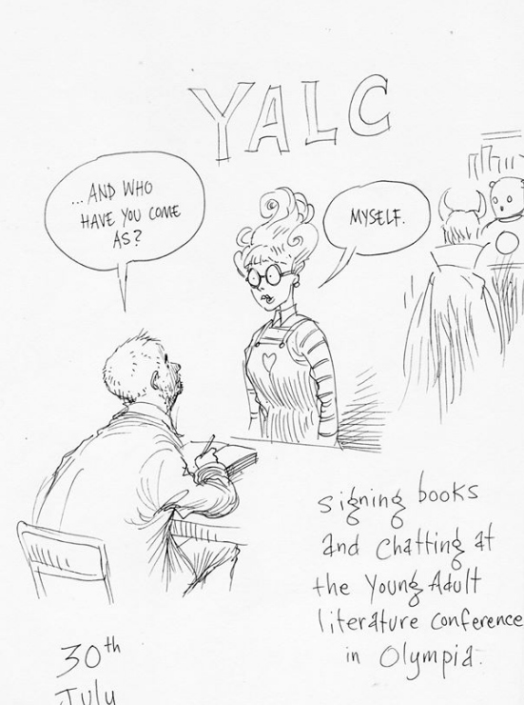
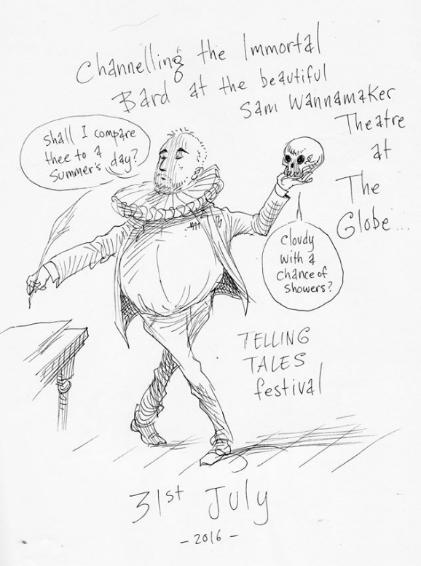
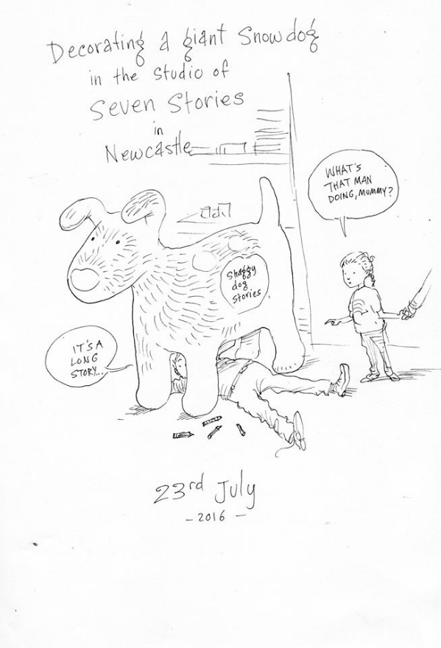
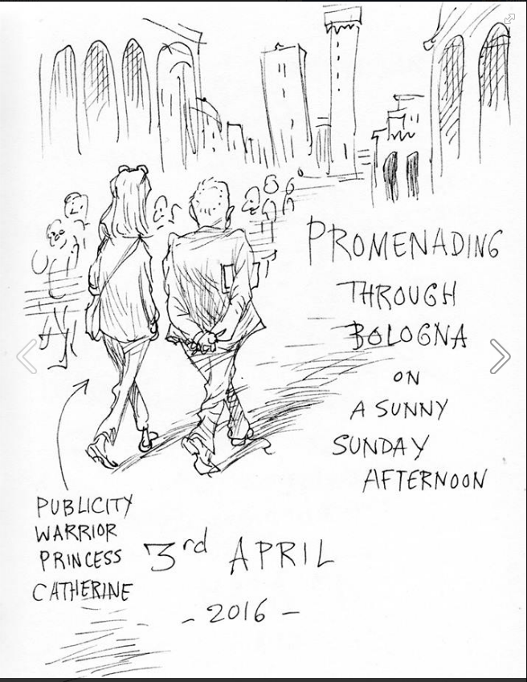
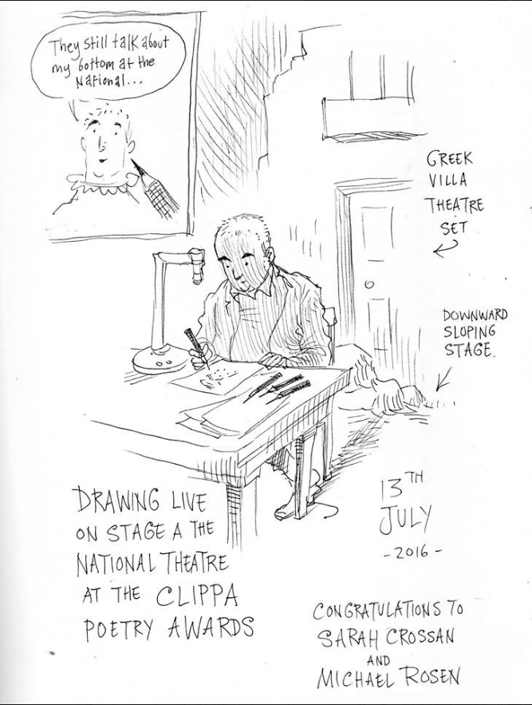
Chris’s legacy is to engage with his audience every day through his Laureate Log

Slide 18
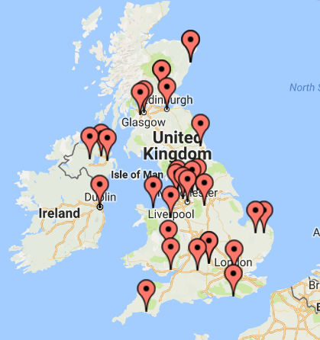
Chris is due to reach all corners of the UK by the end of his term at almost 130 different events:

Slide 19
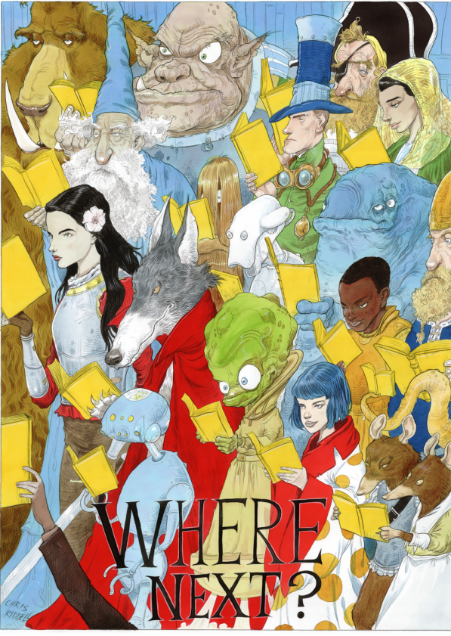
Chris Riddell’s school libraries poster goes to every school in the country.

Slide 20
‘The wonderful thing about the role is that each children’s laureate can make it their own. I suspect that after all these years, Booktrust could pretty much cope with anything a laureate could throw at them!’ Malorie Blackman All laureates report a stimulus to their own creativity during their term. Michael Morpurgo described his laureateship as ‘the most intense and productive period of my life’

Slide 21
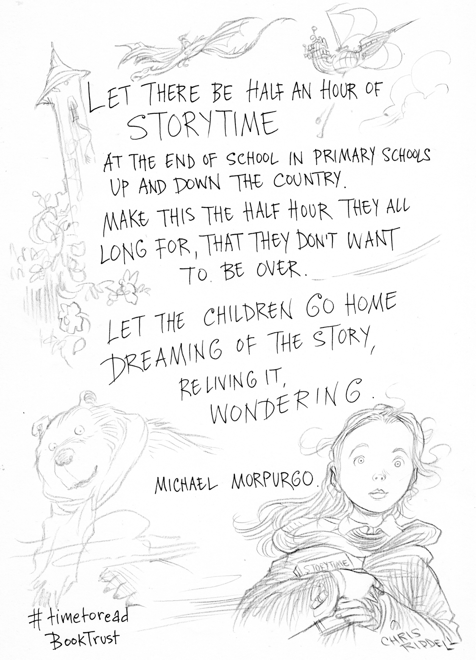
Children’s laureates working together: impact to help more children read for pleasure!

Slide 22
Laureate timeline
October Open nominations to arts and literature partners
November Deadline for Nominations
February Judging meeting
March Successful Laureate informed
June 7 Announcement

Slide 23
