Slide 1


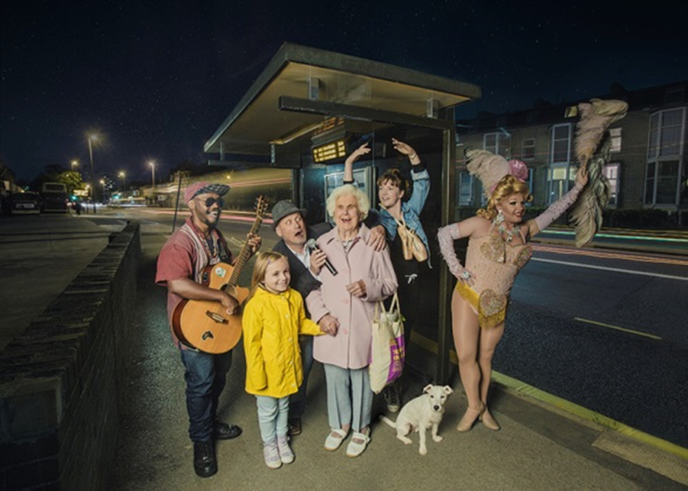

Slide 2

We will cover:
Technical Staff
Project Coordinator
Marketing Lead
Programme:
Family
Music
Cabaret
TODAY’S MEETING

Slide 3
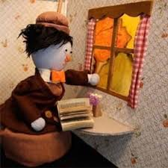
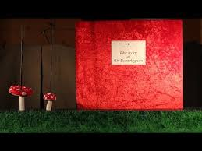
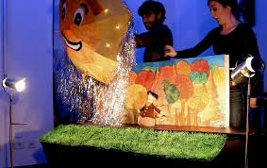
Shake Shake Theatre – The Story Of Mr B
This surprise filled puppet show, set in a giant pop-up book, tells the story of Mr Bumblegrum. As we turn from one page to the next, this grumbling character goes on a colourful and moving journey through the seasons. Nature tries to cheer him up with tenderness and humour, trees play, the sun swirls, mushrooms laugh and snow falls.
As spring arrives Mr Bumblegrum realises he wants friendship again. Can you help blow the stormy clouds away? Will you be his friend? Delighting audiences young and old. Performed with puppets, animated objects and shadow theatre. 3+

Slide 4
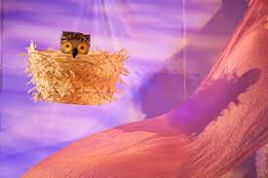
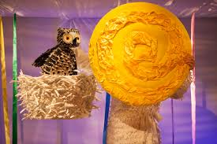
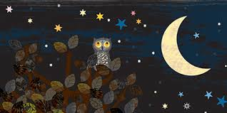
Little Angel – Wow! Said the Owl
Explore the wow-world of colours with this curious little owl who is determined to stay awake to see what day light brings.
From the warm pink glow of dawn through to a day filled with the bright colours of green leaves, blue sky, grey clouds and, finally, a stunning rainbow — ‘WOW!’. But despite the beauty of the daytime world, the little owl decides that the night-time stars are the most beautiful of all.

Slide 5

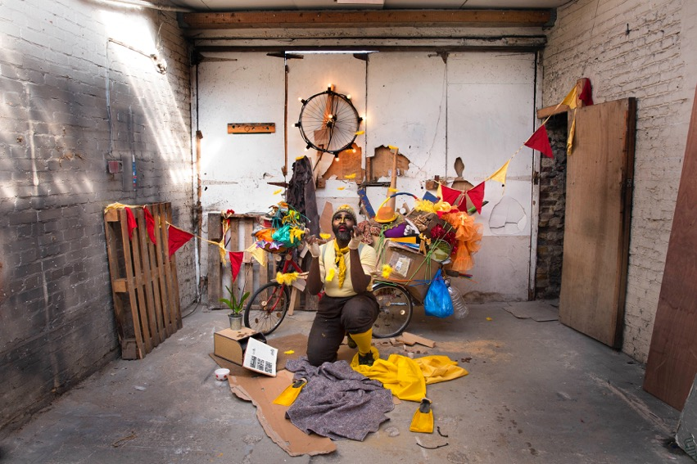
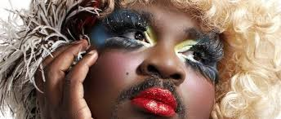
Le Gatueax Chocolat - Duckie
Walking a little differently. Sounding a bit strange. Duckie knows what it's like to not fit the mould.
Critically acclaimed cabaret star Le Gateau Chocolat is breaking out of his shell and re-imagining a childhood favourite, The Ugly Duckling, in his new work Duckie.
A classic tale of identity and belonging. Duckie is set in an animal circus. We join him on an adventure of self-discovery. Peppered with dress ups, songs, Disney references and at it’s core, an important message of acceptance. Duckie is a show for all ages, the entire family, children and the young at heart. Quack! Quack! 3+

Slide 6
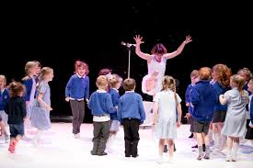
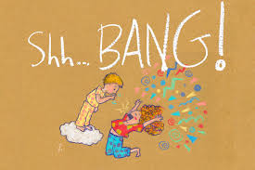
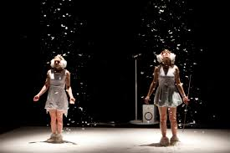
Peut-etre Theatre – Shh…Bang!
A delicate dance-theatre performance for children and their adults, playfully exploring silence and noise.
Two characters on a journey through boings, wooshes, tick tocks and cacophony. on their journey they also manage to listen to the silence. They learn to feel the noise and see the sounds around them.
The research and development for the show was in collaboration with Great Ormond Street Hospital and the Institute of Acoustics and Vibrations in Southampton University. 3+

Slide 7
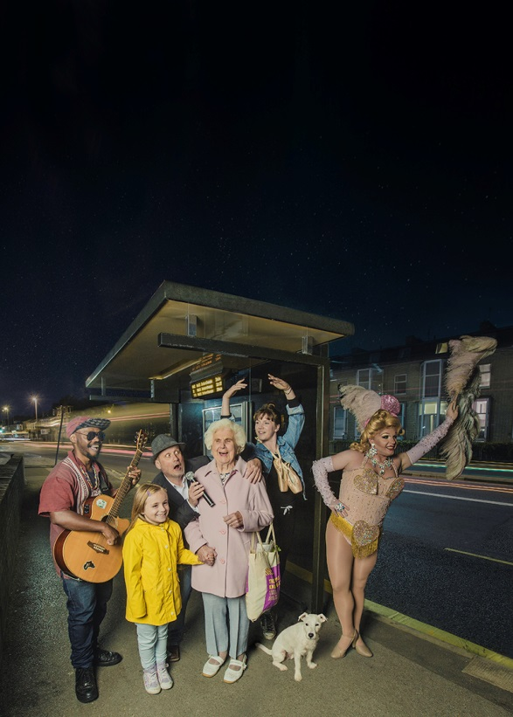

DANCE

Slide 8
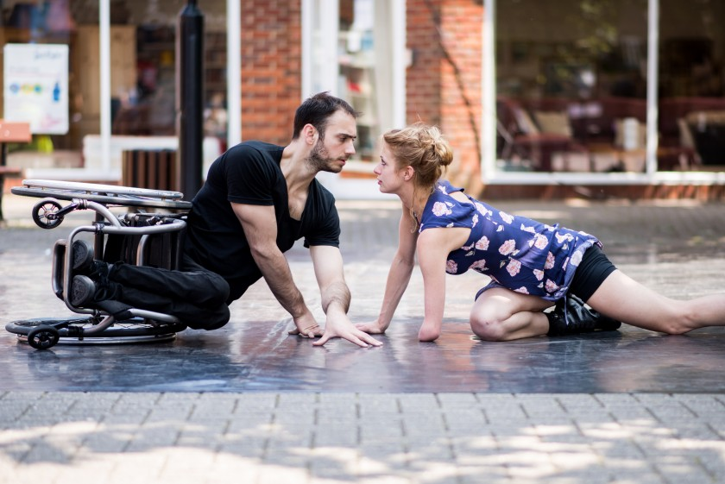
Candoco – You And I Know – By Arlene Phillips
From the ballroom to the Brit Awards, Arlene Phillips has been a trailblazer in choreographing for popular dance genres for over 40 years. Candoco Dance Company, the company of disabled and non-disabled dancers, is delighted to have commissioned Phillips to collaborate with Candoco dancers, Joel Brown and Laura Patay, in a new romantic duet told through a series of vignettes set across time.
Danced with passion and sensitivity to a collection of pop songs, Joel and Laura offer audiences a potent and emotive exploration of how we fall in and out of love over and over again, often with the same person.

Slide 9
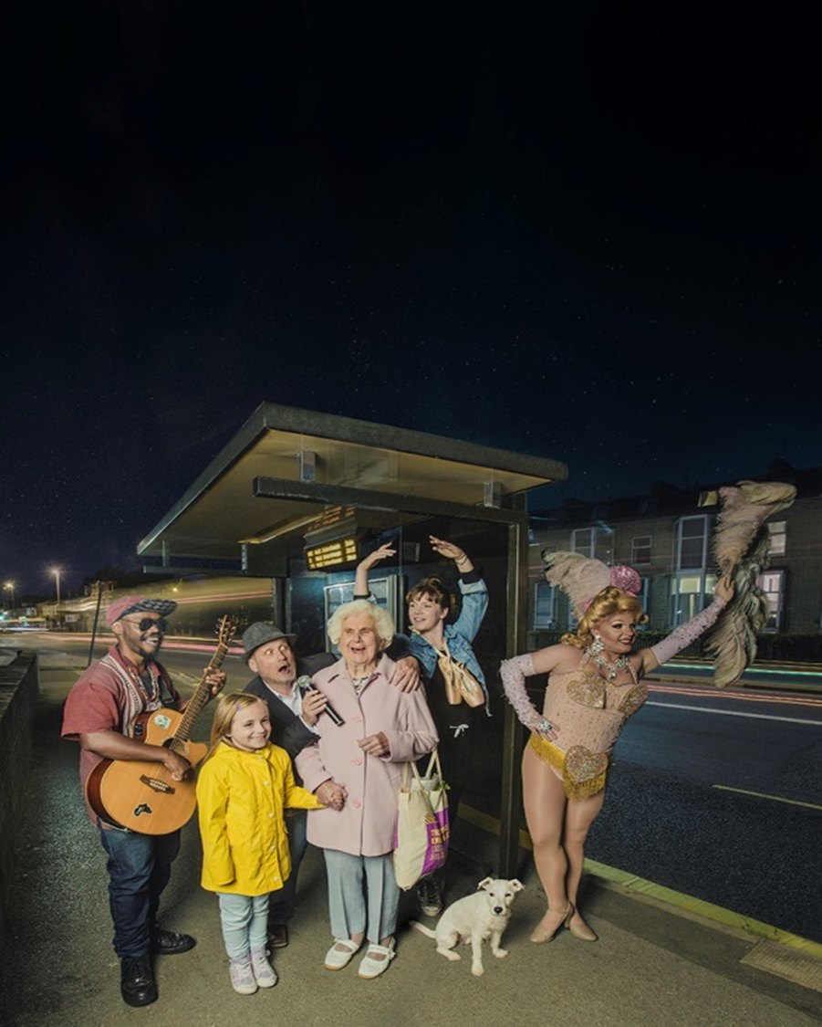

MUSIC

Slide 10
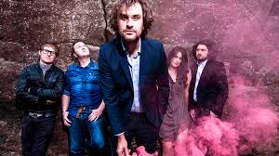
Reverend & The Makers
Jon McClure brought the band together in 2005, Sheffield based they soon had the interest of major record labels wanting them to make an ‘Arctic Monkeys’ type album but the band declined offers to do everything their own way.
The band were selling out gigs and toured with Artic Monkeys in 2006. They speak for the people, have a strong sense of identity and have stayed truth to themselves.
In 2008 they released State of Things, undertook a UK tour, played Glastonbury, Carling Festival, supported Red Hot Chilli Peppers and toured to Australia.
They continue to tour and release new work, Jon is touring an acoustic set and regularly performs secret gigs.

Slide 11

THEATRE

Slide 12
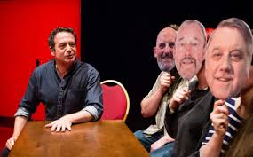
Mark Thomas – Red Shed
Multi award-winning comic/activist Mark Thomas performed his first gigs in The Red Shed in Wakefield, a 47-foot-long wooden hut that doubles up as a Labour Club. Three decades later he returns to celebrate its 50th birthday, entwining the story of his political coming of age with the tale of the people who inspired him. The struggle for hope and survival in a shed, a story of strikes, fights, dinner ladies and beer; friendship, love, memory and above all belief. Theatre, stand-up, journalism, activism and a small amount of help from the audience. 14+

Slide 13
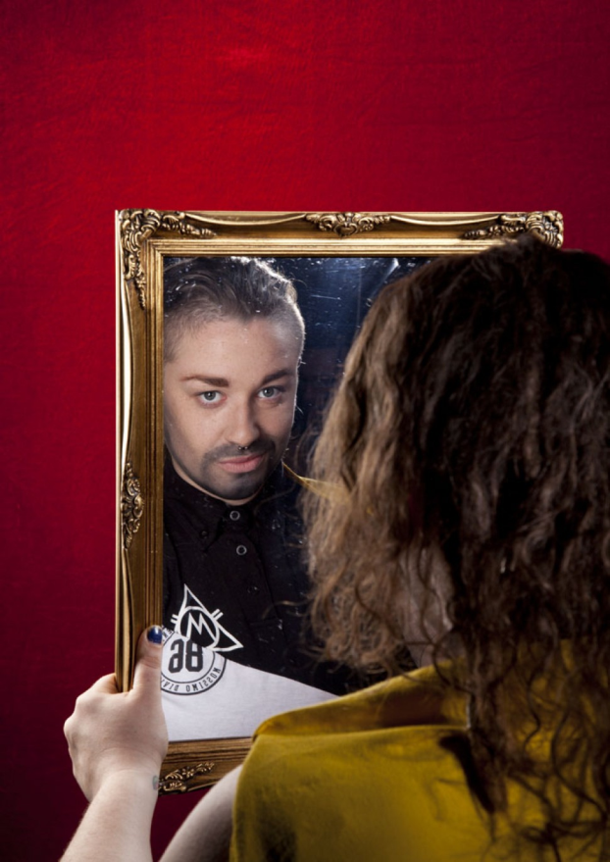
Milk Presents - JOAN
Put your drinks down and your hands together, all the way from Domremy in France (via Soho and 600 years) it’s JOAN!
An earthy story of courage, conviction and hope, this is Joan of Arc - quite possibly the world's first drag king. Packed with guts, heart and some well placed couscous, JOAN fuses lyrical new writing with quick wit and cabaret prowess.
Performed by drag king champion Lucy Jane Parkinson, aka LoUis CYfer ('a marvel to behold' Broadway Baby), and brought together by the ever-probing and playfully anarchic Milk Presents ('Every minute spent with Milk Presents is a gift' British Theatre Guide)
So pull up a pew, or indeed a bar stool, for this fearless new play about what it means to stand out, stand up and stand alone.

Slide 14


Next Meeting

Slide 15
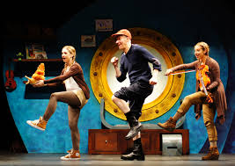
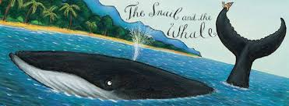
Tall Stories – The Snail and The Whale
Join a tiny snail on her trip round the world in Tall Stories’ magical, musical adaptation of the fantastic picture book by Julia Donaldson and Axel Scheffler.
Longing to see the world, a tiny snail hitches a lift on the tail of a humpback whale. Together they go on an amazing adventure - but when the whale gets beached, how will the snail save him? Follow the tiny snail’s exciting journey, as seen through the eyes of an adventurous young girl and her seafaring father...
Storytelling, live music and lots of laughs, in a show for everyone aged 4 and up.

Slide 16
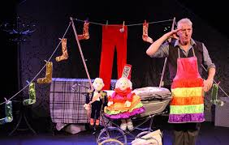
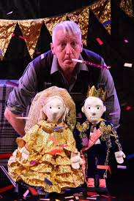
Krazy Kat – Cinder Ella
“Stuck in a tower, hour after hour” she sings to herself. What would you do? Join us for a tall tale of princes and pigtails, of potions and pizzas, as Rapunzel begins to find out there is more to life than just the visits from her Witch…
Multi award-winning Artistic Director Kinny Gardner creates a whole new take on this classic tale, with beautiful puppets, magical transformations, and fully integrated Sign Language. Showcasing Krazy Kat’s mastery of visual storytelling, and bristling with creativity and humour, this is an ingenious and imaginative theatre show with big laughs!
For 3-7 years and their families, the show lasts 50 minutes and is suitable for both deaf and hearing audiences.

Slide 17
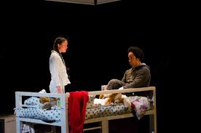
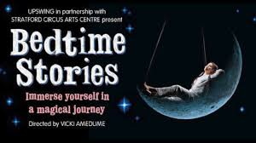
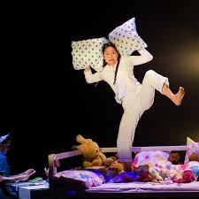
Upswing
Bedtime Stories encourages us to take time out from our busy lives and explore the importance of the connection between carers and children, achieving a work-life balance and managing priorities within the family. Suitable for everyone ages 3+, the show is a transporting and highly immersive experience, that combines awe-inspiring aerial feats with storytelling, physical theatre, dance and stunning projections. Upon entering the theatre space, audiences are invited to relax and feel at home in the environment of a child's bedroom and view the show from the comfort of family beds, tucked up and surrounded by cushions, teddies and blankets.

Slide 18
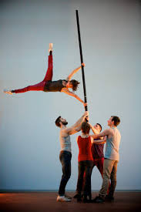
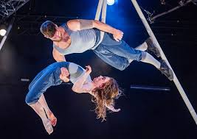
Okhams Razor – Tipping Point
Ockham’s Razor return with their new full length show. Tipping Point is set in the round; the audience drawn in close, as the action veers from catastrophe to mastery. The five performers, enclosed within the circle of the stage, transform simple 5 metre metal poles into a rich landscape of images.
Poles are balanced on fingertips, hung from the roof, lashed, climbed, swung from and walked along, they become forests, cross roads and pendulums. The performers balance, climb and cling to this teetering world, supporting each other as they wrestle with the moment when things begin to shift. They must decide whether to rail against the chaos, struggling to exert order on a disordered world, or ride it out, allowing life to tilt towards the tipping point. 6+

