Slide 1
PAPER CITY!
October 2016

Slide 2
PAPER
In a world of transient communication and fleeting digital memories, paper offers texture and feeling, weight and sensation. Paper reminds us that skill, craft, and creativity couples with something as naturally beautiful as paper can leave a lasting and and powerful impression

Slide 3
CITY
…there is something in Hull which encourages an imaginative response to corners and details, sights and sounds, the effects of light and seasons.

Slide 4
VISION
Places and spaces transformed through the imagination of artists, celebrating the power of colour and the beauty of paper
10 days which champion the ‘freedom to play’ and challenge people’s perceptions and expectations
10 artists invited by G F Smith to join their love affair with paper and add their voice to UK’s City of Culture, Hull 2017

Slide 5
WHO?
10 artists/creatives drawn from contemporary fine art, craft, design, architecture
Selected on basis of quality, profile, interest in exploring material qualities and enjoyment of colour
GF Smith participate – The World’s Favourite Colour

Slide 6
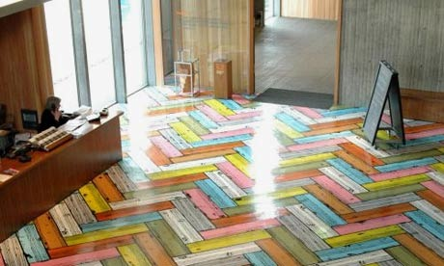
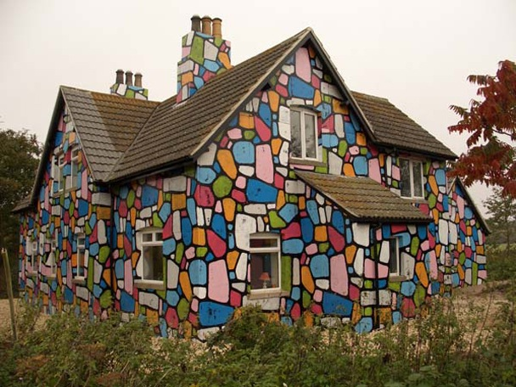
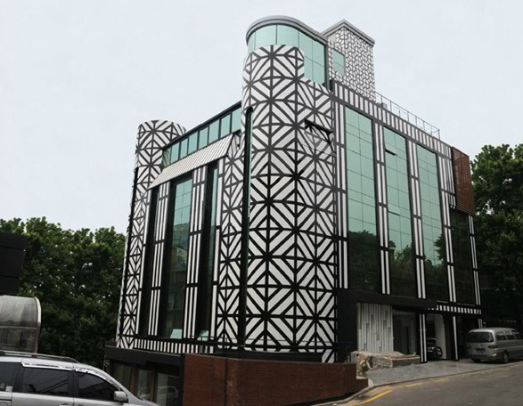
Richard Woods

Slide 7
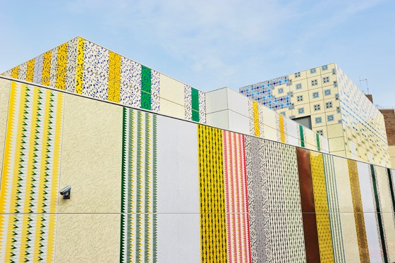
Jacqui Poncelet

Slide 8
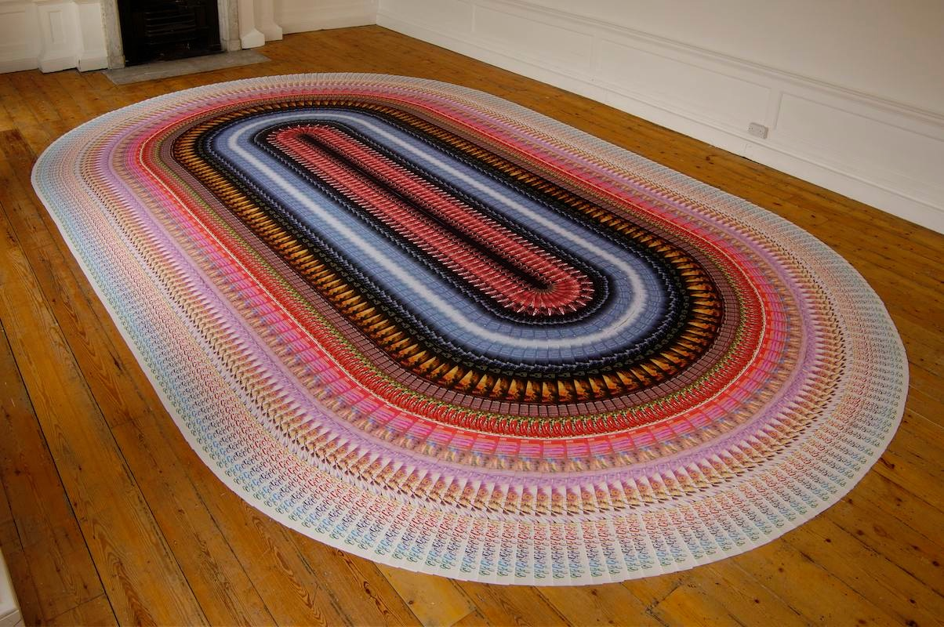
Leo Fitzmaurice

Slide 9
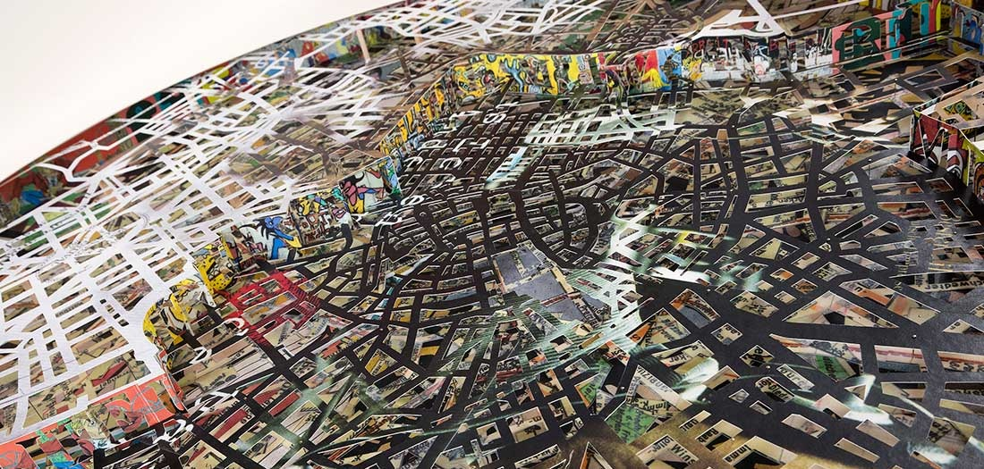
Matthew Picton

Slide 10
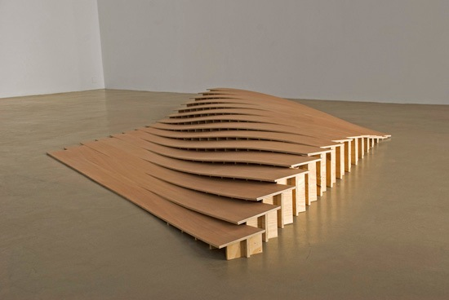
Joanna Sands

Slide 11
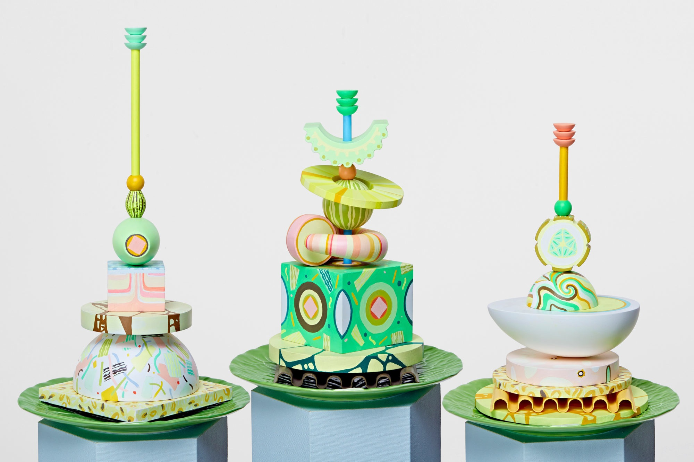
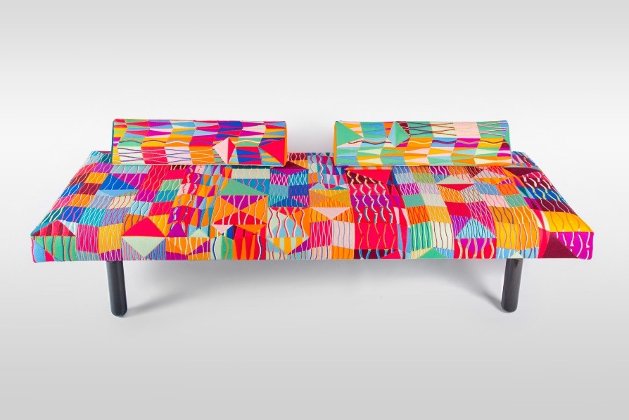
Bethan Laura Wood

Slide 12
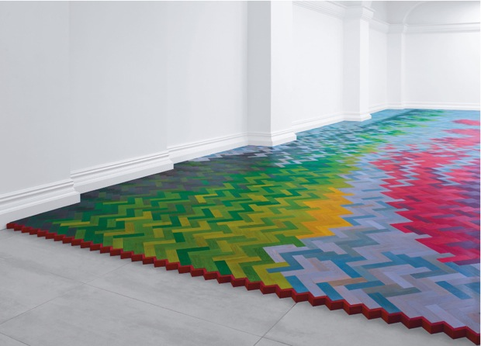
Raw Edges

Slide 13
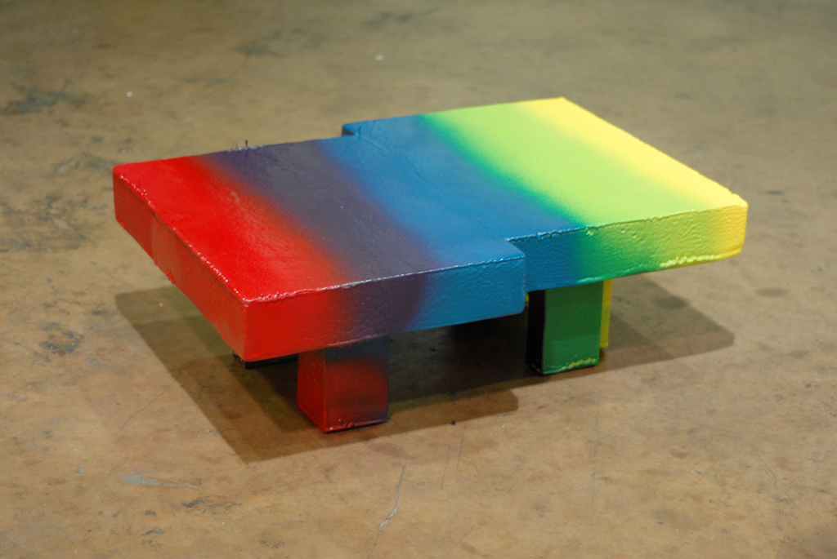
Max Lamb

Slide 14
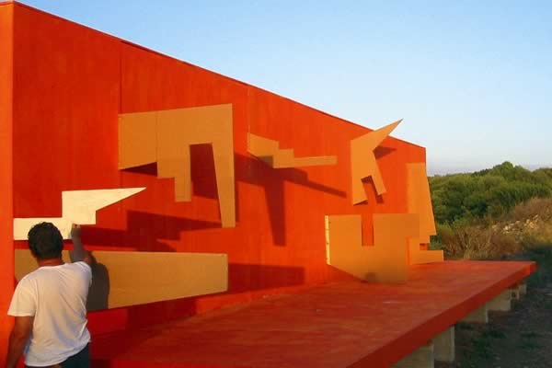
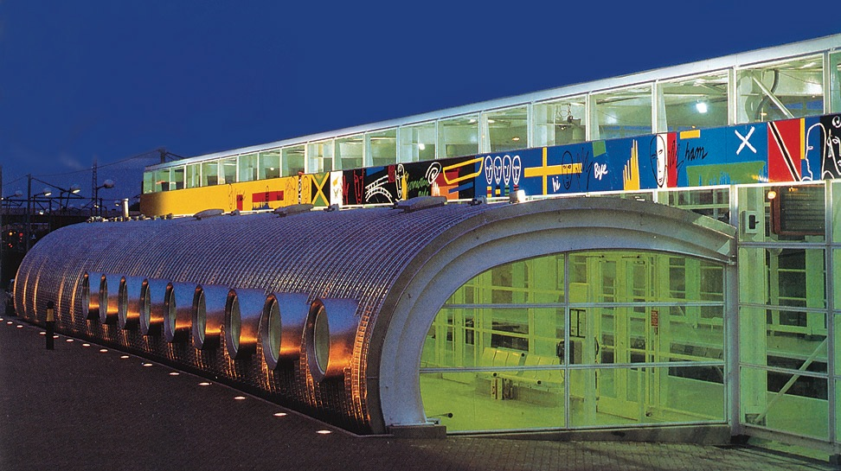
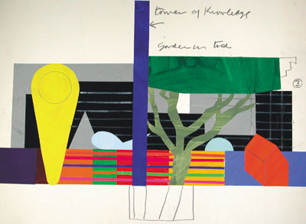
Bruce McLean/Will Alsop

Slide 15
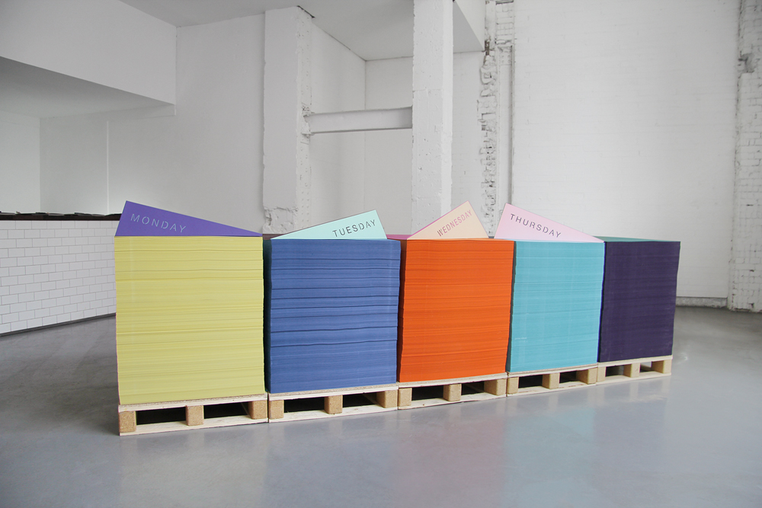
Made Thought

Slide 16
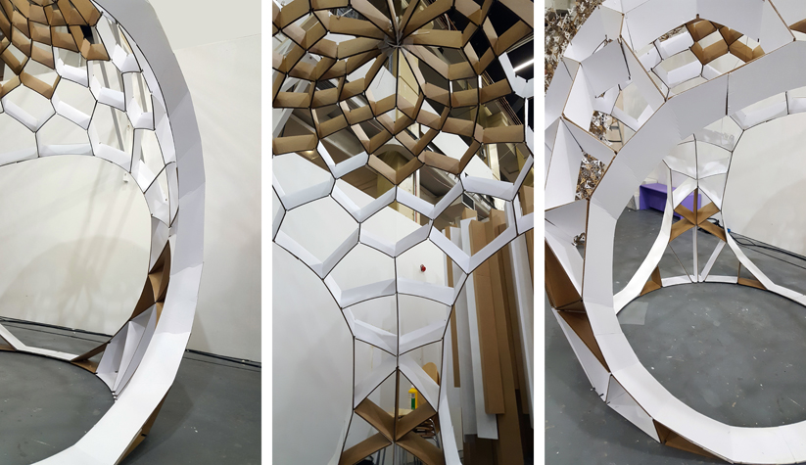
Adam Holloway

Slide 17
WHERE?
Fruit Market -currently focus of public/private regeneration investment programme which will strengthen its unique position in the city as the creative and cultural quarter including a new space for contemporary art
High Street – the commercial heart of the city from its foundation in C13 – C19
Links – safe and accessible pedestrian link High Street/Fruit Market

Slide 18
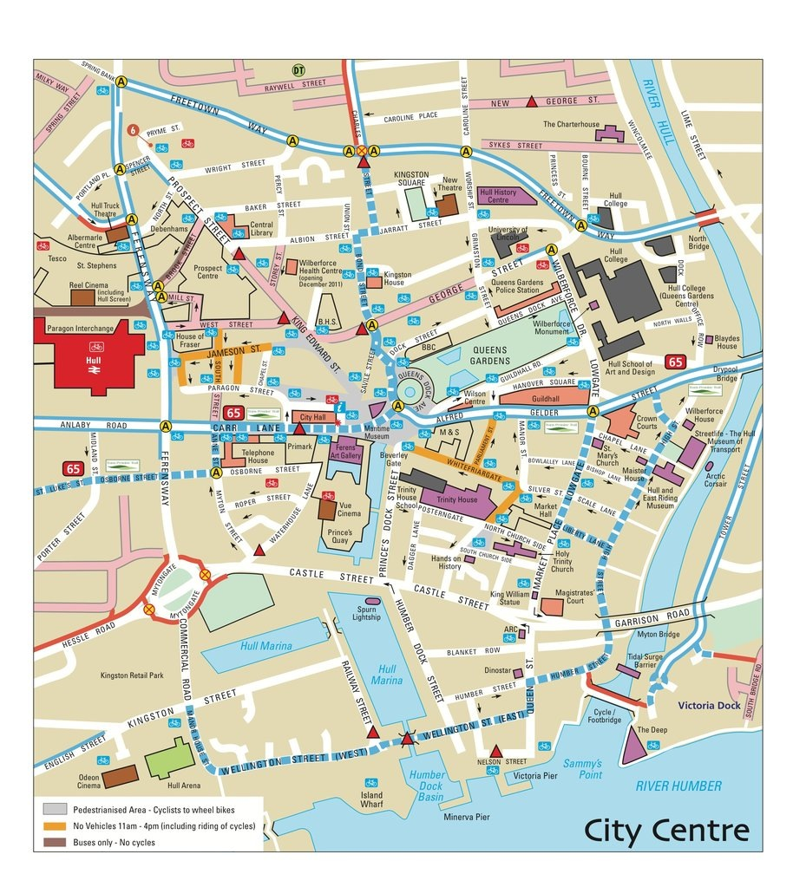

Slide 19
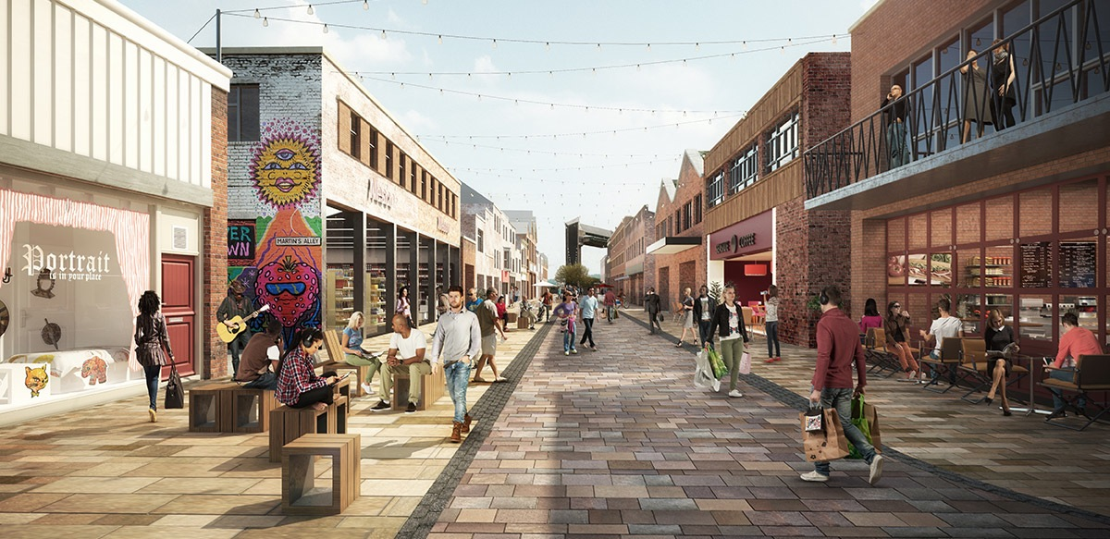

Slide 20
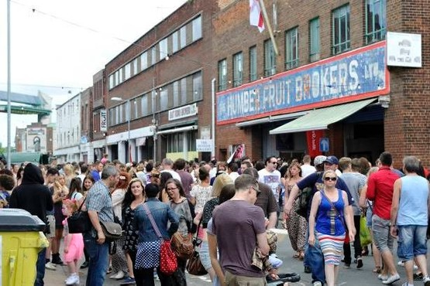
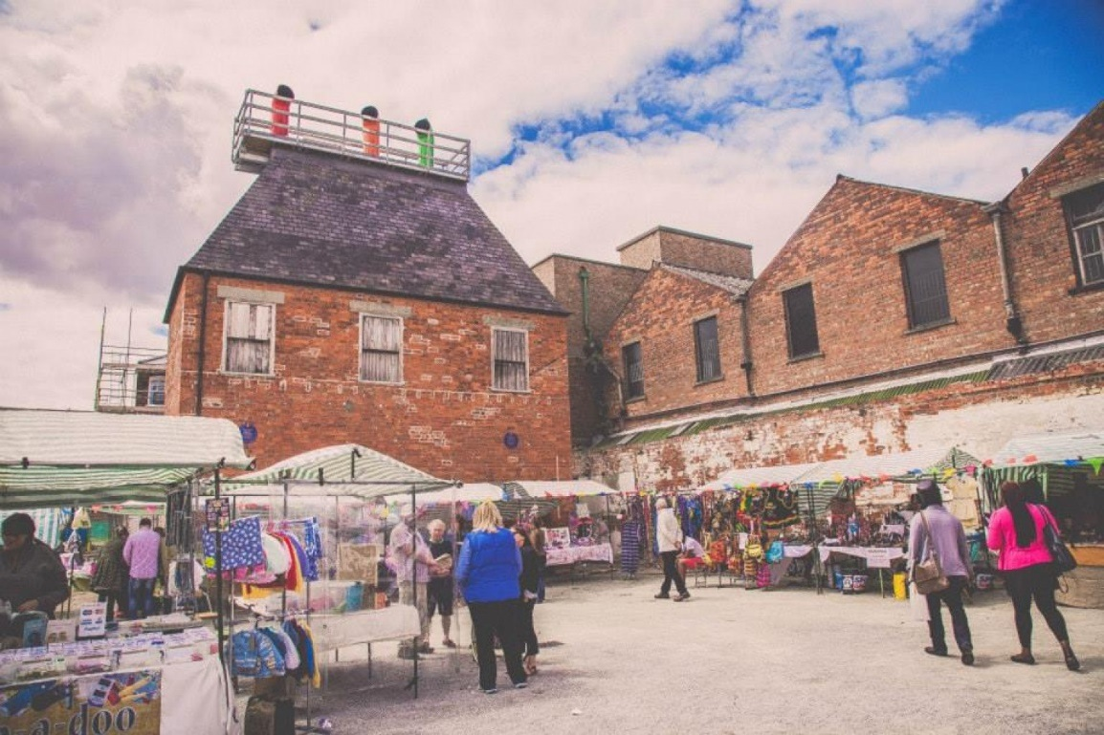

Slide 21
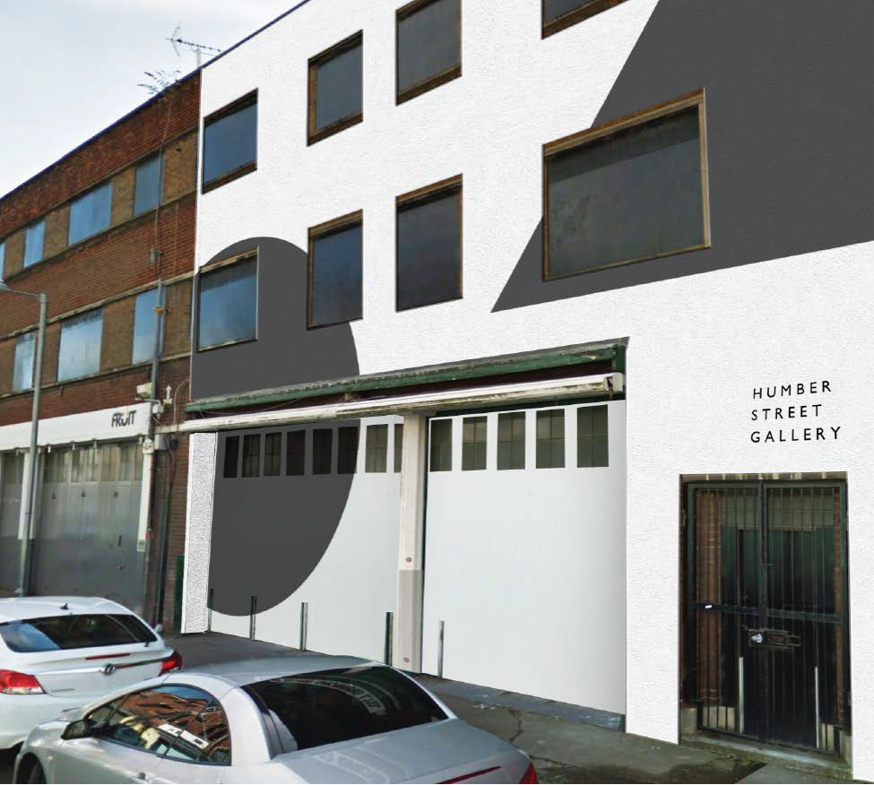

Slide 22
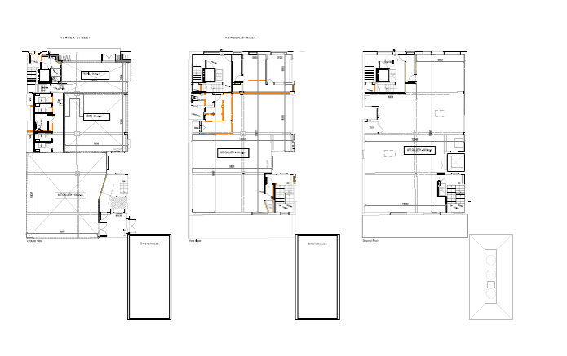

Slide 23
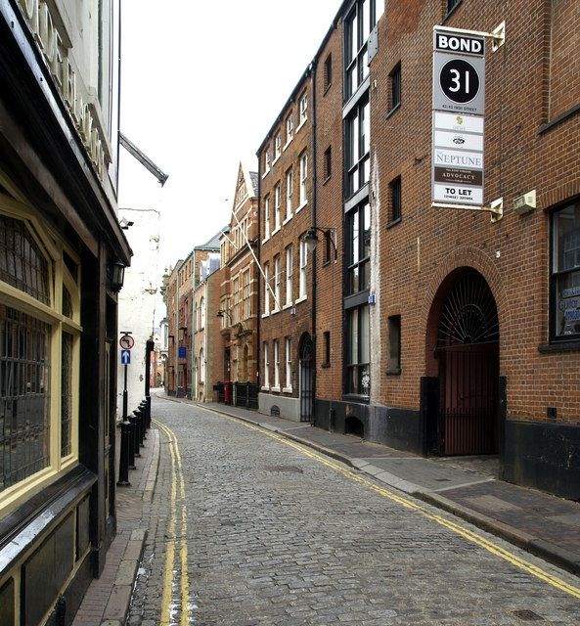
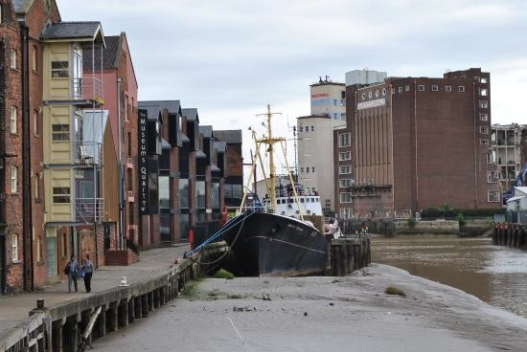

Slide 24
WHEN?
Friday 30th June – Sunday July 9th 2017
Signifies start of Freedom season
Coincides with PRS Foundation’s New Music Biennale (30.06-02.07) – a free festival of contemporary music

Slide 25
PROGRAMME
October 2016 – agree sites, artist list, MOU
November 2016 – invitation to artists
December/January – site visits
February – June – design, making, site preparation
June 23 - installation begins
Thurs Jun 29 – Preview
Fri Jun 30 – Sun Jul 9 Live

Slide 26
Indicative budgets
Per installation:
Artist fee and budget | 10,000 | Includes fees, expenses, materials beyond paper, transport, installation, take down
Initial hosted site visit | 250 | Travel and one night’s stay in Hull
Site costs | 500 | Consents, power, etc
Production management | 1,000 | Allowance for technical/logistic assistance specifically for each installation. H2017 can provide personnel
Marketing/PR | ?
Total | 11,750

Slide 27
MOU/Agreements
Discussion items:
Who contracts artists?
Cash input
Marketing/PR input
In-kind/time input
Suggestions for H2017 – curators; site research and permissions; artist liaison and management; contracts and agreements
Suggestions for GF Smith – materials; artist visit hosting; Made Thought curatorial input

