Slide 1

SUPERMARKET ARTIST TAKEOVER

Slide 2

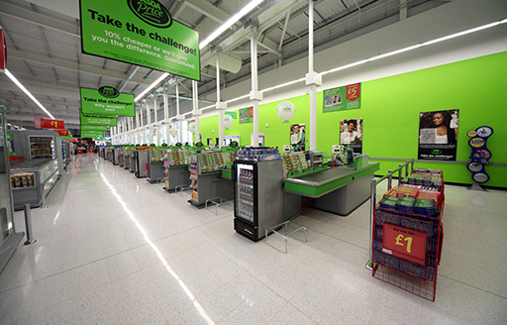

Where to begin?
Visibility
Space
Atmosphere

Slide 3

VISIBILITY
The design of the supermarkets are big, visible and can be spotted for miles around.
Don’t want to remove that visibility but enhance it.
Show the immediate community that something different is happening inside.
Give a great photo shoot moment for the project, with the supermarket lending itself 100% to the artists work.
One idea is to commission the following artist to cover as much of the building as possible to create a stunning spectacle.

Slide 4
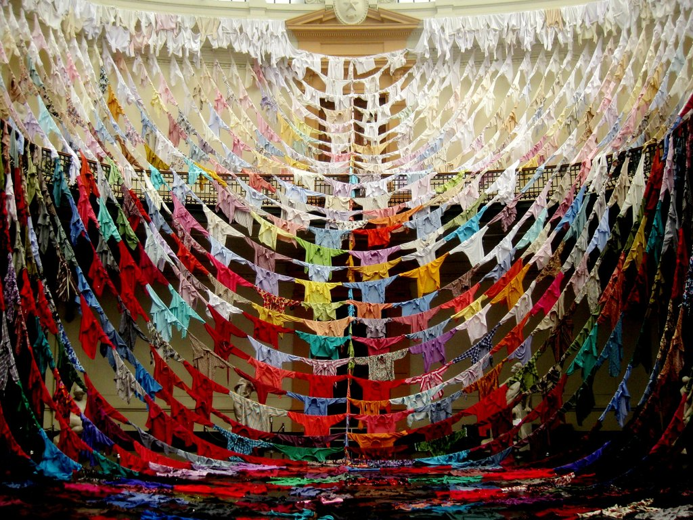
...producing fantastic, grandeur shapes in open spaces. Her pieces really transform any space they inhabit.
kaarina
kaikkonen

Slide 5
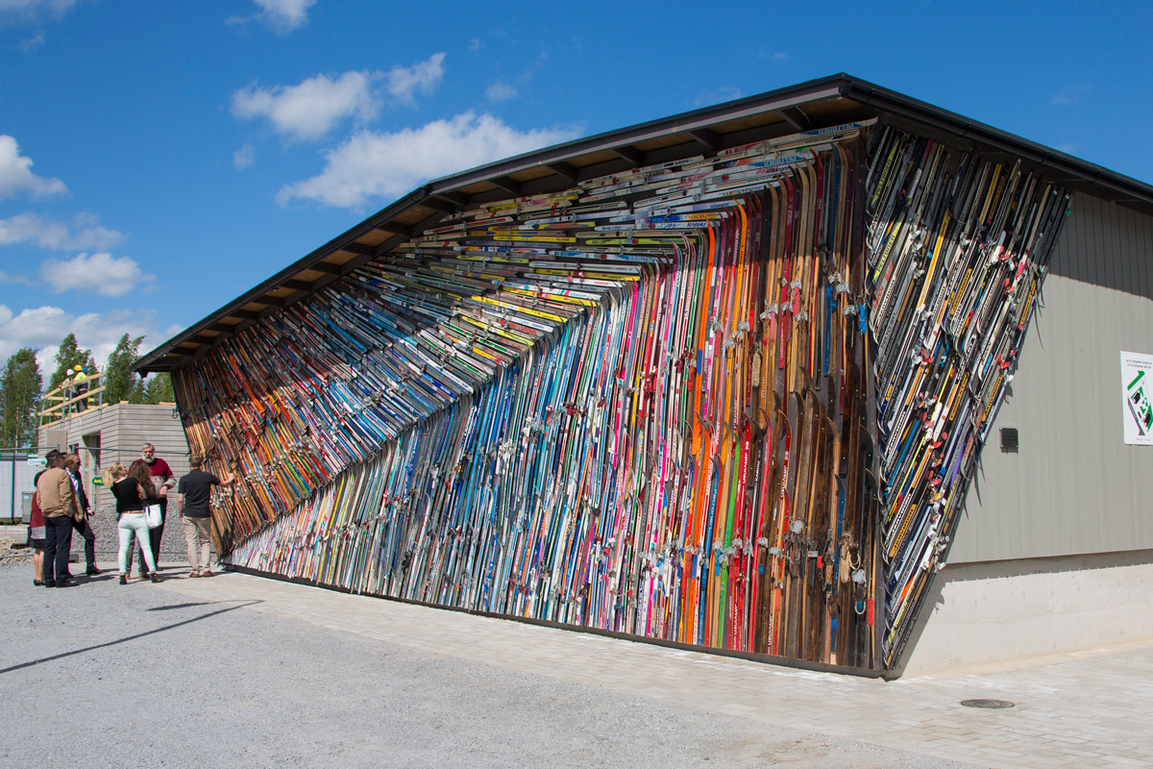

Slide 6
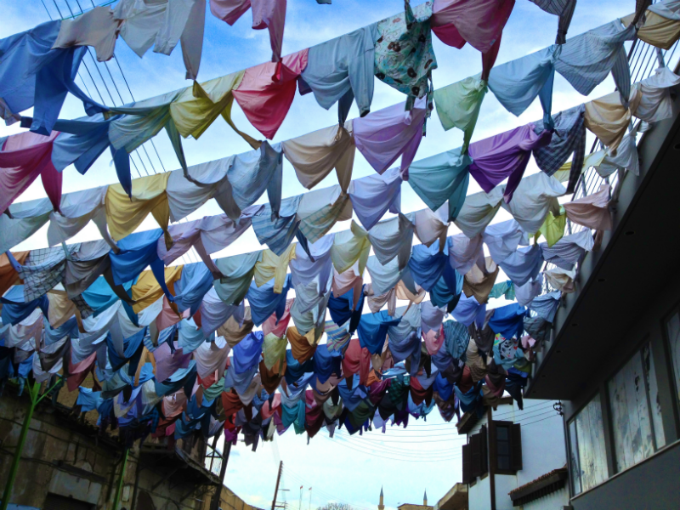

Slide 7
Space
Use the space inside the shop wisely and inventively without taking away from shoppers being able to do their usual things.
- Use all space, from greeting shoppers to the shopper being able to find remarkable and unexpected surprises during their shop.
Allow shoppers to have fun in the space and enjoy what they are hearing and seeing.

Slide 8
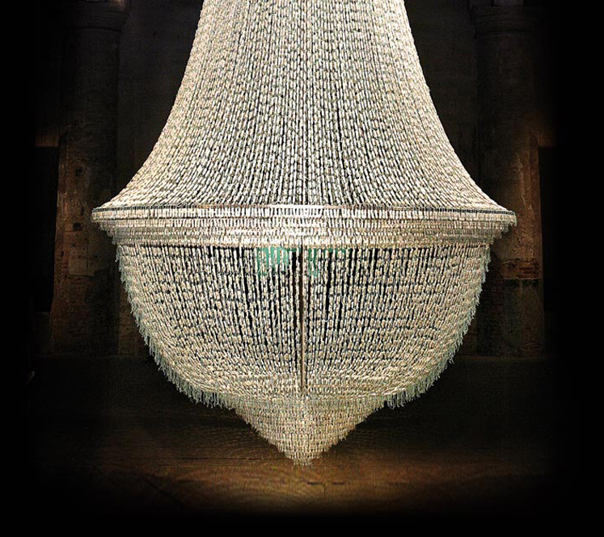
...artwork that provokes and
delights simultaneously. You gasp
with pleasure.
Joana
Vasconcelos: Lifesize Treats

Slide 9
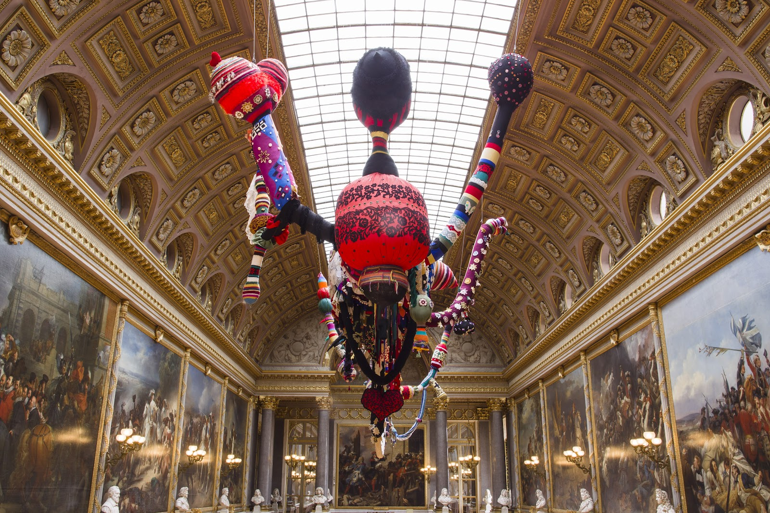

Slide 10
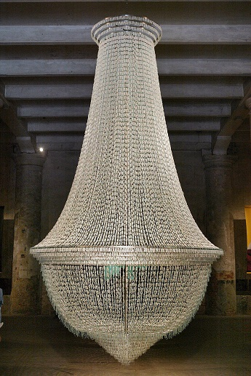
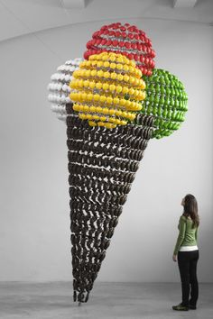
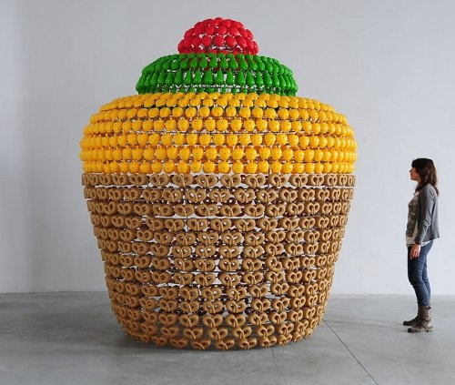

Slide 11
Tampon Chandelier
Giant ice cream made from plastic toys.
Giant cup cake made from plastic toys.

Slide 12
Interactivity
Rather than just making the experience an observational one, we want the shoppers to interact, have fun and create where possible.

Slide 13
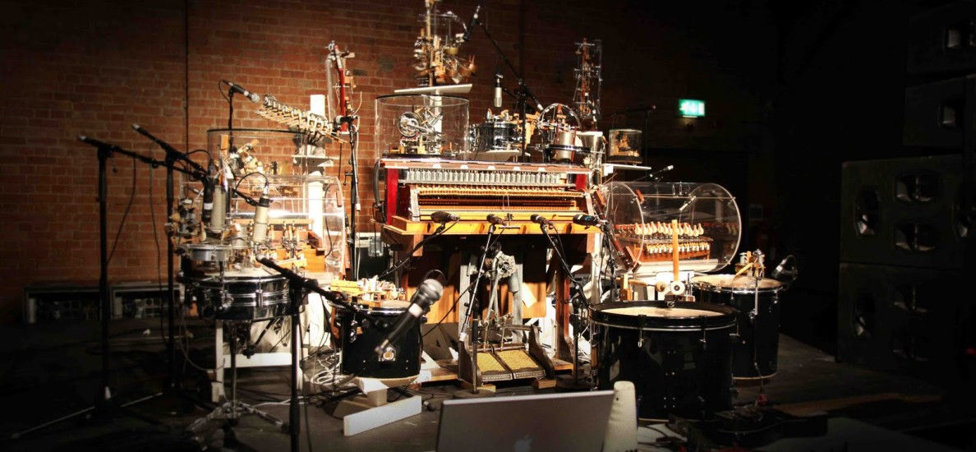
Felix
Machines

Slide 14
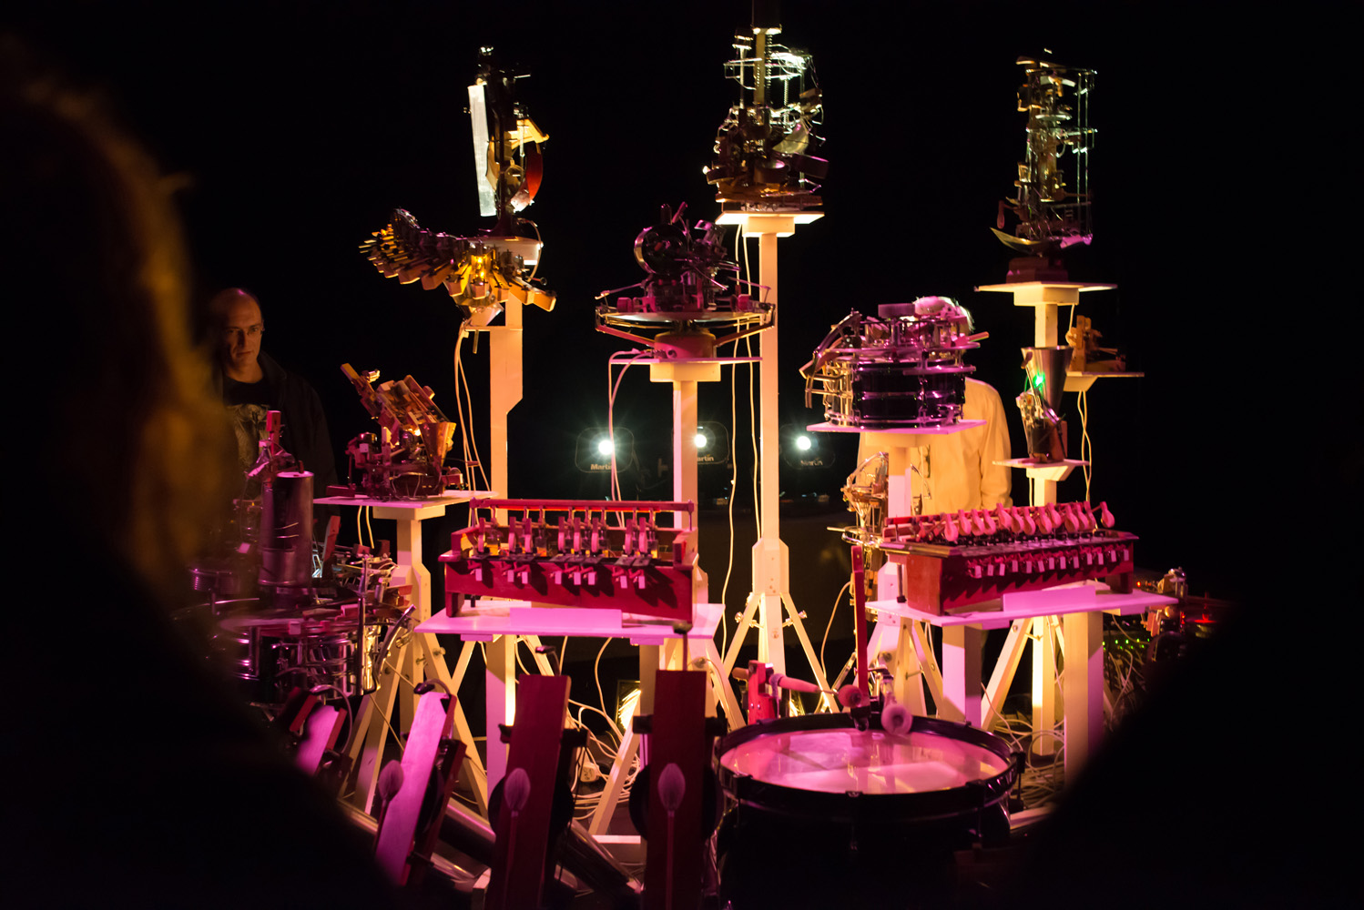
“...aims to build a space where artificial and dream-like environments can become a reality."

Slide 15
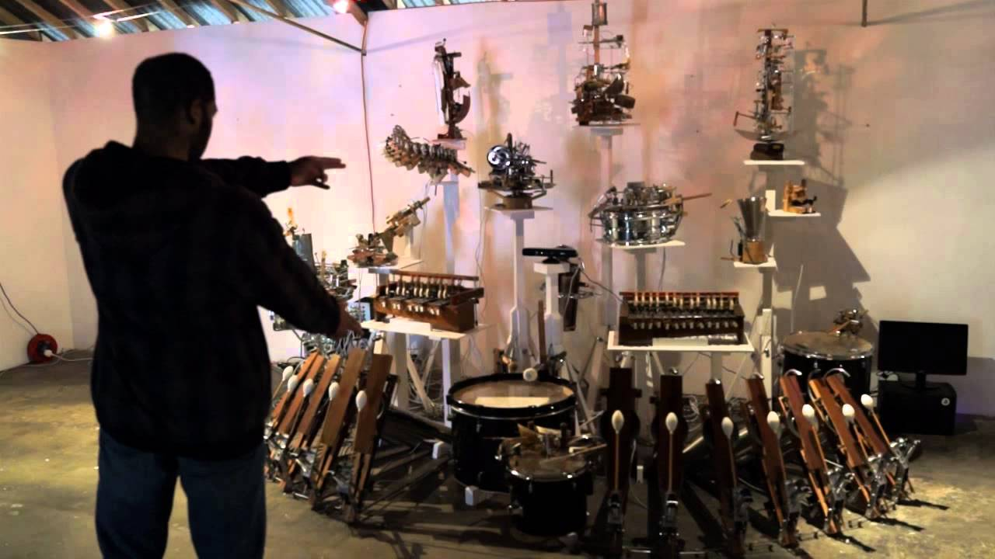

Watch what happens when the customer becomes the conductor

Slide 16
ATMOSPHERE
At this point we wanted to explore what the audio experience could be for the shoppers.
We went to back to what the audio experience used to be.

Slide 17



Slide 18
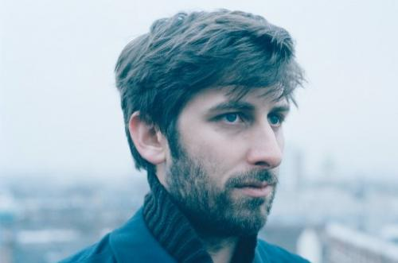
Nostalgia 77
DJ and Jazz Producer.
Blends tones together to give the music a calm but inventive tone.

Slide 19
Then we thought why stop there?
Not everyone likes the same kind of music.

Slide 20
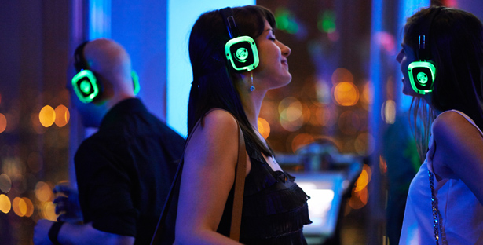
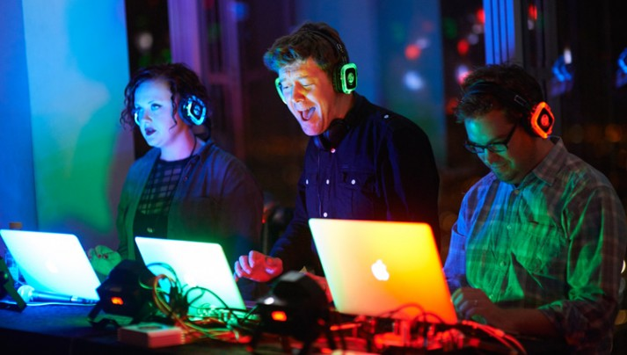
Let people choose their own station on borrowed headphones at the beginning of the shop.
Set an area for people to dance to this music at the end of their shop. A range of channels will be there to cater for a range of tastes.

Slide 21
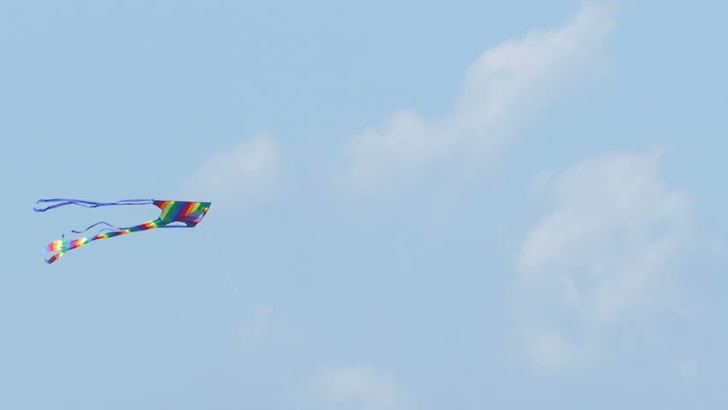
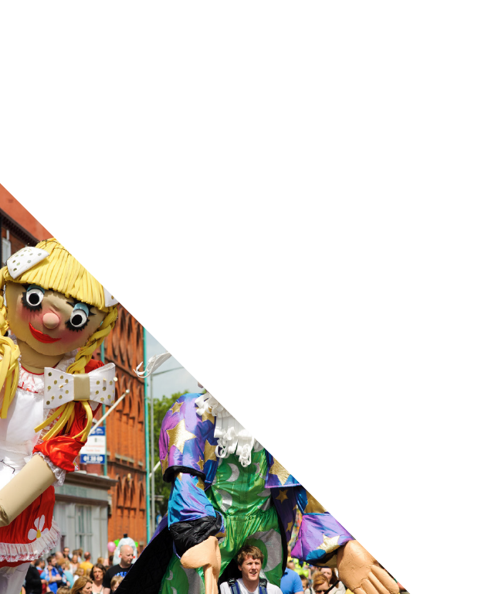
Kite Festival
An incredible day of kite flying spectacles, family fun where everyone’s efforts are celebrated on the same level as exceptional art and culture with competitions in all categories.
The Skies the Limit

Slide 22
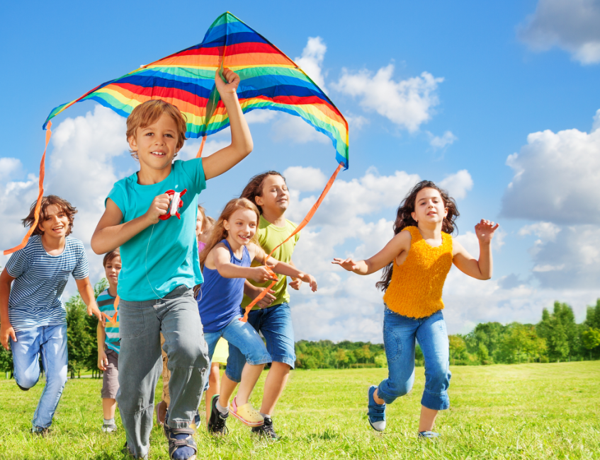
Primary Schools
The Hull2017 Education team would work with schools to deliver education packs and let them collaborate with kite making specialists to ensure kites are able to soar through the skies.
Artists to use a range of techniques to help the classes design their kites.
Science will play a role to demonstrate how kites manage to stay in the air and will influence the kite designing process.

Slide 23
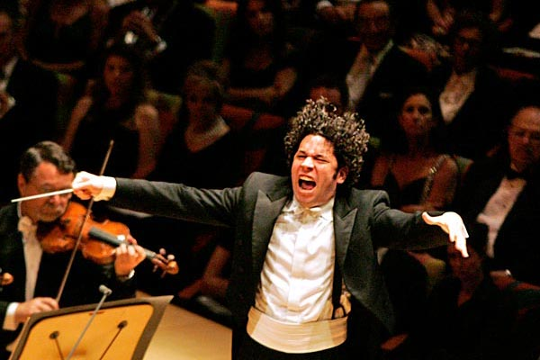
Secondary Schools
Secondary Schools/Academies
Match them up with a musician and a kite flying specialist who would choreograph a flight with them.
All would be collaborating, to bring the music and the flight together.
We would work with partners such as the Hull Music Services, The Sesh and PRS to find the right musicians and composers to work with the groups.

Slide 24
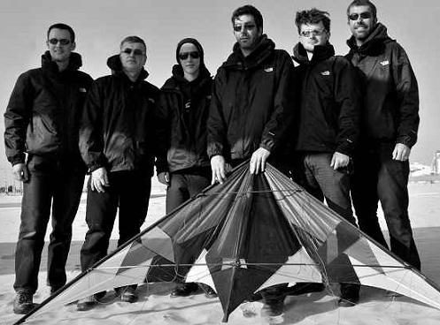
Professional Displays:
We will also feature professional displays from teams like The Scratch Bunnies who are current Biennial World Team Champions. We’d ask them to judge and give hints, tips and advice on how to make those displays even more jaw dropping. With all the teams in the, in the morning, they’ll meet all the schools we have been participating with to fly their kites and give them some last minute tips.

Slide 25
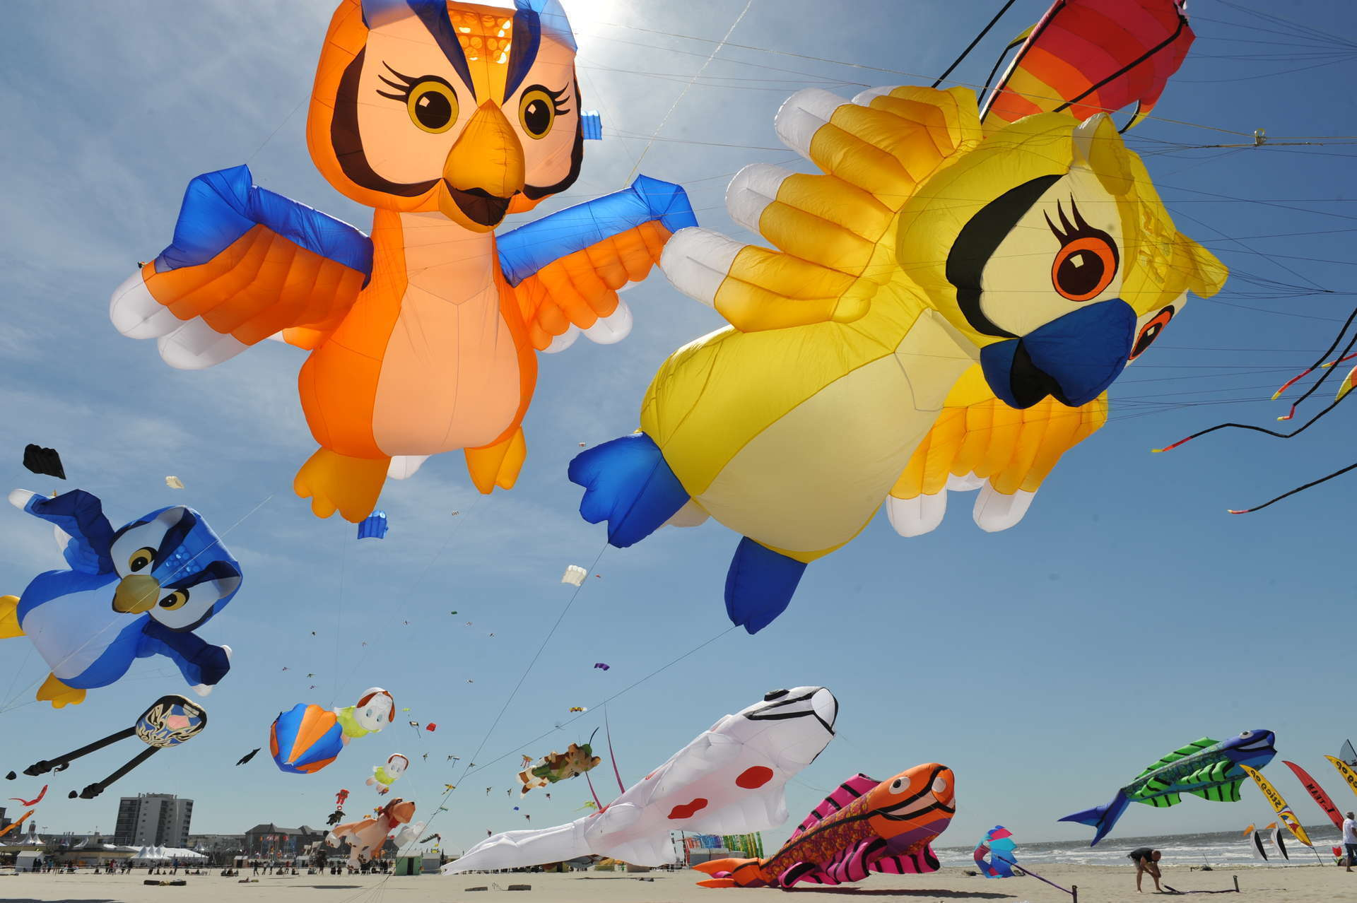
Competitions
There’ll be several competition categories including best choreography, featuring moves that can be seen here. There’ll also be best designed kite in several categories going through the age ranges, largest kite, best kite made out of recycled materials, best animal kite and the list goes on.

Slide 26

Main Stage
The festival main stage will not only be the focal point where all demonstrations and competitions will be coordinated from but it also contain incredible music as the day is going on, at regular intervals.

Slide 27

Closing Movie
To end the day we’d invite all the families, participants, tutors, audiences, workshop leaders, artists and musicians to enjoy a big outdoor film that will be flight or kite related.
We would present this on a large outdoor screen.

