Slide 1



Slide 2

Programme Schedule
End of Show Party
Production:
Licenses/PLI/DBS/H&S
Get in/Get out -Schedule
Food & Drink
Marketing & Dressing The Space
Ticket Sales & Plan
Volunteering & Buddies
May

Slide 3
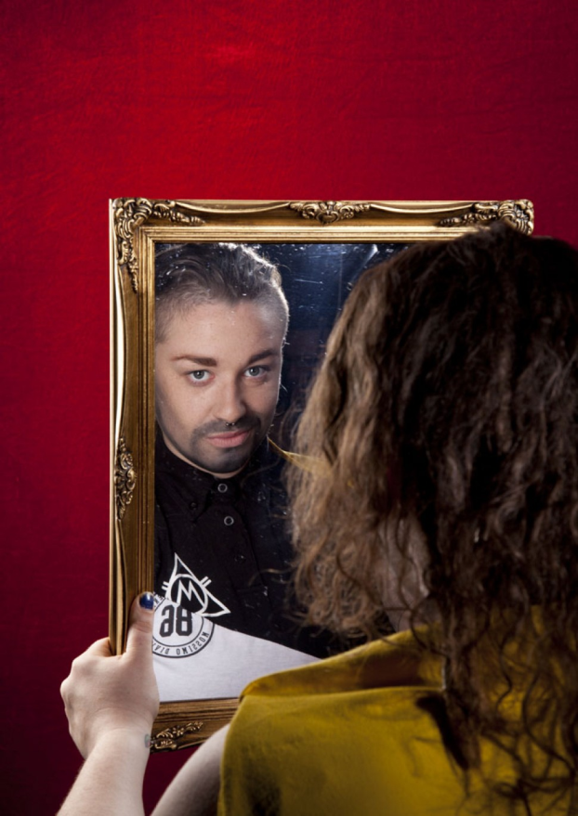
Milk Presents - JOAN
Put your drinks down and your hands together, all the way from Domremy in France (via Soho and 600 years) it’s JOAN!
An earthy story of courage, conviction and hope, this is Joan of Arc - quite possibly the world's first drag king. Packed with guts, heart and some well placed couscous, JOAN fuses lyrical new writing with quick wit and cabaret prowess.
Performed by drag king champion Lucy Jane Parkinson, aka LoUis CYfer ('a marvel to behold' Broadway Baby), and brought together by the ever-probing and playfully anarchic Milk Presents ('Every minute spent with Milk Presents is a gift' British Theatre Guide)
So pull up a pew, or indeed a bar stool, for this fearless new play about what it means to stand out, stand up and stand alone.

Slide 4
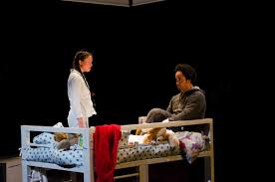

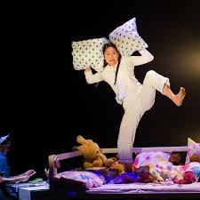
Upswing
Bedtime Stories encourages us to take time out from our busy lives and explore the importance of the connection between carers and children, achieving a work-life balance and managing priorities within the family. Suitable for everyone ages 3+, the show is a transporting and highly immersive experience, that combines awe-inspiring aerial feats with storytelling, physical theatre, dance and stunning projections. Upon entering the theatre space, audiences are invited to relax and feel at home in the environment of a child's bedroom and view the show from the comfort of family beds, tucked up and surrounded by cushions, teddies and blankets.

Slide 5
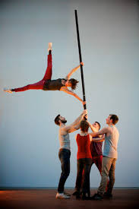
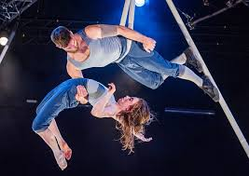
Okhams Razor – Tipping Point
Ockham’s Razor return with their new full length show. Tipping Point is set in the round; the audience drawn in close, as the action veers from catastrophe to mastery. The five performers, enclosed within the circle of the stage, transform simple 5 metre metal poles into a rich landscape of images.
Poles are balanced on fingertips, hung from the roof, lashed, climbed, swung from and walked along, they become forests, cross roads and pendulums. The performers balance, climb and cling to this teetering world, supporting each other as they wrestle with the moment when things begin to shift. They must decide whether to rail against the chaos, struggling to exert order on a disordered world, or ride it out, allowing life to tilt towards the tipping point. 6+

Slide 6

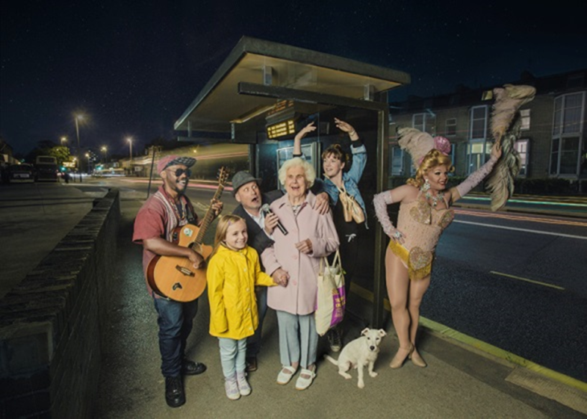
22nd September
&
Next Meeting

