Slide 1
SUPERMARKET ARTIST
TAKEOVER

Slide 2

WHERE TO BEGIN…
We focused on three key areas:
Visibility
Space
Atmosphere

Slide 3
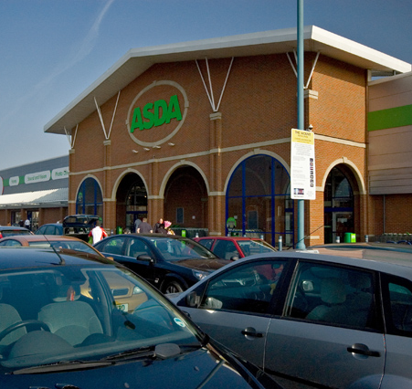

Visibility
The supermarkets are big, visible and can be spotted for miles around. We don’t want to compromise that visibility but to enhance it.
The work would show the local community that something different is happening inside.
The work would provide iconic images for the project.

Slide 4
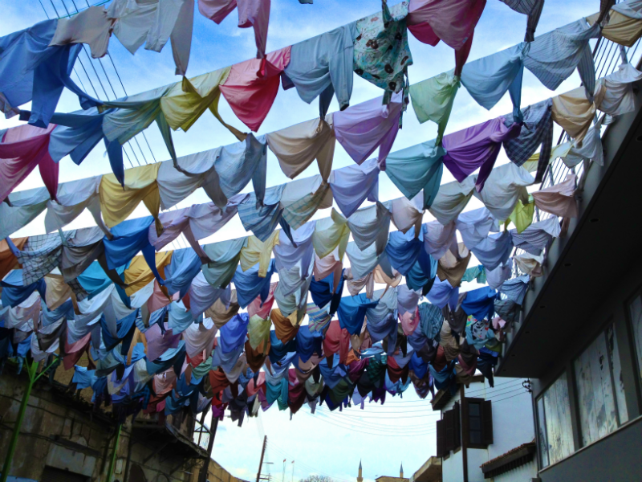

kaarina kaikkonen

Slide 5
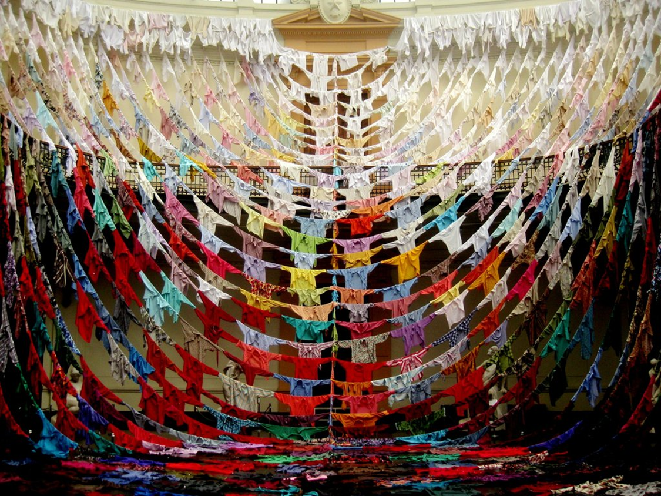
“...producing fantastic, grandeur shapes in open spaces. Her pieces really transform any space they inhabit.”

Slide 6

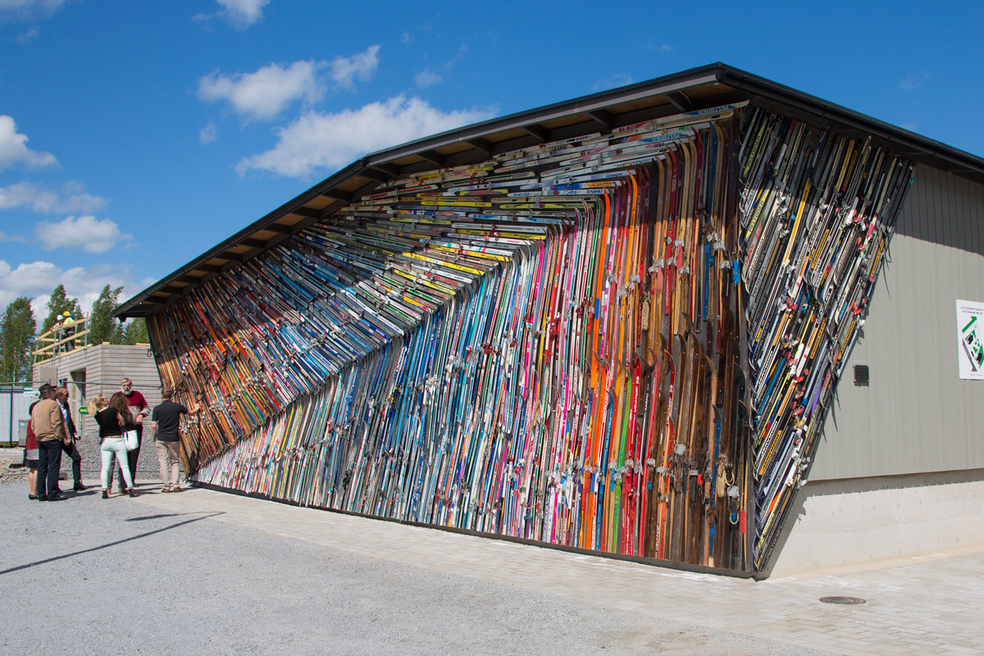

Slide 7
Space
The space inside the shop would be used wisely and inventively without inhibiting customers’ usual behaviour.
All space would be used, from greeting people to uncovering unexpected finds and experiences during their shop.
Customers would have fun in the space and enjoy what they are hearing and seeing.

Slide 8
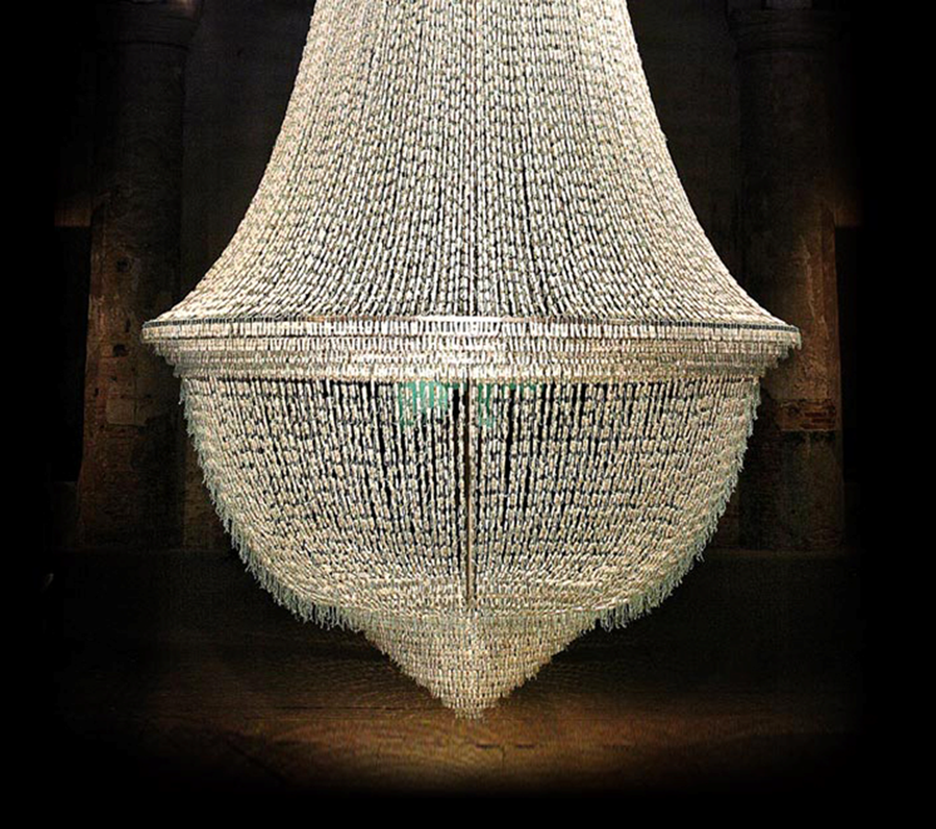
“...artwork that provokes and
delights simultaneously. You gasp
with pleasure.”
Joana
Vasconcelos

Slide 9
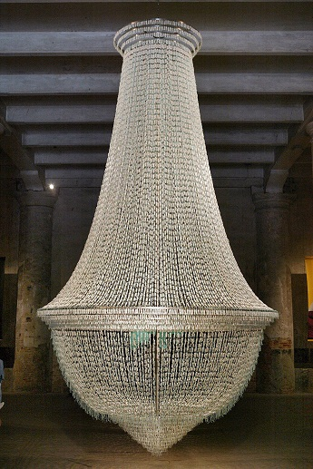
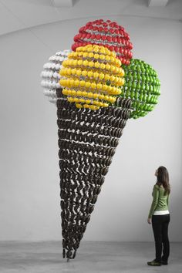
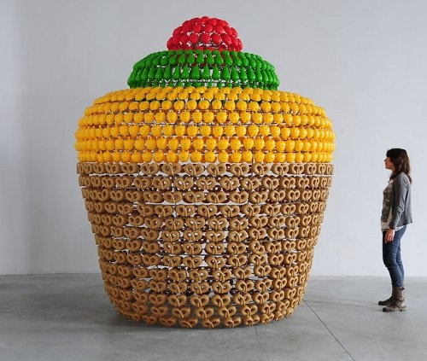
Tampon Chandelier
Giant cup cake and ice cream made from plastic toys

Slide 10
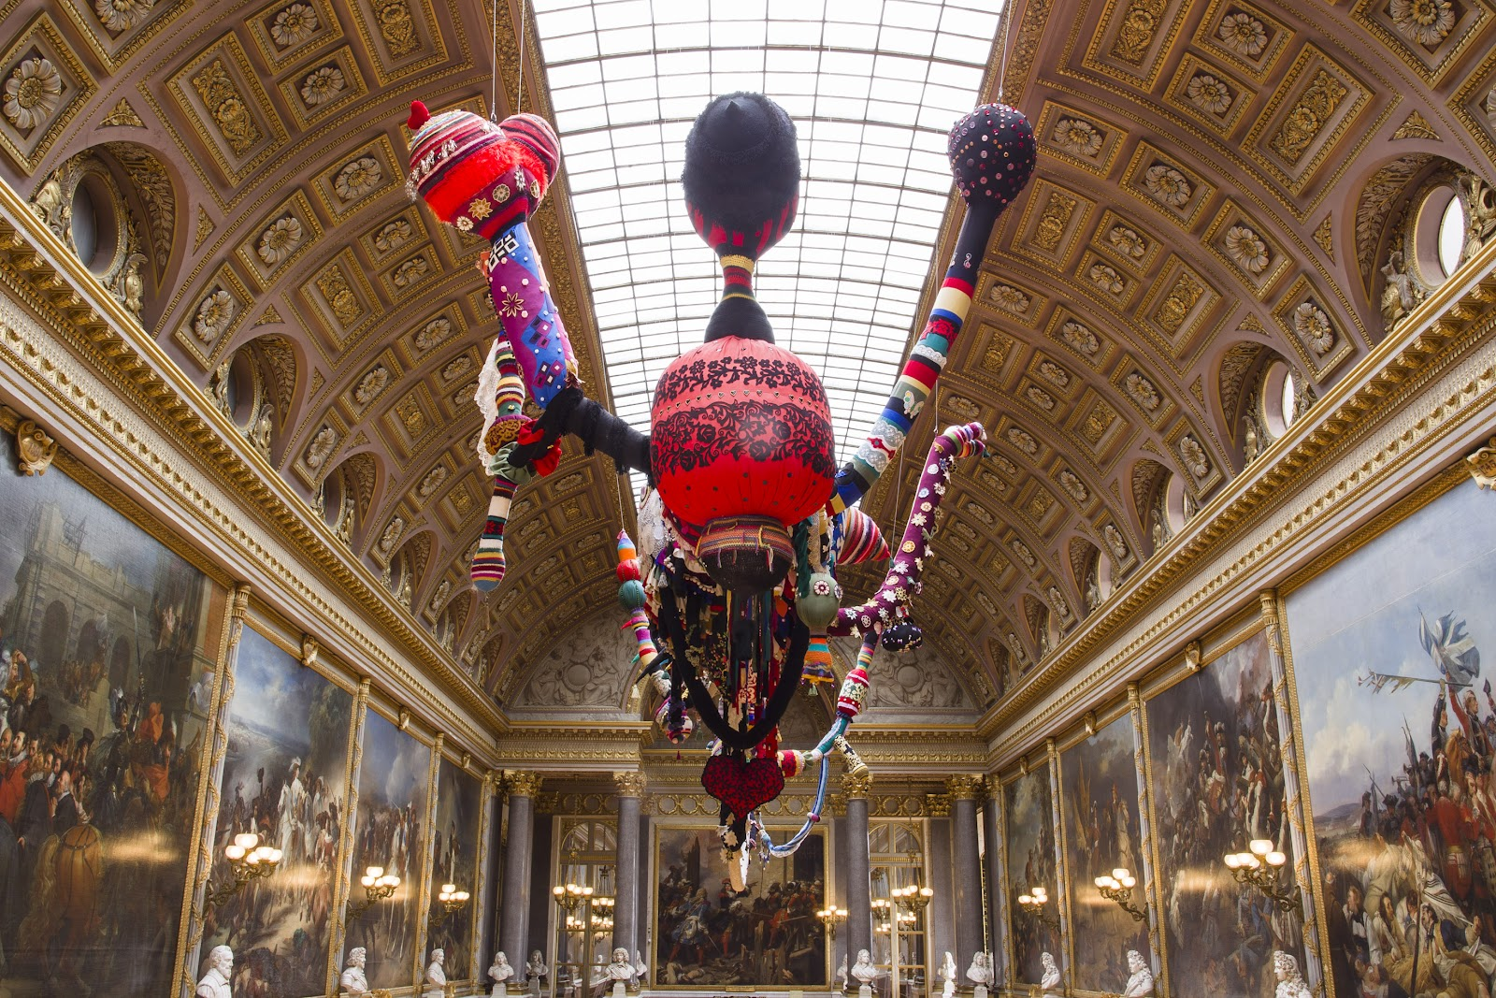

Slide 11
Interactivity
Rather than just making the experience an observational one, we want customers to interact, have fun and create where possible

Slide 12
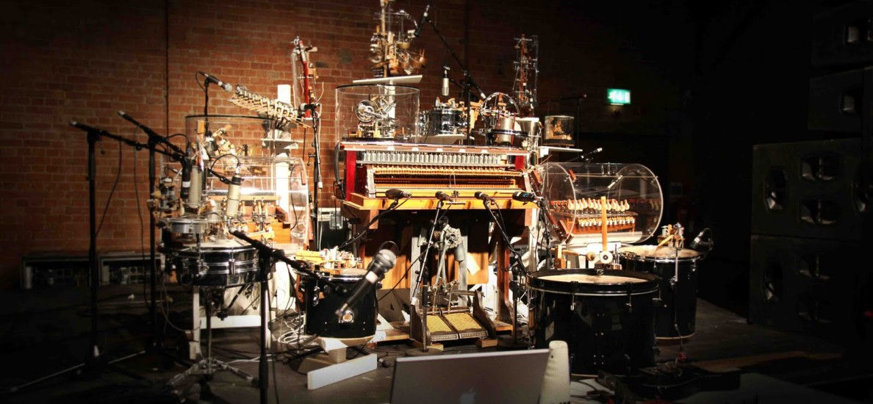
Felix
Machines

Slide 13
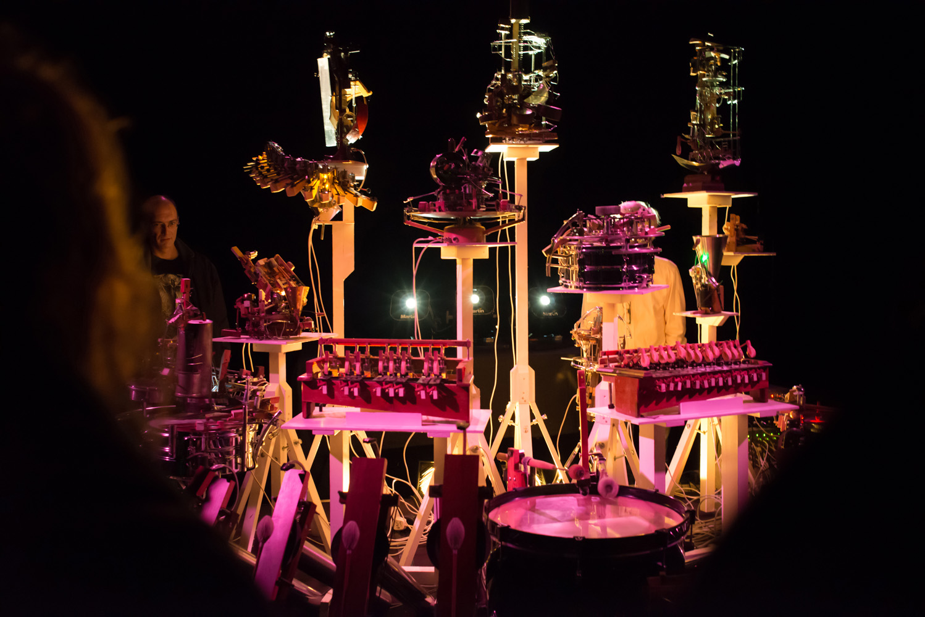
“... a space where artificial and dream-like environments can become a reality."

Slide 14
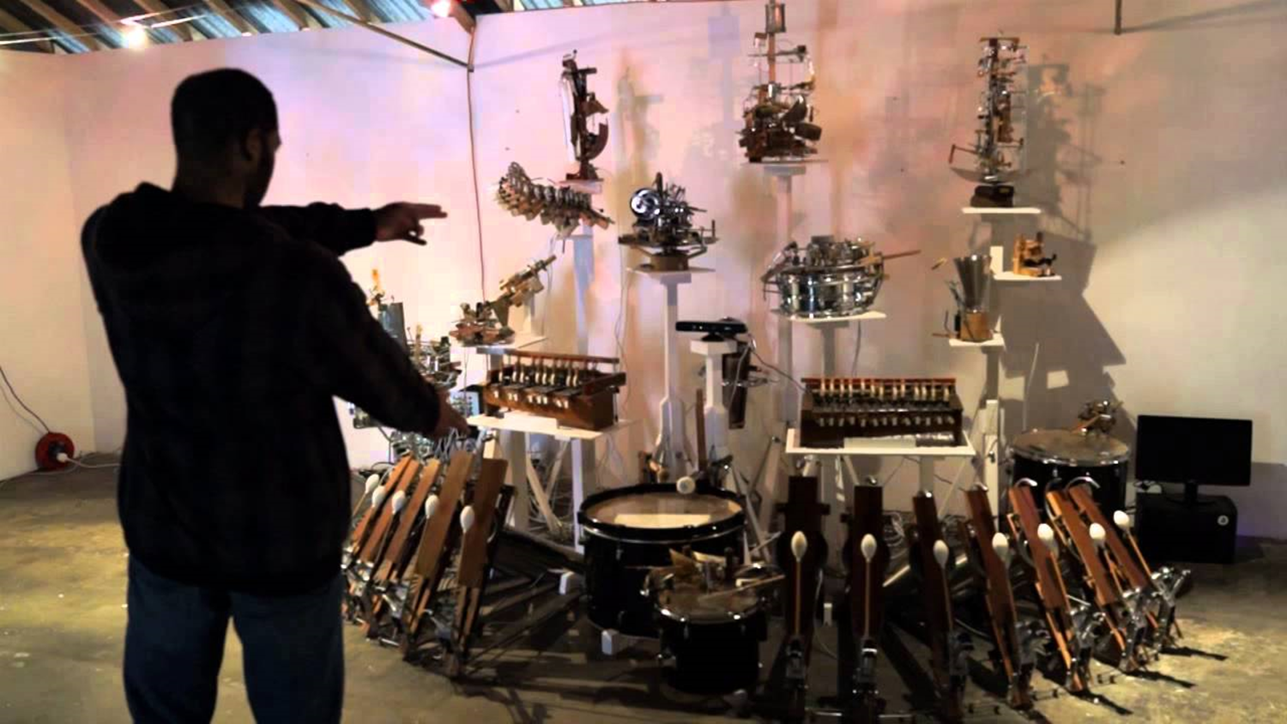

Watch what happens when the customer becomes the conductor

Slide 15
ATMOSPHERE
At this point we wanted to explore what the audio experience could be for customers.
We went back to what the audio experience used to be.

Slide 16



Slide 17
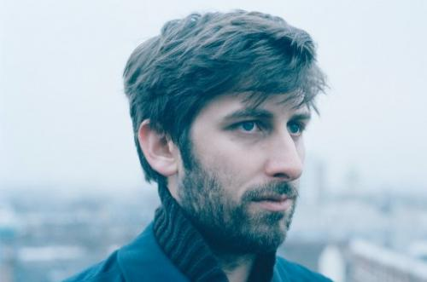
NOSTALGIA 77
“Inventive and accessible”
- The Guardian
DJ and Jazz Producer.
Blends tones together to give the music a calm but inventive tone.

Slide 18
Then we thought ‘why stop there?’
Not everyone loves the same music…

Slide 19
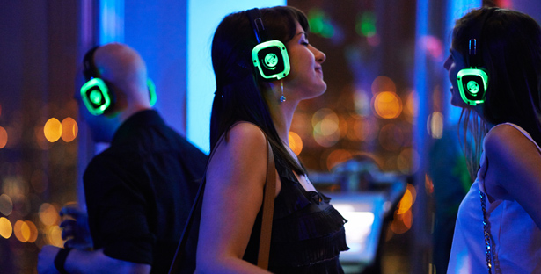

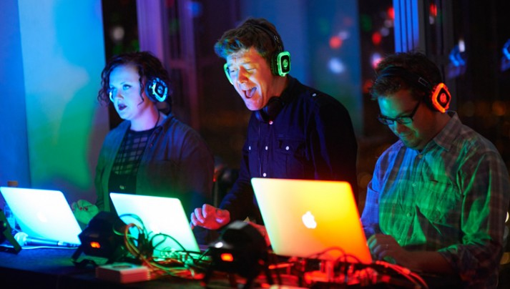
Let people choose their own station on borrowed headphones at the beginning of the shop.
Allow people to shop and dance around the store. A range of channels will be available to cater for all tastes.

Slide 20
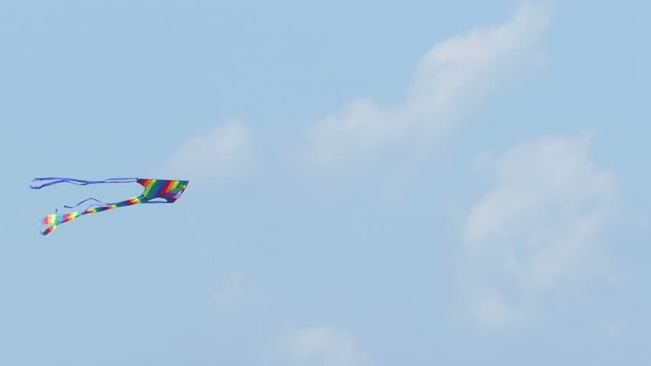
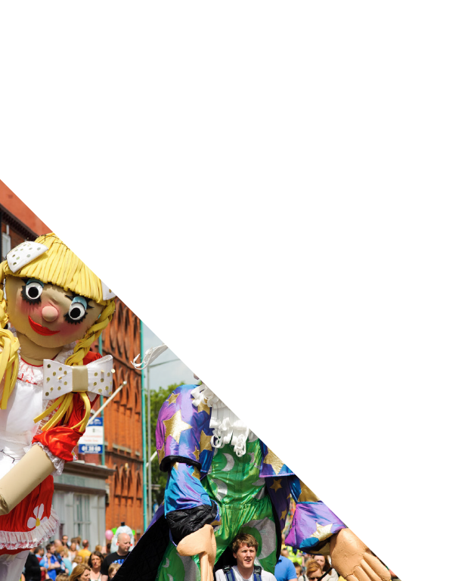
Kite Festival
A 3 month programme of kite design and making, in schools in Hull, leading to an incredible day of kite-flying spectacles, where exceptional art and culture combine with competitions and family fun.
The Sky’s the Limit

Slide 21


Primary Schools
The Hull 2017 would work with schools across Hull to deliver workshops and collaborations with artists and kite-makers to ensure kites are able to soar through the skies.
Artists would use a range of techniques to help the classes design their kites.
Science would play a role in demonstrating how kites stay in the air and influence the design process.

Slide 22
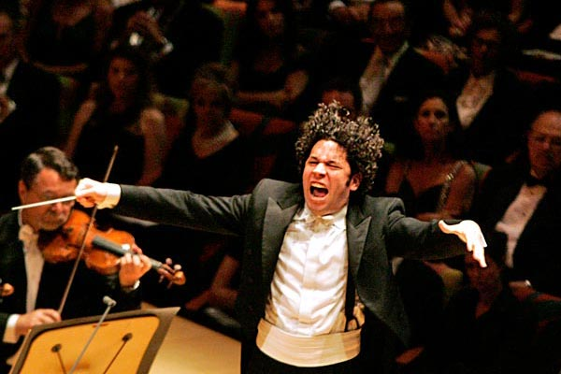

Secondary Schools
Secondary Schools
Classes would be matched with a musician and a kite specialist to choreograph a mass flight to music.
Partners could include such as the Hull Music Services, The Humber Street Sesh and PRS for Music to find the right musicians and composers to work in schools.

Slide 23
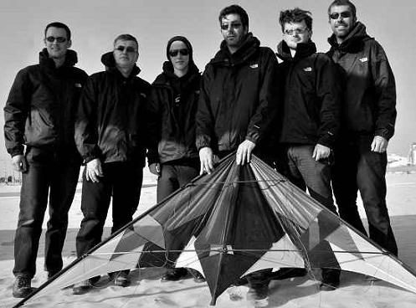

Professional Displays
The project could also feature professional displays from teams such as The Scratch Bunnies - current Biennial World Team Champions - to judge and give hints, tips and advice on how to make school displays even more jaw dropping.

Slide 24
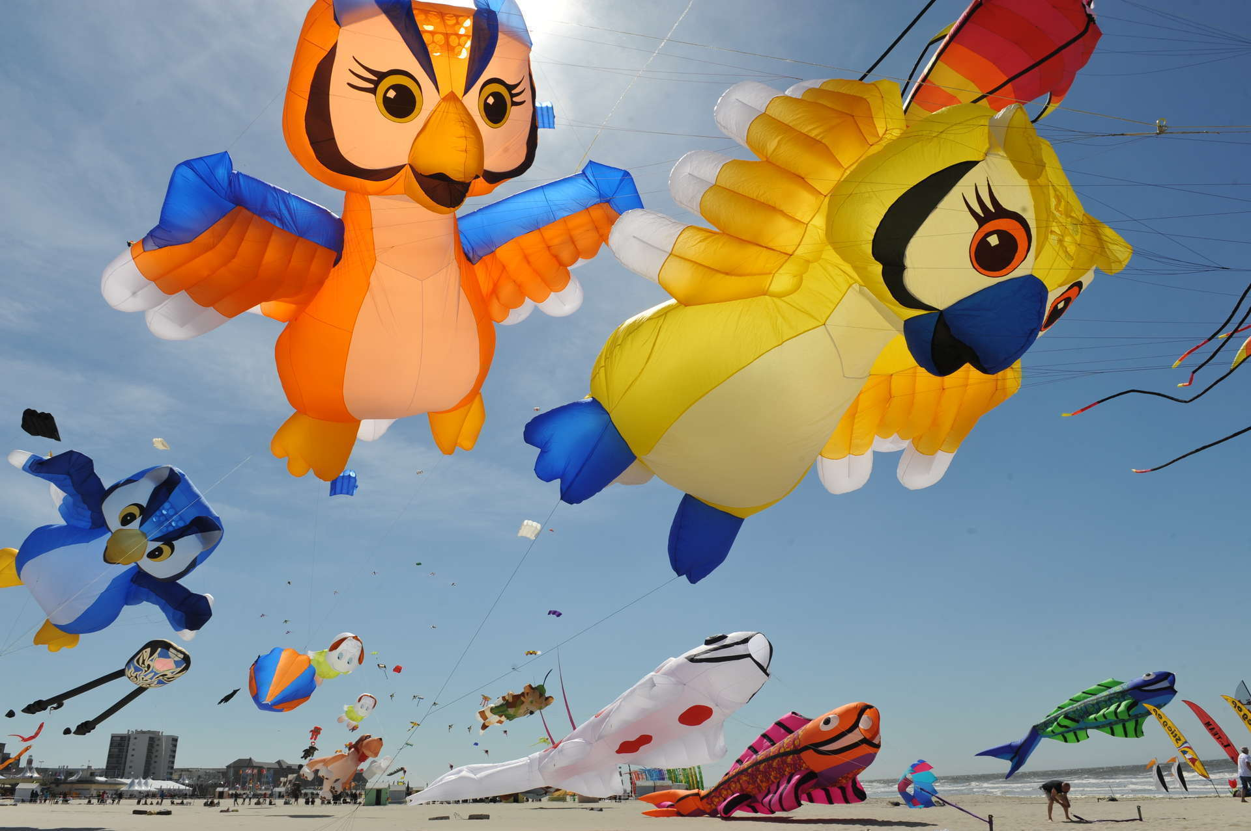
Competitions
Across Hull schools there could be several competition categories: best choreography; best designed kite; largest kite; best kite made out of recycled materials; best animal kite and the list goes on…

Slide 25

Main Stage
The project would culminate in a day-long festival in a central Hull park. This main stage will not only be the focal point for all demonstrations and competitions but also contain incredible music throughout the day.

Slide 26

Closing Movie
To end the day all families, participants, tutors, audiences, workshop leaders, artists and musicians would be invited to enjoy an outdoor film that will be flight or kite related presented on a large outdoor screen.

