Slide 1


MADE IN HULL
Niccy Hallifax, Opening Lead Producer
Chris Clay, Technical Director
September 2016

Slide 2
The first and opening event of our year as UK City of culture, and the first of the season Made in Hull will be a large scale and comprehensive celebration of the heritage and culture of the city, and a statement of intent of the way we intend to (re)position the city & to engage in meaningful ways with its communities. Over 7 days, all are invited….

Slide 3
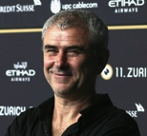
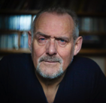

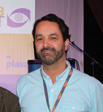
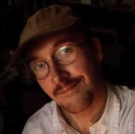
CORE CREATIVE TEAM
Sean McAllister
Creative Director
Rupert Creed
Writer
Ala Lloyd
3D & Environmental Designer
Durham Marenghi
Lighting Designer
Dan Jones
Composer & Sound Designer
Working with Sean McAllister a documentary director the project the 7 day event captures Hull's history, culture and residents in a dramatic and thematic way by using some of the heritage buildings and structures as a canvas to hold the conversation about Hull and celebrate through
The core creative team are experts in their fields and are currently in the process of commissioning several local and national artists to create a response on and around the Old town and Marina area of the city as well as looking at the project and ensuring coherence and cohesion between sites.

Slide 4
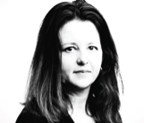
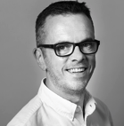
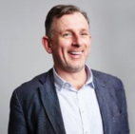
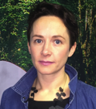
CORE PRODUCTION TEAM
Niccy Hallifax
Creative Producer
Chris Clay
Technical Director
Jon Drape
Ground Control
Kate Doyle
Ground Control
Working with Niccy Hallifax the Producer and Chris Clay the technical director with the production and technical production team are working with ground control have been brought in to manage and help deliver the technical and operations aspects of the overall project for the Opening.
This team will work with the core creative team in tandem to ensure that all the artists visions are realised as well as ensuring that the event is smooth running and operationally delivered in a befitting manner with the correct licenses and permissions etc.

Slide 5

Project Aims
to kick off a year long programme that really does showcase the City as the national cultural centre for 2017
to unlock Hulls heritage and show its prospects in a dynamic & inclusive way using the buildings as canvases & the people as the live performance.
to connect individuals and communities & build the cultural input into the UK psyche .
to uncover and celebrate the intangible things which make Hull unique: the “Spirit of Hull”

Slide 6
Key Themes: Opening….
The story of a city and its people over the past 70 years- told on its buildings, shop windows, streets, skyline and public spaces through projected film, image, sound, words, light and live performance.
Significant shared events and achievements
Connectivity & insularity.
The community’s values & attitudes- innovators & achievers- its humour
Hull people at work Hull people at play
The Characters of Hull
Dead Bod- a local folklore icon.

Slide 7
LOCATIONS, ARTISTS
Phase 1 & 2.

Slide 8
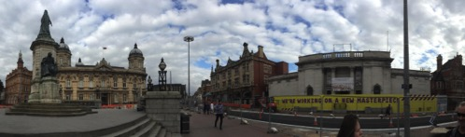
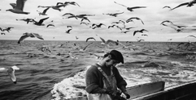
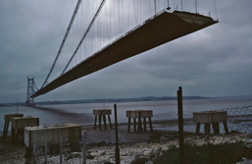
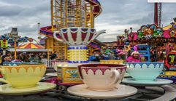
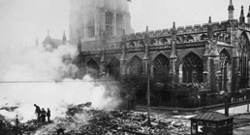
Location One: Queen Victoria Square.
The ‘big theme’ story of Hull over 75 years- what we’ve achieved, endured & celebrated at work, at play & in our culture- the significant shared city experiences that have instilled confidence, creativity, resilience, a strong community identity, an ability to re-invent ourselves and seize the moment that is 2017.
The Blitz - bombing raid, city devastation, the people’s resilience, barrage balloons, the rebuild & regeneration
The docks & fishing (the flooding wave, the post war boom in port & maritime trade & employment, the loss of men & the 1968 Headscarf Revolutionaries / 70’s decline)
Hull game-changers, achievers (in politics, art, sport, construction & industry)
& shared events & achievements’ – Hull Fair- Humber Bridge- The future & wind power.

Slide 9
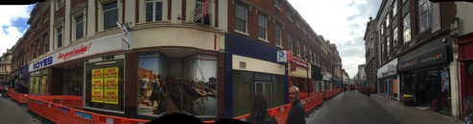
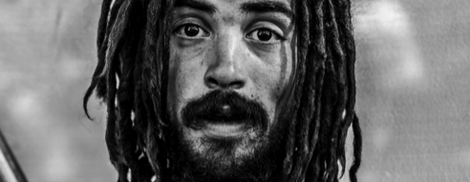
Location Two: Whitefriargate Street.
THE CHARACTERS OF HULL
The major themes we are exploring but told in a more intimate & in-depth way through the people of Hull.
Hull characters take us in and through the archive material giving it a human face
The street of folklore – a chance to meet the characters of Hull telling their stories
The street narrative focuses on ‘Hull at Play’- how we enjoyed ourselves – how we spent our hard earned cash from work, our leisure time in the city and on holiday- through times of full employment in the 60s, declining in the 70s and 80s to the BSF initiative in the 00’s. Then through to now through each generation, linking economic prosperity & leisure of the city.

Slide 10
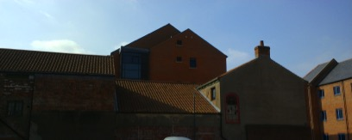
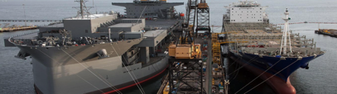
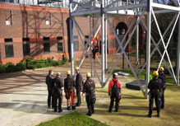
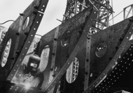
Location Three: Oriel House. (in discussion)
THE DIGNITY OF LABOUR
A hard working city- a city of great inventiveness, manufacturing and international trade / the fight for worker’s rights / the decline of manual labour industries- the despair of dole / a future power house of ideas
We turn a place of frustration, anger & despair into a place of beauty & creative energy
Possible elements:
Production lines- inc caravans, fish, peas, household & medical
Products- retro and current
Film, photo & press archive of work on docks, fishing & other
19th C, 60s & 70s dockers strike archive
Big Lil- headscarf wives campaign
Decline of industry – fishing and docks
Spoken audio sound bites- sanctions, lost ambitions & dreams
Reaffirming of the docks, most whit goods in the UK come through Hull docks, the building the Humber Bridge
Siemens- wind power- our future

Slide 11
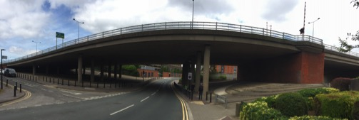
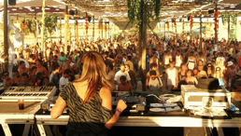
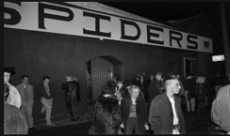
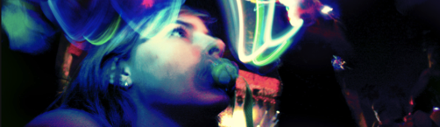
Location Four: The Underpass.
Hull People Love to Party.
A sound & light installation with live performance portraying the culture of Hull’s clubbing scene and the people’s passion to party. A sound & light driven event with flash-mob performances, where the public can participate or pass through, where dance styles and fashions can move through time, or mix and morph, with a music soundtrack incorporating spoken word sound bite mash-ups referencing Hull’s clubbing experience & the social and political context.
Possible elements:
Hulls clubbing scene over time- from dance hall to disco, house party & rave, the Tower, LA’s, the Silhouette & Fuel
Dance & fashion styles over the decades
The changing social & political context and the emergence of the festival culture in Hull.

Slide 12
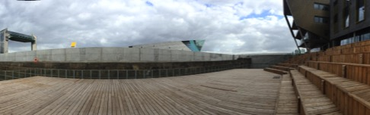
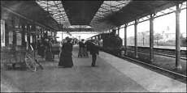


Location Five: The Deep.
DEPARTURES & ARRIVALS- HULLS CONNECTIVITY- THE FLOW OF PEOPLE INTO AND THROUGH THE CITY
Migrations- The flows of people over time, through and into the city:
Fleeing war, persecution, poverty. Seeking refuge and freedom. (17th C Hugenots, 19th C Jews from Eastern Europe, children fleeing the Spanish Civil War, Kosovans, Afghans, Iraqis, Congolese, Eritrians, Syrians
Seeking work – the Irish to build Hull docks, Brixham fishermen, young men from Scandinavia, incomers like Larkin who came for a new job as University Librarian, and many more
The transit route from the riverside to Lazarus Hotel to the Station / Brexit- the tension between a welcoming and insular city
Arrivals and Departures now and the port & station.

Slide 13
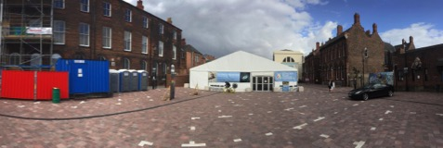




Location Six: Zebedee’s Yard.
PHYSICAL HULL- Hull’s Sporting Achievements & the cultural interplay with Dance
Film animation & soundscapes portraying Hull’s shakers and movers in team & solo sports, the tribal allegiances of local fans, and the physical & cultural interplay between sport and dance. Where the playing field is the stage, and the human body is the vehicle, celebrating strength, stamina and the beauty of movement- from the corps de ballet & principal dancer, to the boxer in the ring, to the team on the pitch.
Possible elements:
Craven Park dog-track, the Speedway, football, rugby, boxing
Dance forms& Hull dancers Xander Parish & Kevin O Hare
The interplay of movement between sport and dance- players, fans & audiences
A two rugby team town- east & west Hull – the dockers & fishing communities’ allegiances- Clive Sullivan- the Hull rugby derby of 1980

Slide 14
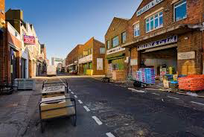
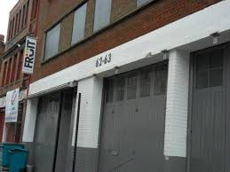
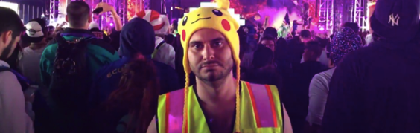
Location Seven: Roaming & Fruit Humber Street.
Pot Luck at Fruit
A 2 week programme of nightly events at Fruit including music- stand-ups- films- guest performers each night- celebs from Hull (the thing I remember about Hull) – bands from Hull.
Prescott, Lucy Beaumont, Jarvis Cocker, Alan Johnson, Pinky, Bud Sugar
Other activity on Humber street
Street roaming activity through artists looking at the modern Hull with festivals and the spoken word, music & film.
New art exhibition space with an exhibition of Alec Gills a photographers work.

Slide 15
TECHNICAL CONSIDERATIONS

Slide 16
Next steps
Develop a robust budget along side production and design development
Apply for the correct licences
Ask permissions
Contract artists and start to create a media and marketing plan
Check facts and footage used and clear usage
Construct a series of story strands across the event pieces.

Slide 17


